Slide 1
Expanded noun phrases

Slide 2
How to expand Noun Phrases
beans
Add words before the head noun:
Those beans will be planted.
Those colourful magical beans will be planted.
Several of those colourful magical beans will be planted.
Add words after the noun:
Beans with brown spots will be planted.
Beans with brown spots and a curious glint will be planted.
Or you can do both at once:
Those colourful beans with brown spots will be planted.

Slide 3
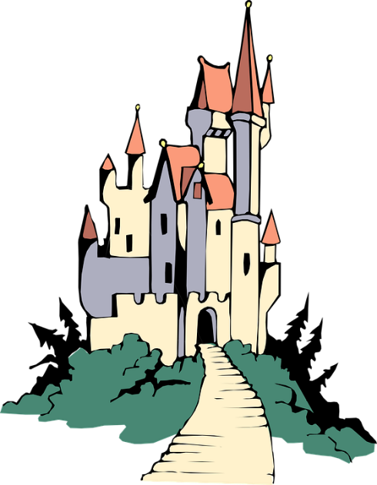
How to build Expanded Noun Phrases
Different types of words, phrases and clauses can all be used in an expanded noun phrase.
adverb
adjectives
determiner
that terribly creepy abandoned castle
castle
the castle with tall turrets covered in red like the tips of daggers
Prepositional phrase
The castle, which was hidden at the top of the beanstalk, loomed.
Relative clause

Slide 4
Changing Perceptions
The bear roared.
You can add detail which changes perception using expanded noun phrases.
The giant, angry bear with teeth like razors roared.
The badly injured bear with terrified eyes roared.
The merry bear, who was playing with his cubs, roared.
These expanded noun phrases create very different images.

Slide 5
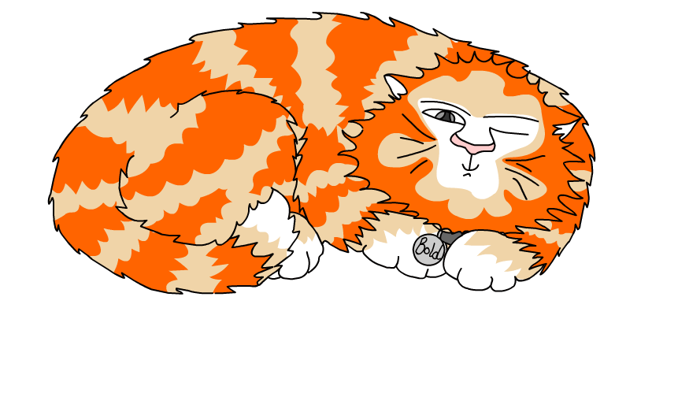
Explore more Hamilton Trust Learning Materials at https://wrht.org.uk/hamilton/ .

