Slide 1
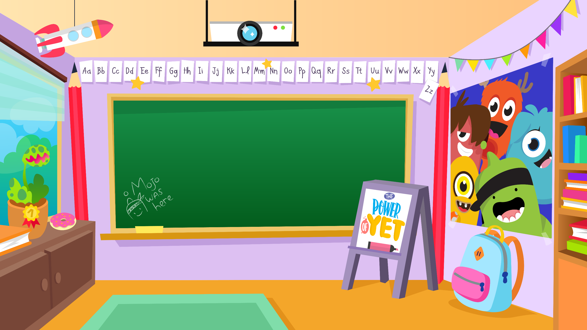
Home Learning activities WC 11.5.20 Year 1 CG Teaching group.
Challenge

Slide 2
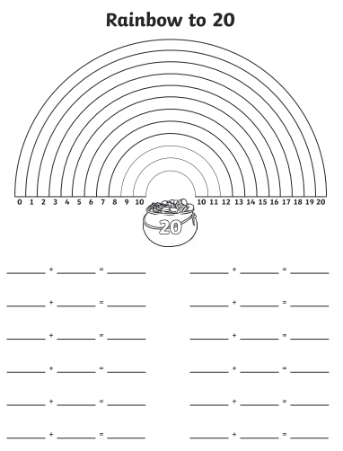
Home Learning Recap - Maths
Colour in or draw a rainbow and record the addition sentences that make 20.
Extension – Record the subtraction facts that match the statement,
E.g. 1+19=20 so 20 – 1 = 19 or 2- - 19 = 1

Slide 3
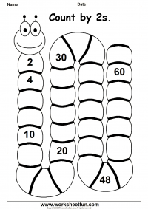
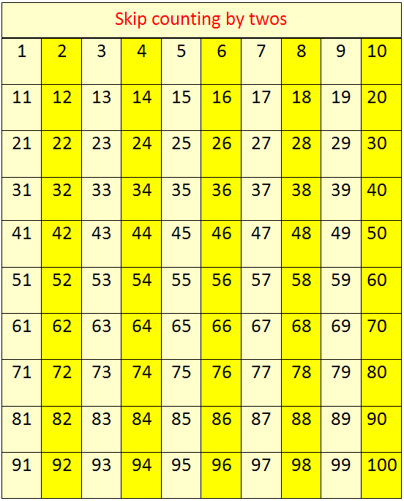
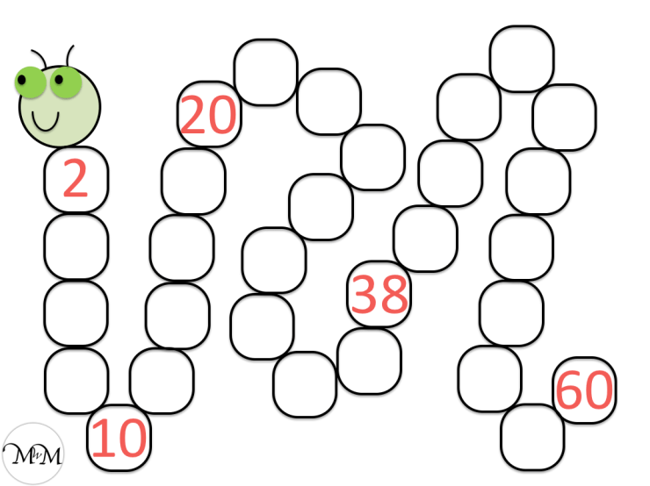
Home Learning Challenges - Maths
What is skip counting?
To skip count you add the same number over and over. You can start at any number. To count by 2s, you add 2 to get the next number, 5s, you add 5 and 10s you add 10. –
Begin each day by counting in 2’s 5’s and 10’s. Don’t forget all the fun counting songs we sing in the classroom. Search Jack Hartmann on youtube.
Challenge
Day 3
Day 1
Day 2

Slide 4
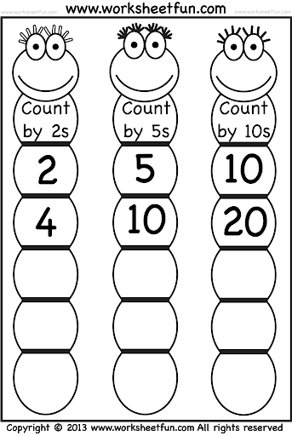
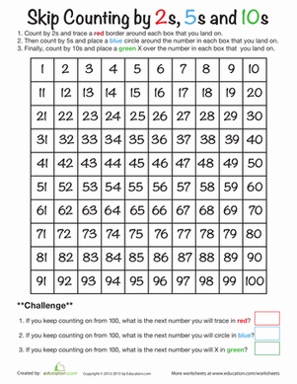
Home Learning Challenges - Maths
Day 4
Day 5
1. Count in 2s and trace a red border around each box that you land on.
2. Then count in 5s and place a blue circle around the number that you land on.
3. Finally, count by 10s and place a green X over the number in each box that you land on.

Slide 5
Home Learning Recap - Phonics

Slide 6
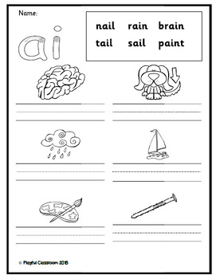
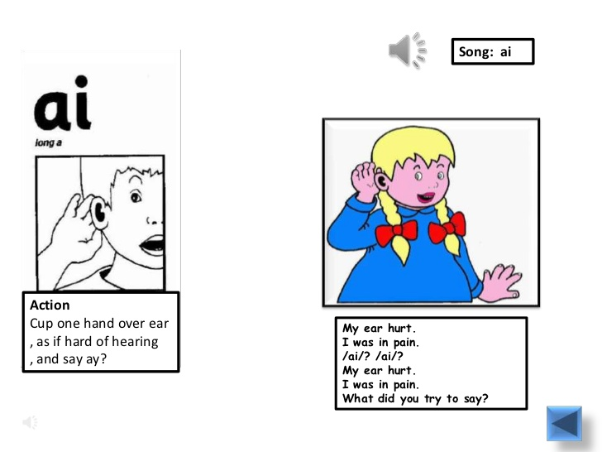
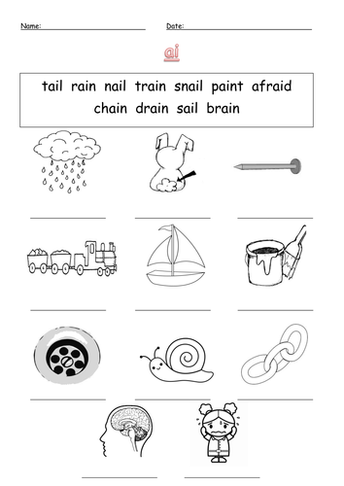
Home Learning Challenges - Phonics
Phonics is a method of teaching children to read by linking sounds (phonemes) and the symbols that represent them (graphemes, or letter groups). Phonics is the learning-to-read method used in primary schools in the UK today.
Day 1 – Learn it. What sound does it make, what does it look like? Day 2 – Use the grapheme to write the words correctly, read them out loud to check. Day 3 – Match the word to the pictures.
Day 4 – Make a snap gam including the sound you have learnt.
Day 5 – Play the snap game with a family member.
Home phonics game – Make some cards with the different sounds that you know on them, have 2 of each sound and play snap with them. When you lay a card down, you must say a word with that sound in.

Slide 7
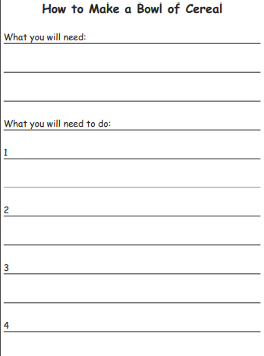
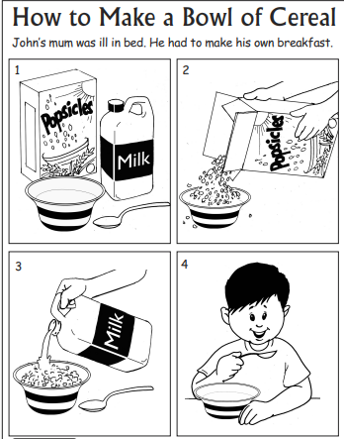
Home Learning Challenges – English
Write a set of instructions.
Instructions give a clear guide for people to follow. Your task is to write a set of instructions to tell someone how to make a bowl of cereal.
Day 1 - Draw and label what you will need to complete this activity.
Day 2 – Draw the 4 steps that you will complete and put them in order. Add words to order the pictures e.g. First, then, next, after that, finally. Check that your instructions work by following them yourself.
Day 3 – Draft some simple sentences using the pictures and sentence starters that you made on day 2.
Day 4 – Edit and improve your sentences, Check your spelling, look for finger spaces, find and use capital letters and full stops. Challenge – Add some description words e.g cold milk, crunchy cereal
Day 5 – Publish, write up your instructions. Copy your edited draft using your best handwriting. Save your work to show me.

Slide 8
Home Learning Challenge - Spelling
Use look, cover, write, check to learn the common Exception words.
Look | Cover and say | Write and check | Amend errors | Repeat
he
she
we
me
be
you
all
are
her
was
they
my

Slide 9
Home Learning Recap - RE
RE – We are continuing to look at the religion Islam, and how and why Muslims celebrate and worship. How much can you remember?

Slide 10
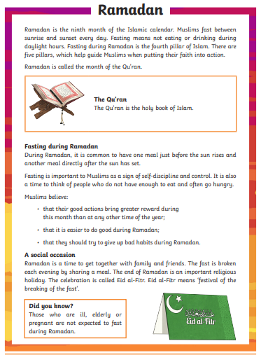
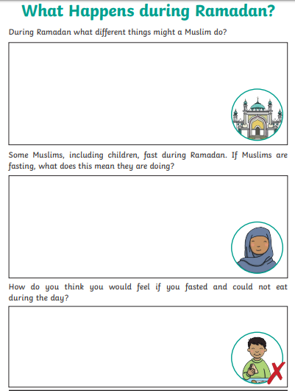
Home Learning Challenge - RE
RE – We are continuing to look at the religion Islam, and how and why Muslims celebrate and worship.

Slide 11
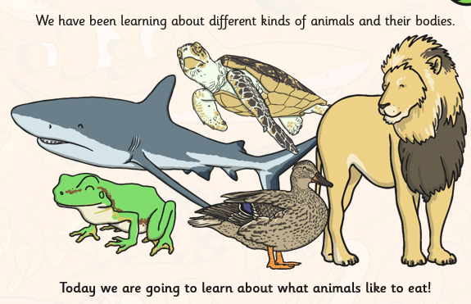
Home Learning Challenge - Science
A carnivore is an animal that eats just meat. They usually have to catch their food
A herbivore is an animal that eats just plants.
An omnivore is an animal that eats a combination of meat and plants.
Are humans carnivores, herbivores or omnivores? Why?
Your task is to research some of your favourite animals and write a list of food that they would like to eat. Can you make a list for an omnivore, carnivore and a herbivore?
DT link - Can you use your skills with tools to prepare one of the foods in your list?

Slide 12
Home Learning Challenge - PSHE
.
My special people
Draw, label and write about four people that are special to you. Can you explain why they are special?

Slide 13
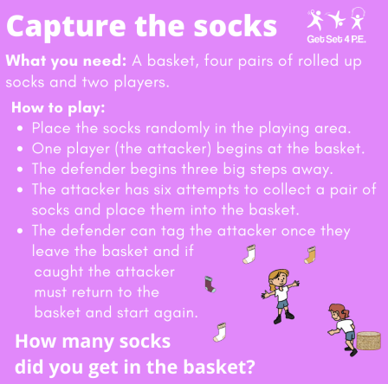
Home Learning- PE

Slide 14
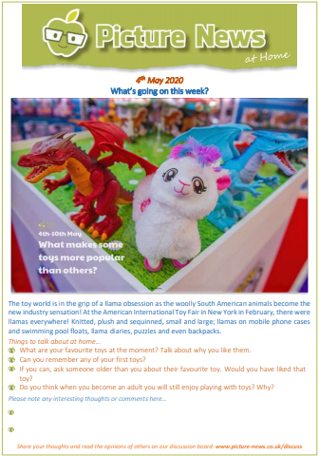
Home Learning
Collective worship from our friend Mr Buckeridge– Do we treat different people of having different worth? Today's CW explores the value God places on us all, no matter who we are, and how this should affect us in our own relationships. https://www.youtube.com/watch?v=y_kA3TpL5pA&feature=youtu.be
Picture news this week links beautifully with our History Topic for this term– old Toys.
http://www.bluecoatmeresprimary.co.uk/wp-content/uploads/sites/4/2020/05/Picture-News-at-Home-4th-May.pdf

Slide 15
Home Learning Non Screen Activities

