Slide 1

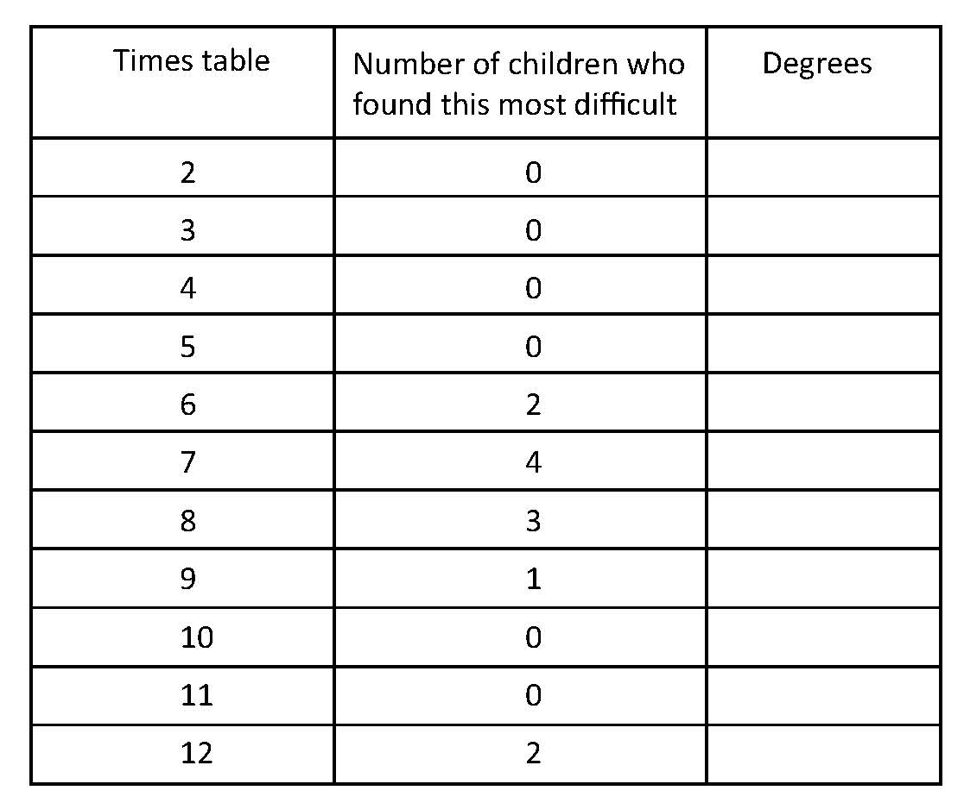


Construct pie charts.
We are going to draw a pie chart to show these results.
First we will calculate how big each segment needs to be.
12 children were asked which times table they found most difficult to learn.
This is a table of the results.
How many degrees do we need to show 2 children?
HINT! 2 is ¹/₆ of 12 children.
How many degrees do we need to show 4 children?
HINT! 4 is ¹/₃ of 12 children.
60°
120°
90°
3 is ¹/₄ of 12 children, so we need a quarter of 360˚ (the full circle) to show 3 children.
30°
60°
Now check that the total adds to 360˚.
How many degrees do we need to show 1 child?
Notes:
Take feedback on children's ideas about what the table shows, e.g. 4 children found the 7 times table the hardest. 4 is one third of the group of 12 children.

Slide 2
Construct pie charts.
2 children: ¹/₆ of the circle, 60˚ .
1 child: ¹/₁₂ of the circle, 30˚.
2 children: ¹/₆ of the circle, 60˚.
60°
120°
90°
30°
60°
6 times table
7 times table
8 times table
3 children: ¹/₄ of the circle, 90˚.
4 children: ¹/₃ of the circle, 120˚.
9 times table
12 times table
Notes:
Show children how to construct the pie chart.
Discuss the results, pointing out how it clearly shows the information about how difficult the groups of children found each times-table. Note that - unlike a bar chart - any categories that have a frequency of zero are not represented in any way.
Children can now go on to do differentiated GROUP ACTIVITIES. You can find Hamilton’s group activities in this unit’s TEACHING AND GROUP ACTIVITIES download.
WT/ARE: Construct a pie chart with 6 segments based on the TV preferences of 6 children.
GD: Construct a pie chart to show the proportions of ingredients in different cereals.

