Slide 1
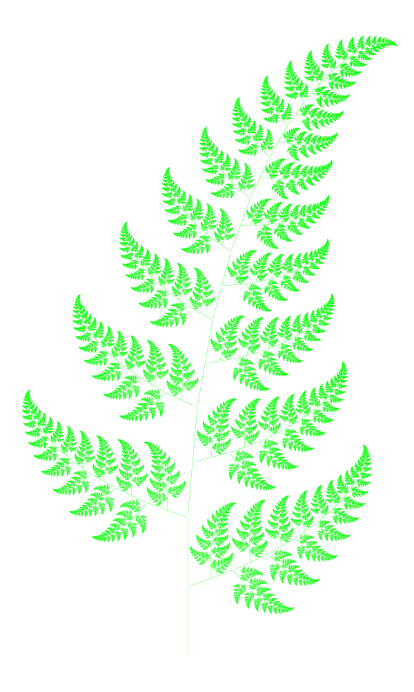

Explore ‘Fractals’.
Benoit Mandelbrot first used the term fractal in 1975 to describe structures “in which smaller and smaller copies of a pattern are successively nested inside each other, so that the same intricate shapes appear no matter how much you zoom in to the whole”. He found fractals in nature, in ferns and trees for example, and in the cosmos.
Here is an example from https://en.wikipedia.org/wiki/File:Bransleys_fern.png
Can you see how see how each frond is like a mini-fern; a tiny exact copy of the larger original?
Enter ‘fractals in nature’ into a search engine and see what other fractals you can find…
Notes:
Discuss children's ideas and reasoning for their sketches of how the pie chart might look for your class.
Children can now go on to do differentiated GROUP ACTIVITIES. You can find Hamilton’s group activities in this unit’s TEACHING AND GROUP ACTIVITIES download.
WT: Interpret pie charts showing the way children come to school.
ARE/GD: Interpret pie charts to determine which matches bowls of different coloured counters.

Slide 2
Explore ‘Fractals’.
Today we are going to create our own fractals.
Can you see how the pattern develops?
First a line is drawn.
Then 2 lines are drawn, ²/₃ the length of the 1st line, and at 60˚ to each other.
This ‘rule’ is then used to draw the repeating pattern.
Notes:
Discuss children's ideas and reasoning for their sketches of how the pie chart might look for your class.
Children can now go on to do differentiated GROUP ACTIVITIES. You can find Hamilton’s group activities in this unit’s TEACHING AND GROUP ACTIVITIES download.
WT: Interpret pie charts showing the way children come to school.
ARE/GD: Interpret pie charts to determine which matches bowls of different coloured counters.

Slide 3
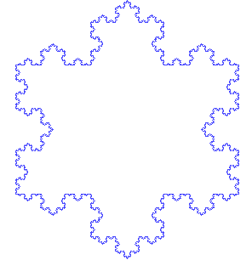
Explore ‘Fractals’.
Click on this ‘Koch snowflake’ to see how it is created…
Can you describe the rule for creating this pattern?
OK, Now it’s time to have a go at creating your own FRACTALS.
Have Fun!
Notes:
Discuss children's ideas and reasoning for their sketches of how the pie chart might look for your class.
Children can now go on to do differentiated GROUP ACTIVITIES. You can find Hamilton’s group activities in this unit’s TEACHING AND GROUP ACTIVITIES download.
WT: Interpret pie charts showing the way children come to school.
ARE/GD: Interpret pie charts to determine which matches bowls of different coloured counters.

