Slide 1
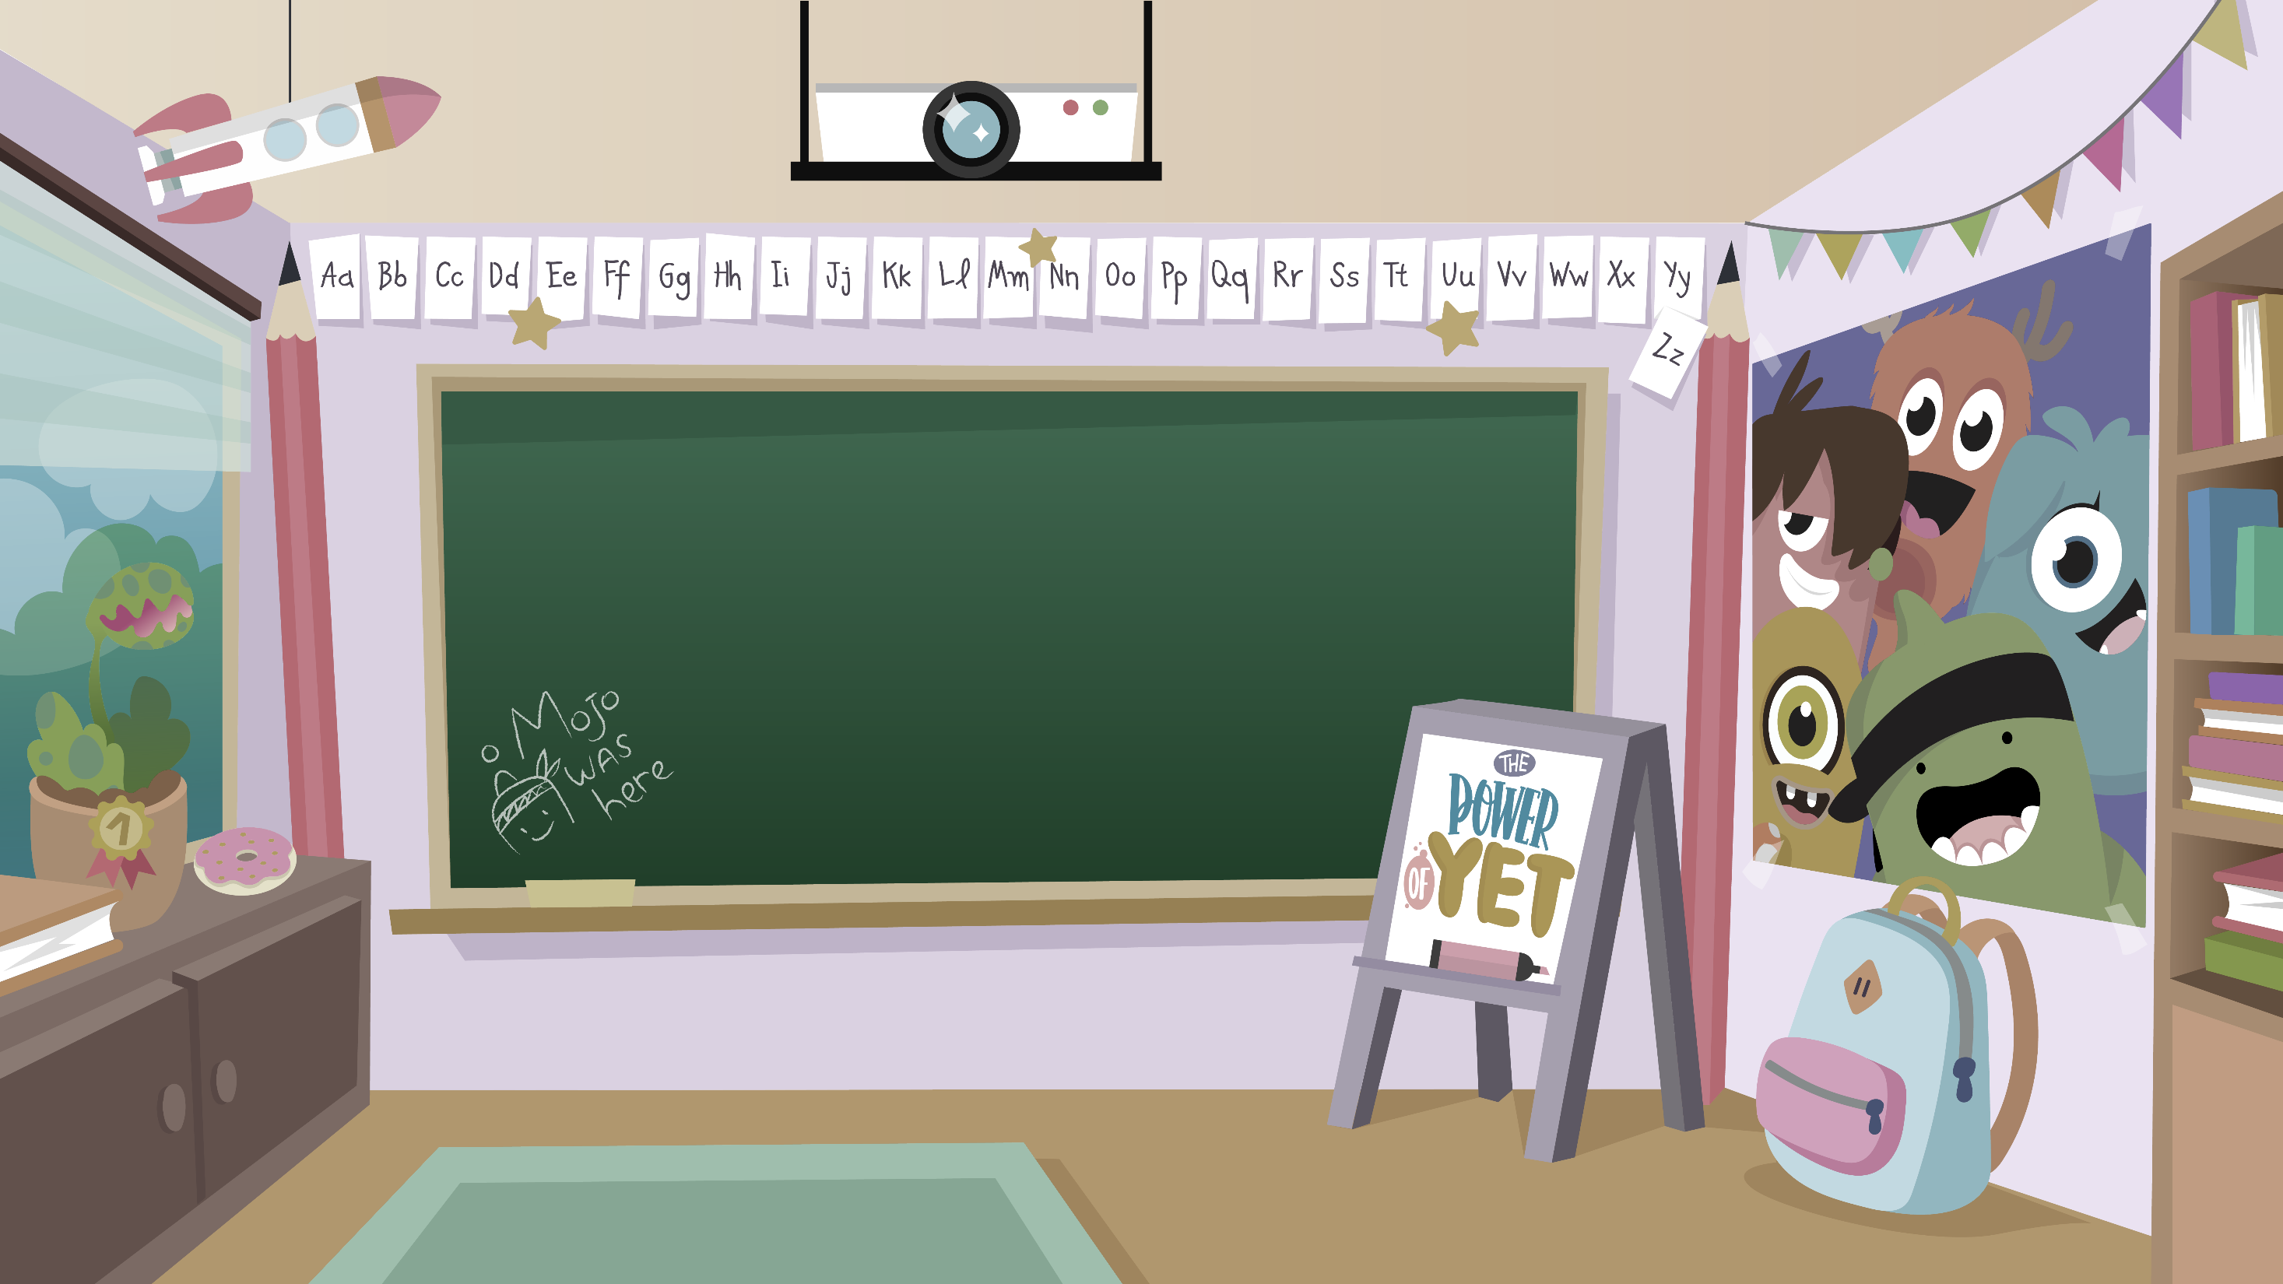
Home Learning activities WC 1.6.20 Year 1 CG Teaching group.
Challenge

Slide 2
Hello year 1! I hope you have enjoyed your half term rest.
Here is some more learning activities for you to do at home.
Don’t forget, there is work available on Purple Mash too and remember to send me some of your work through Class Dojo.
I hope to see you all soon
Mrs Gliddon

Slide 3
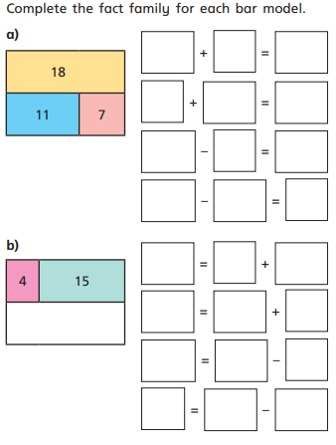
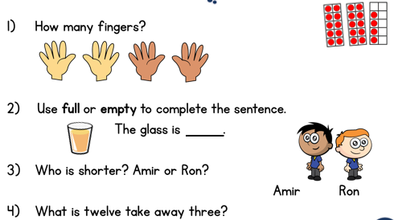
Home Learning Recap - Maths

Slide 4
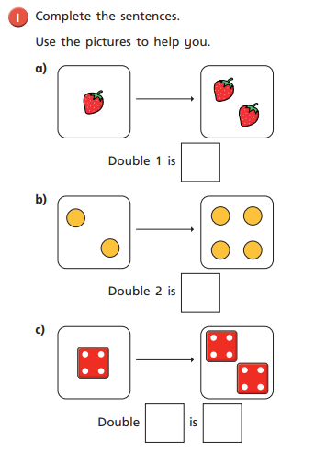
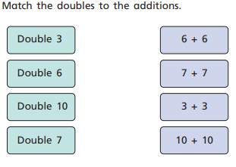
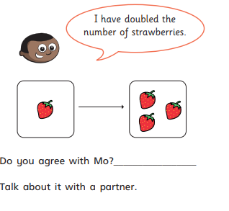
Home Learning Challenges - Maths
We are starting to look at multiplication and division, You can use step counting!
Challenge

Slide 5
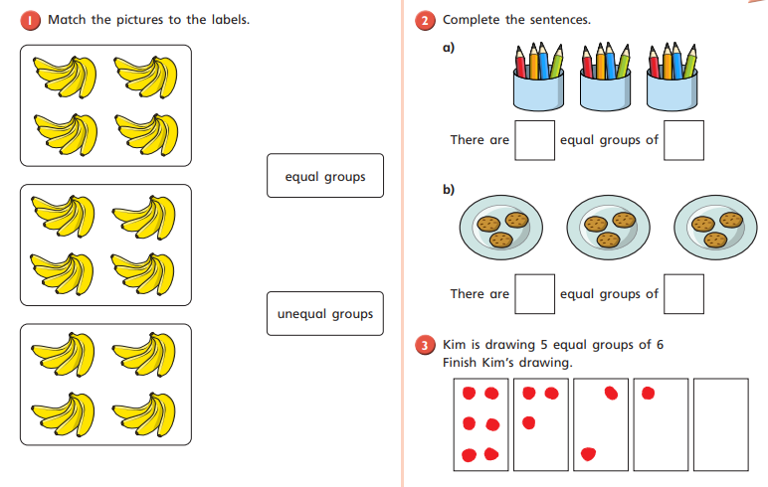
Home Learning Challenges - Maths

Slide 6
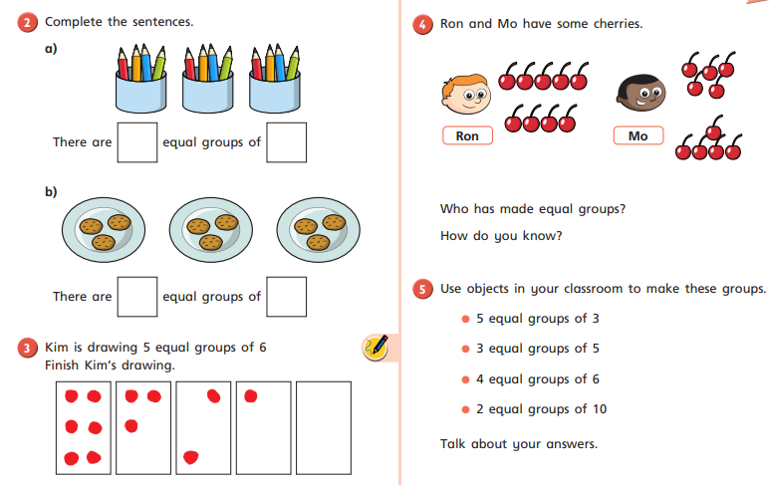
Home Learning Challenges - Maths

Slide 7
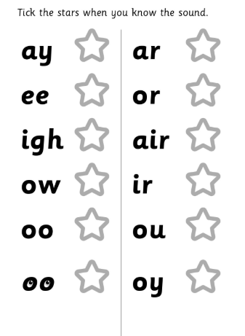
Home Learning Recap - Phonics

Slide 8
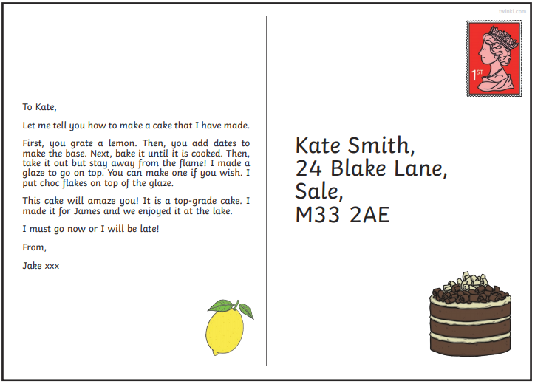
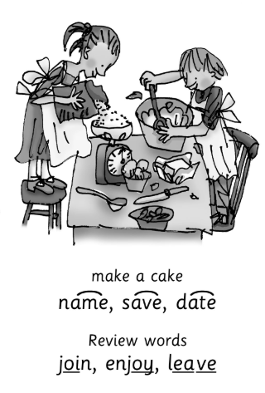
Home Learning Challenges - Phonics
Remember, there are some great videos on Youtube to help. Ruth Miskin Training set 3 speed sounds and spelling lessons are definitely worth while in teaching your child and set 2 are great for recap lessons.
Find the words that contain the split digraph a-e and read them.

Slide 9
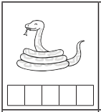
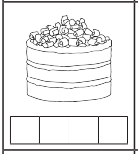
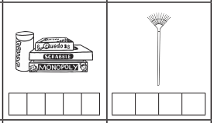
Home Learning Challenges - Phonics

Slide 10
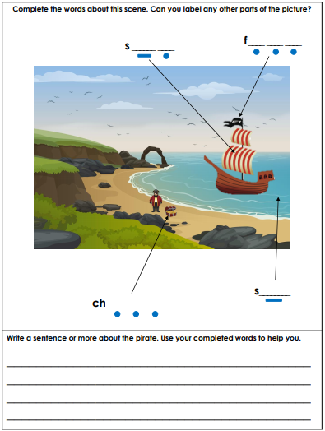
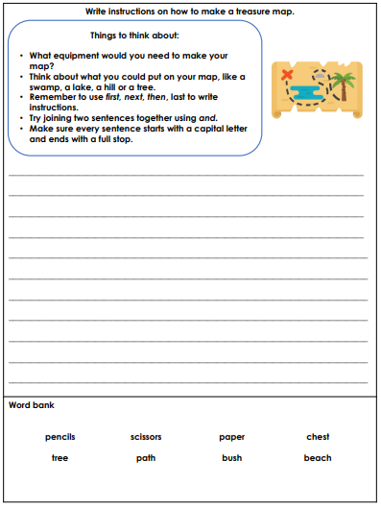
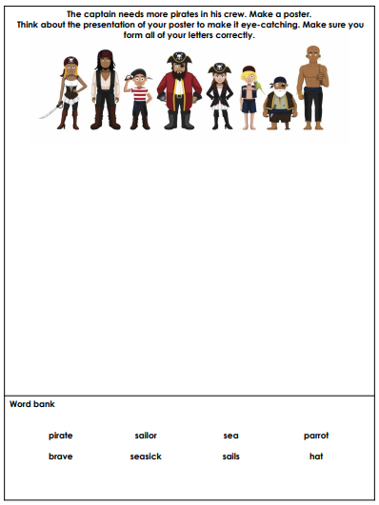
Home Learning Challenges – English

Slide 11
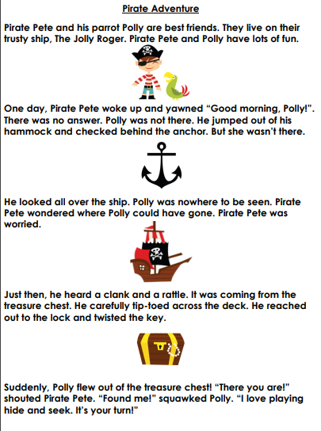
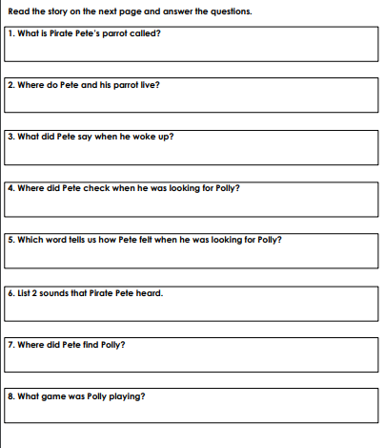
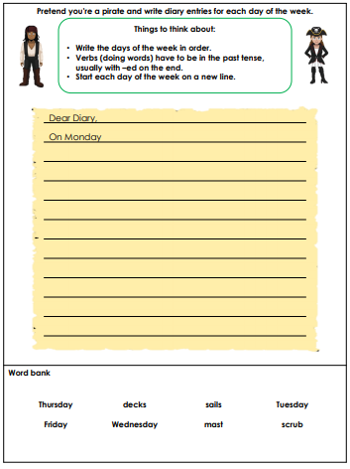
Home Learning Challenges – English

Slide 12
Home Learning Challenge - Spelling
Use look, cover, write, check to learn the common Exception words.
Look | Cover and say | Write and check | Amend errors | Repeat
do
to
today
of
said
says
were
is
his
one
once
ask

Slide 13
Home Learning Recap - RE
RE – This term we are looking at the Christian Church.
What things might happen at Church? How many can you think of?
1
2
3
4
5

Slide 14
Home Learning Challenge - RE
Not all churches are the same but there are some things that you will find in most churches. This week we will look at the altar. Read the information and write the answer to the question.

Slide 15
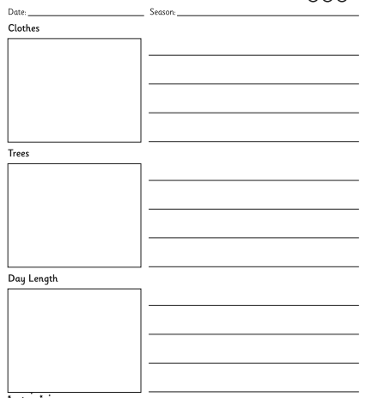
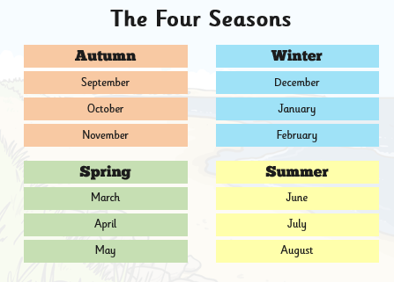
Home Learning Challenge – Science
The Seasons
https://www.bbc.co.uk/teach/class-clips-video/the-changing-seasons/zh4rkmn

Slide 16
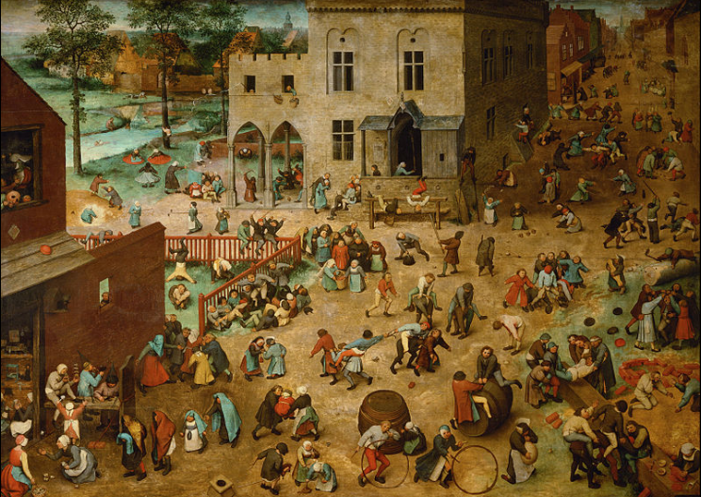
Home Learning Challenge - History
In History we have started looking at identifying old and new toys. Have a look at this painting ‘Children’s games’ by Pieter Bruegel. What old games/toys can you see?

Slide 17
Home Learning Challenge - History
A timeline is a listing of events that have happened in Chronological Order. This means that the events are listed in the order that they happened.
Can you draw or use photographs and label a time line of your life. Think about your life and key events, for example when you were born, a special birthday, starting school

Slide 18
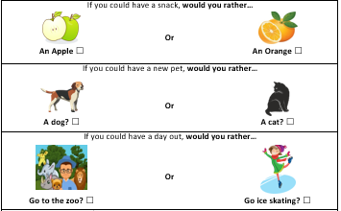
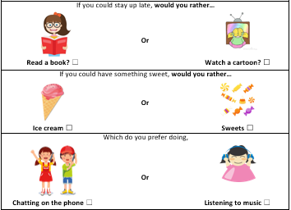
Home Learning Challenge - PSHE
Everyone has to make decisions, some more difficult than others. Read this would you rather scenarios, decide what you would rather do or have and explain your reasons.

Slide 19
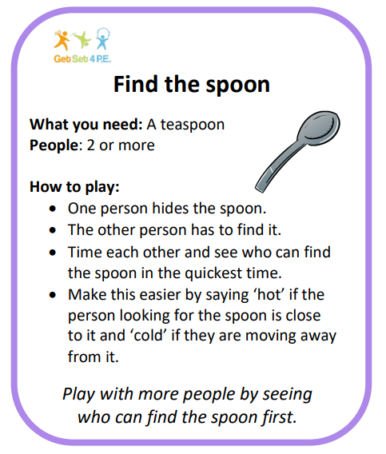
Home Learning- PE

Slide 20
Home Learning Non Screen Activities

