Slide 1
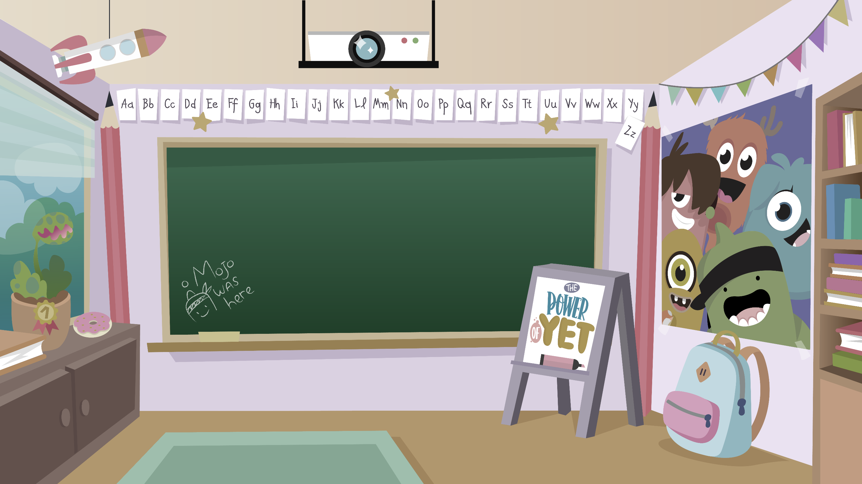
Home Learning activities WC 18.5.20 Year 1 CG Teaching group.
Challenge

Slide 2
.
Challenge
Hello year 1! I hope you are all keeping safe and are well! Here are some activities to keep you busy while we are still off school. Remember you can contact me and share your work through Class Dojo
Mrs Gliddon

Slide 3
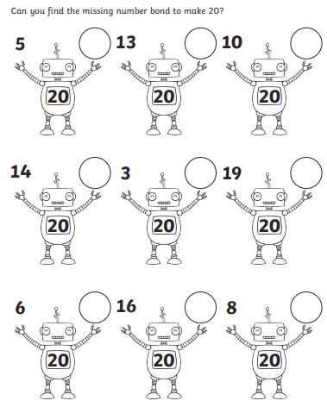
Home Learning Recap - Maths
Learning your number bonds up to 20 will help you with lots more maths in the future.
Extension – Record the subtraction facts that match the statement,
E.g. 5 + 15 = 20 +19=20 so 20 – 1 = 19 or 2- - 19 = 1

Slide 4
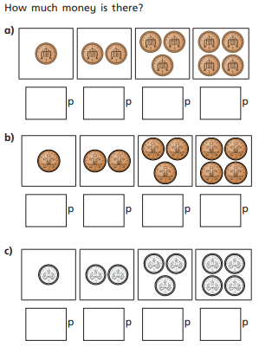
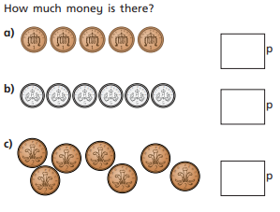
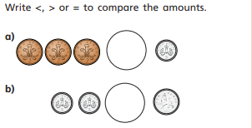
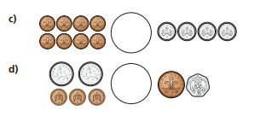
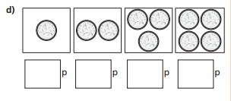
Home Learning Challenges - Maths
Money
Children in year One should know the value of coins and notes. To help find totals of money, children can use their step counting skills to help them.
Challenge
Day 1
Day 2
See if you have any change around and begin by checking that you know the values of the coins – Use these to help you count.
* Remember, the wider part of the symbols likes the larger number *

Slide 5
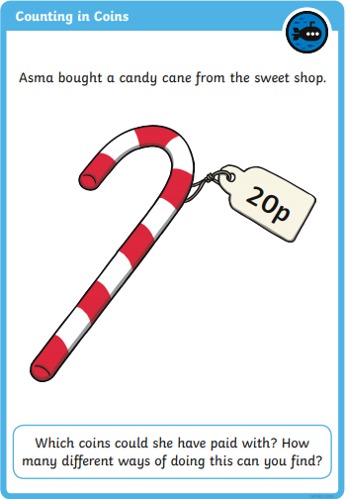
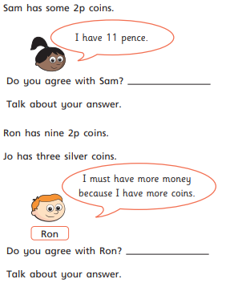
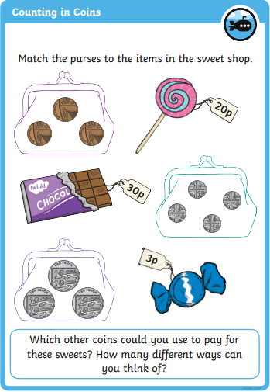
Home Learning Challenges - Maths
Day 4
Day 5
Use real/toy coins or draw them to prove your answers.

Slide 6
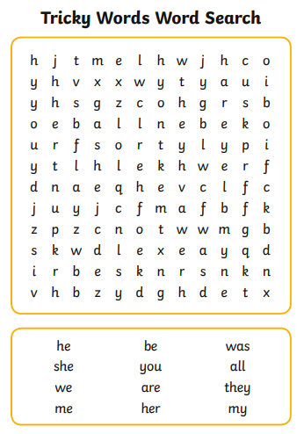
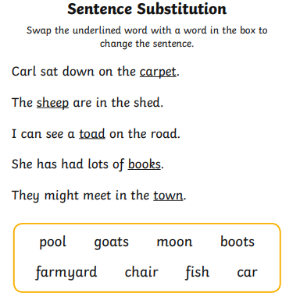
Home Learning Recap - Phonics

Slide 7
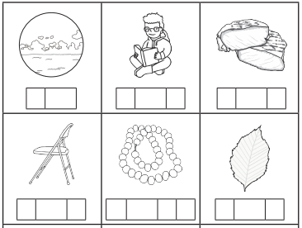
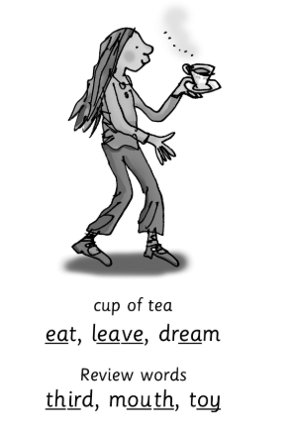
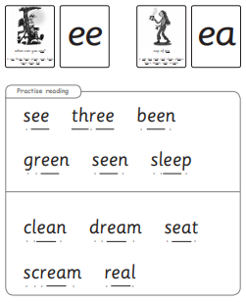
Home Learning Challenges - Phonics
Day 1 – Learn it. What sound does it make, what does it look like? Day 2 – Use the grapheme to write the words correctly, read them out loud to check. Day 3 – Match the word to the pictures.
Day 4 – Make a matching game of the ‘ea’ sound – see below.
Day 5 – Play the matching game with a family member.
Remember, there are some great videos on Youtube to help. Ruth Miskin Training set 3 speed sounds and spelling lessons are definitely worth while in teaching your child and set 2 are great for recap lessons.
Write the ‘ea’ words onto pieces of paper, you will need each one writing twice, turn them all over and take it in turns to try and match the same words together.

Slide 8
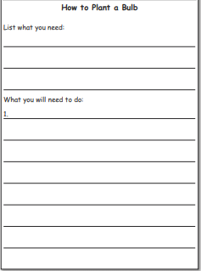
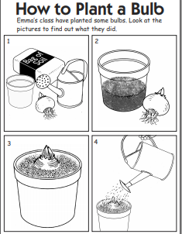
Home Learning Challenges – English
Write a set of instructions.
Instructions give a clear guide for people to follow. Your task is to write a set of This week, we will continue writing instructions, because I know that now you will be amazing at it.
Day 1 - Draw and label what you will need to complete this activity.
Day 2 – Draw the 4 steps that you will complete and put them in order. Add words to order the pictures e.g. First, then, next, after that, finally. Check that your instructions work by following them yourself.
Day 3 – Draft some simple sentences using the pictures and sentence starters that you made on day 2.
Day 4 – Edit and improve your sentences, Check your spelling, look for finger spaces, find and use capital letters and full stops. Challenge – Add some description words e.g brown mud, cold water.
Day 5 – Publish, write up your instructions. Copy your edited draft using your best handwriting. Save your work to show me.

Slide 9
Home Learning Challenge - Spelling
Use look, cover, write, check to learn the common Exception words.
Look | Cover and say | Write and check | Amend errors | Repeat
some
come
love
where
there
here
by
so
go
no
your
has

Slide 10
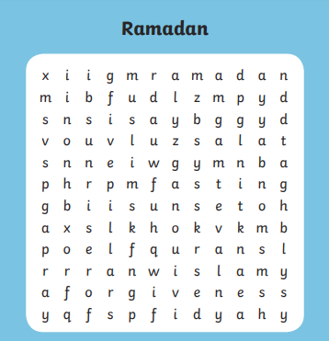
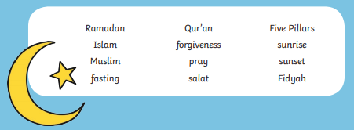
Home Learning Recap - RE
RE – We are continuing to look at the religion Islam, and how and why Muslims celebrate and worship. Can you remember what these words mean?

Slide 11
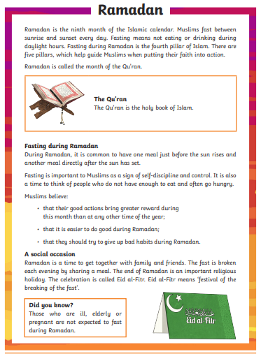
Home Learning Challenge - RE
RE – We are continuing to look at the religion Islam, and how and why Muslims celebrate and worship.
Make a Moon and star decoration – The Symbol for Islam.
1 - Cut out a moon and star shape.
2 – Decorate the moon and stars.
3 – Make a hole at the top of the moon and the top of the star.
4 - Use some ribbon/string to tie the star to the moon.
5 – Display your decoration.

Slide 12
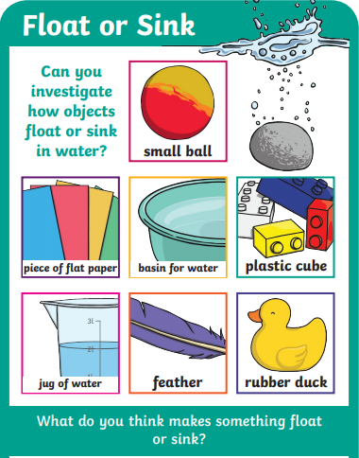
Home Learning Challenge - Science
Think back to our work on materials, it was way back in September!!
Can you create an experiment to test if objects float or sink?
How can you make the test fair?
What equipment will you need?
Can you predict (have a good guess) at what will happen?
Can you explain how you tested the objects?

Slide 13
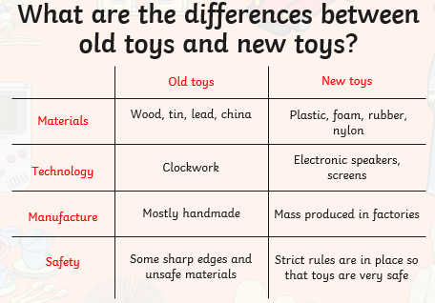
Home Learning Challenge - History
In History we are looking at identifying old and new things in pictures. We will be doing this by looking at toys.

Slide 14
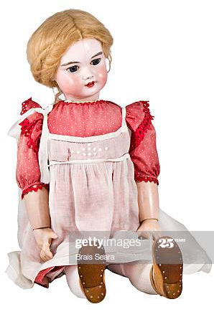
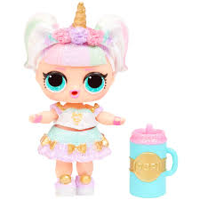
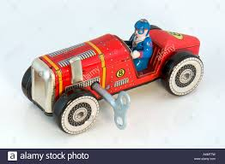
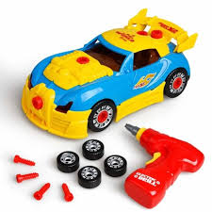
Home Learning Challenge - History
To help us to learn about old toys we can ask Grandparents or older people that we know or we can use the internet. Can you compare and write sentences about the old and new cars. You can either do cars or dolls.

Slide 15
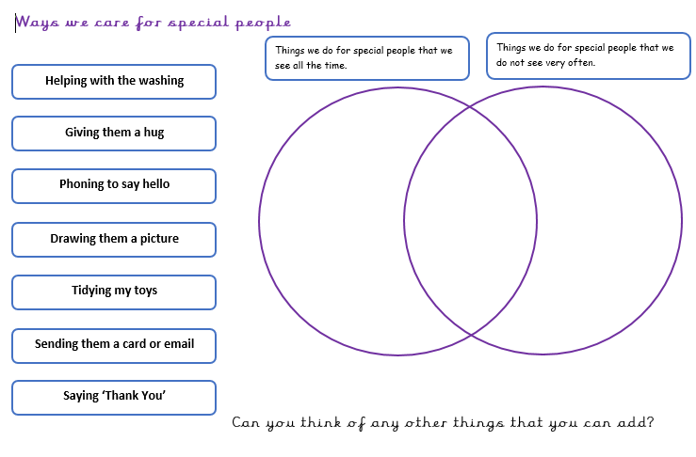
Home Learning Challenge - PSHE

Slide 16
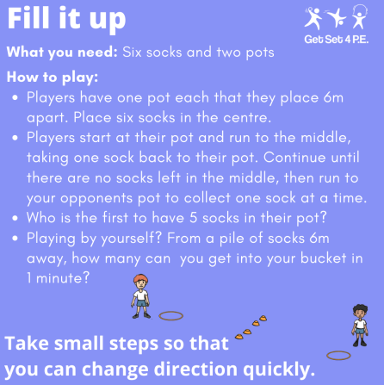
Home Learning- PE

Slide 17
Home Learning Non Screen Activities

