Slide 1
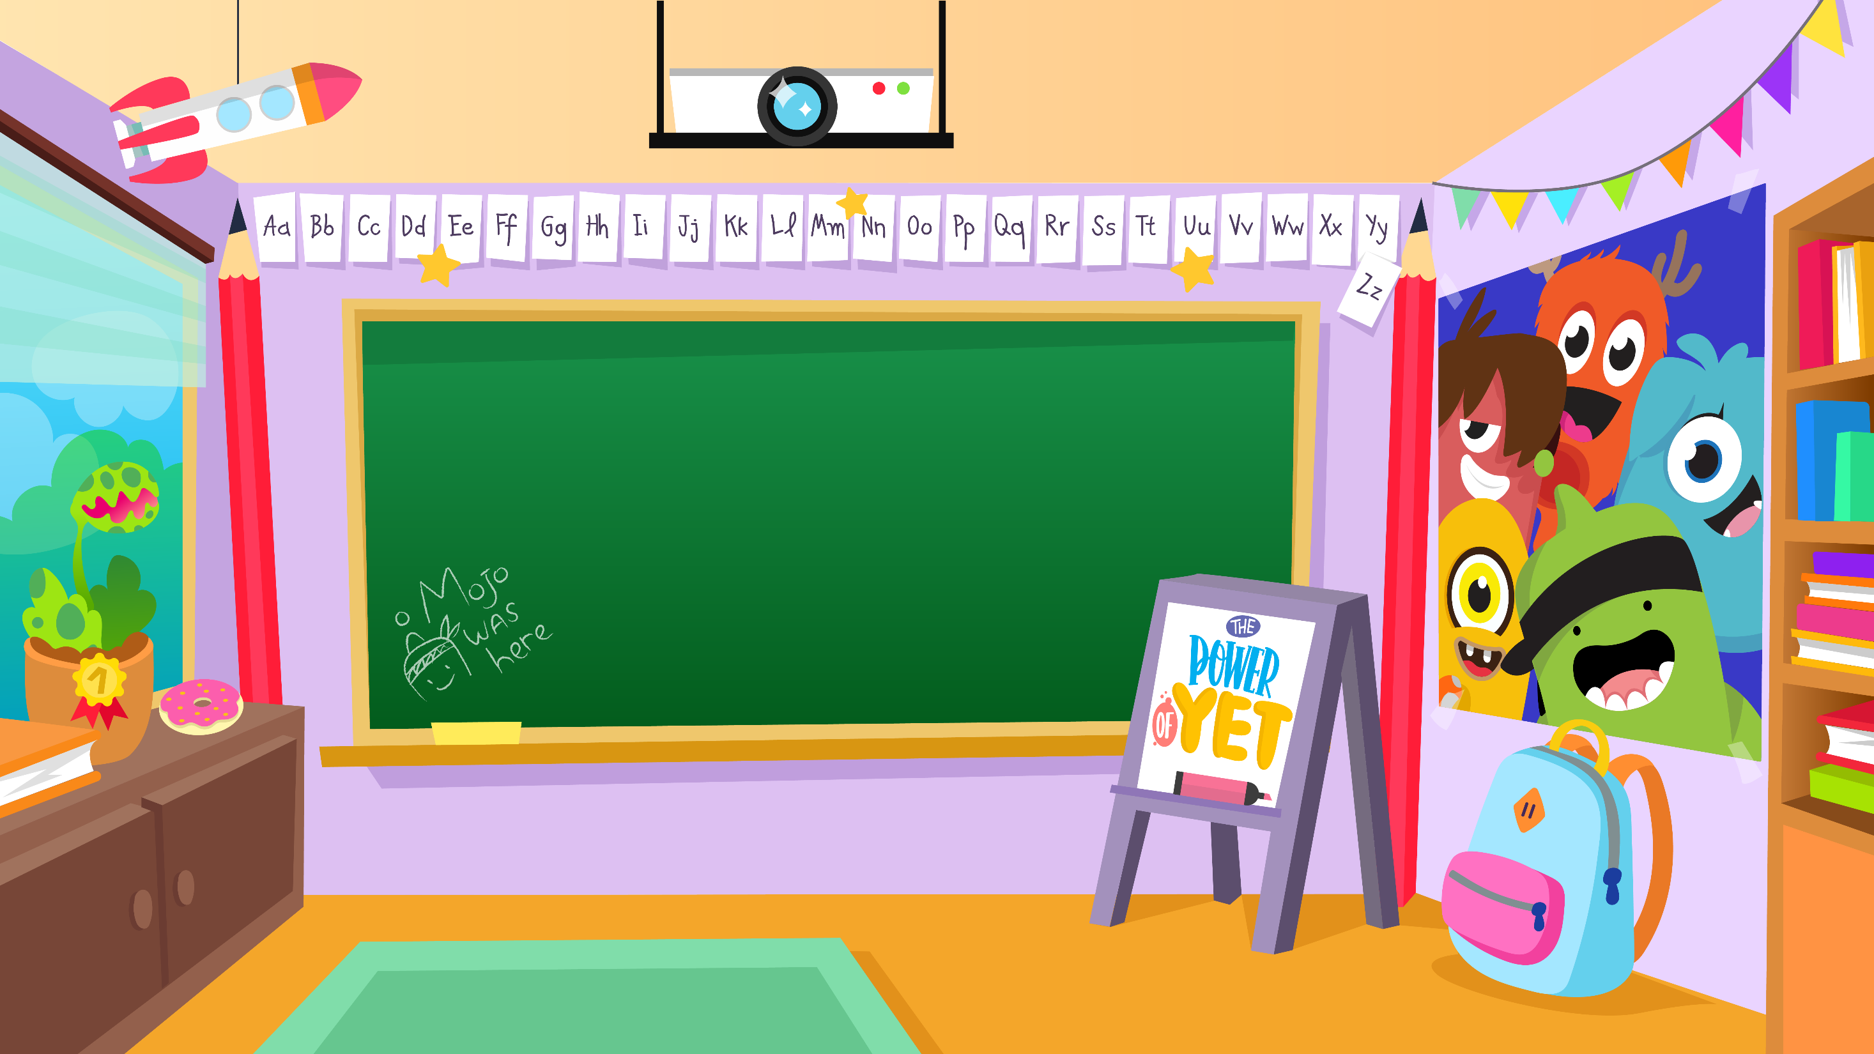
Home Learning activities WC 01.06.20 Year 2 AC Teaching group.
Challenge

Slide 2
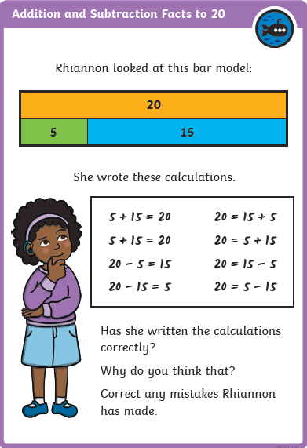
Home Learning Recap - Maths
Learning your number bonds up to 20 will help you with lots more maths in the future.
Extension – Can you create your own bar model and write the number facts up to 20?

Slide 3
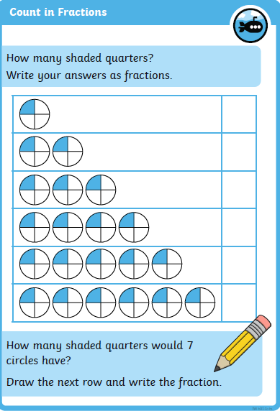
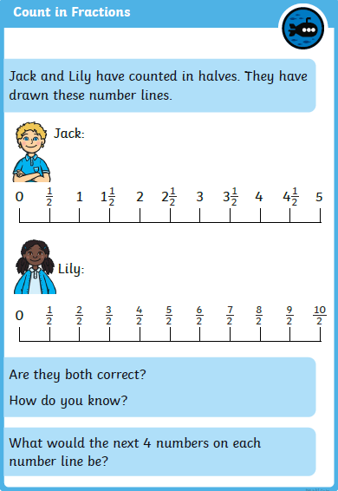
Home Learning Challenges - Maths
Fractions
Children in Year Two should know ½, ¼ and 1/3 of shapes, objects and quantities. They should also know that 2/4 = ½. They should also be able to count in fractions.
Challenge
Day 1
Day 2

Slide 4
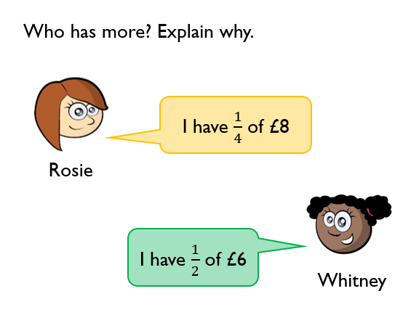
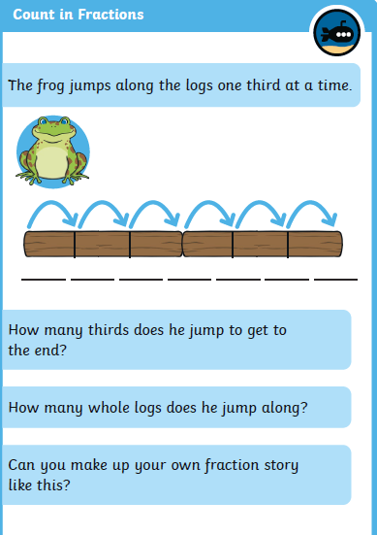
Home Learning Challenges - Maths
Day 4
Day 5

Slide 5
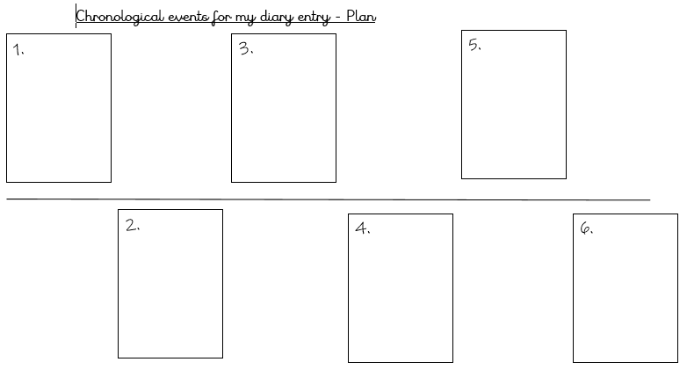
Home Learning Challenges – English
Write a Diary Entry.
Can you write a diary entry of what you have been doing at home?
You can write about one day or you can write about a few days. Remember – it must be written in past tense.
Day 1 –Create a timeline of chronological events from the time of getting up/first day.
Day 2 – Verbally build each of your numbers in a sequence of sentences. Include adjectives, feelings, conjunctions and suffixes (e.g. amazement, hopeless) Draft numbers 1 – 3. Re-read to check your work makes sense.
Day 3 – The same as Day 2 for events 4-6. Can you write a closing detailing where you are and how you are feeling at the minute?
Day 4 – Edit and improve your sentences, Check your spelling, your sentences make sense, punctuation and conjunctions.
Day 5 – Publish, write up your diary entry in neat – you might even want to create your own notebook out of paper and give it a front cover. Copy your edited draft using your best handwriting. Save your work to show me.

Slide 6
Home Learning Challenges – English example
Write a Diary Entry of what you have been doing. I have highlighted in red Year 2 writing features.
31st May 2020
Dear Diary,
What a great week it has been! I’ve been so busy that I’m now exhausted! Let me tell you all about it.
On Monday, I spent most of the day in the garden enjoying the beautiful sunshine. I did a little bit of gardening, watered my plants and even read some of my book. I had a BBQ when the sun started to disappear. It was delicious!
Tuesday was an even busier day! I did some school work so the children in my class had activities for the following week and I even managed to bake a mouth-watering chocolate cake. Just a little secret between us, I had two slices throughout the day because everyone knows chocolate and cake are two of my most favourite things. In the evening, I went for a lovely, relaxing walk through the fields near my house. There were sheep grazing hungrily in the fields, ducks were swimming along the river and I even saw a deer run quickly into the trees. It was amazing to see!

Slide 7
Home Learning Challenge - Spelling
Use look, cover, write, check to learn the spelling rules for the sound /u/ spelt with ‘o’
Look | Cover and say | Write and check | Amend errors | Repeat
other
mother
brother
nothing
Monday
money
cover
honey
discover
wonder

Slide 8
Home Learning Recap - RE
RE – We are looking at the religion Islam, and how and why Muslims celebrate and worship.
Can you remember the story of Moses when we learnt about Judaism? Remember – This story is also in the Bible (Christianity)
Watch this story to remind yourself:
https://www.youtube.com/watch?v=RdSQT7DS1lI
God appeared to Moses. Moses and the Israelites made a ‘covenant’ with God – The Ten Commandments.

Slide 9
Home Learning Challenge - RE
RE – We are going to be looking at stories from The Qu’ran.
Activity:
Compare the stories of Moses- Judaism and Prophet Musa – Islam.
How are they similar?
How are they different?
Watch the following clip about the story of Prophet Musa and answer the questions at the end of the video:
https://www.youtube.com/watch?v=E40QshQOyc8

Slide 10
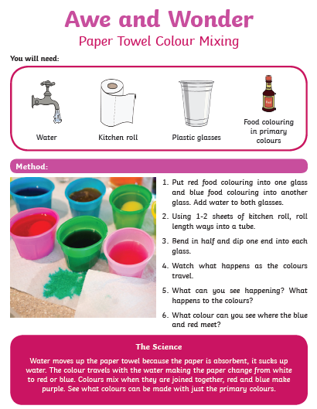
Home Learning Challenge - Science
What happens to the food colouring as the water is added?
What happens to the paper towel after it has been
dipped in the coloured water?
Does the water travel fast or slow?
How could you change the speed?
What happens when the colours meet?

Slide 11
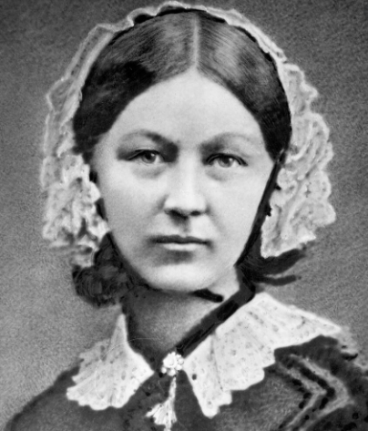
Home Learning Challenge - History
In History we are looking at Florence Nightingale.
Research and answer the following questions:
When was Florence Nightingale born? When did she die?
Where was she from?
Why is she significant?
What was her nickname?
.

Slide 12
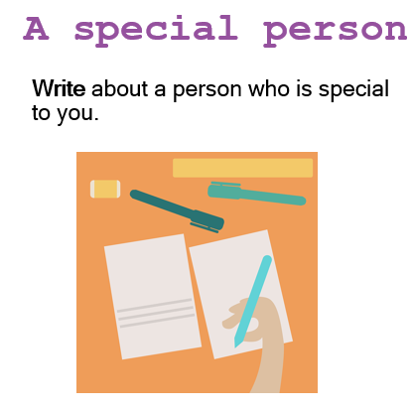
Home Learning Challenge - PSHE
Think about the following questions to help you:

Slide 13
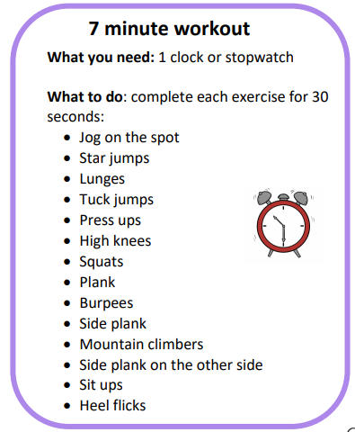
Home Learning- PE

Slide 14
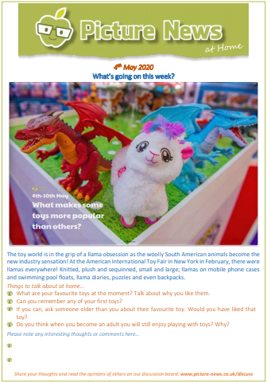
Home Learning
Collective worship from our friend Mr Buckeridge–https://www.youtube.com/watch?v=y_kA3TpL5pA&feature=youtu.be
Picture news- please look on our website weekly for the latest picture news.

Slide 15
Home Learning Non Screen Activities

