Slide 1
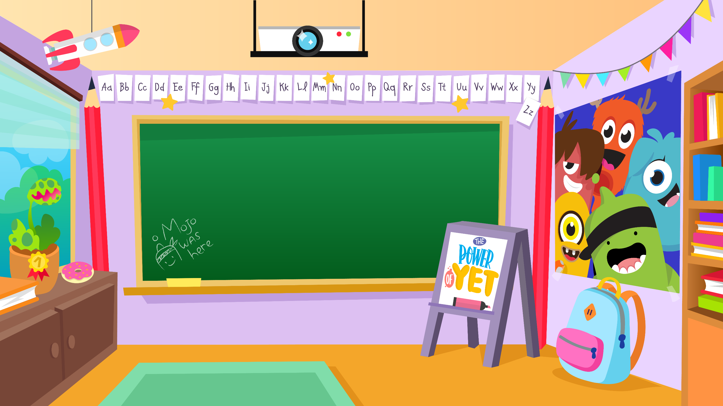
Home Learning activities WC 18.5.20 Year 2 AC Teaching group.
Challenge

Slide 2
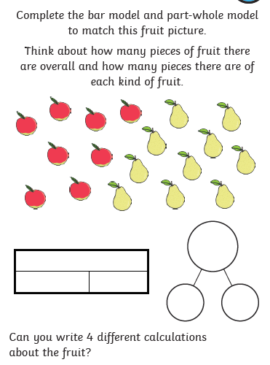
Home Learning Recap - Maths
Learning your number bonds up to 20 will help you with lots more maths in the future.
Extension – Can you create your own bar model and part-whole model using different objects at home?

Slide 3
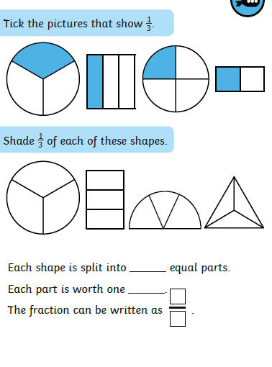
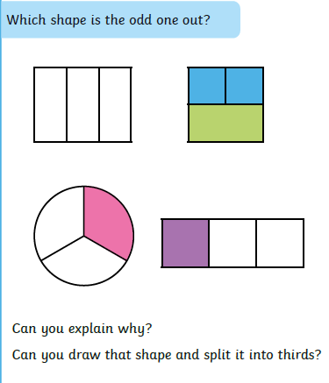
Home Learning Challenges - Maths
Fractions
Children in Year Two should know ½, ¼ and 1/3 of shapes, objects and quantities. They should also know that 2/4 = ½.
Challenge
Day 1
Day 2

Slide 4
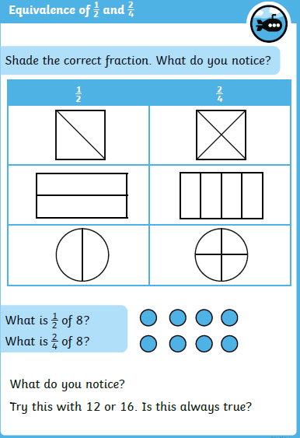
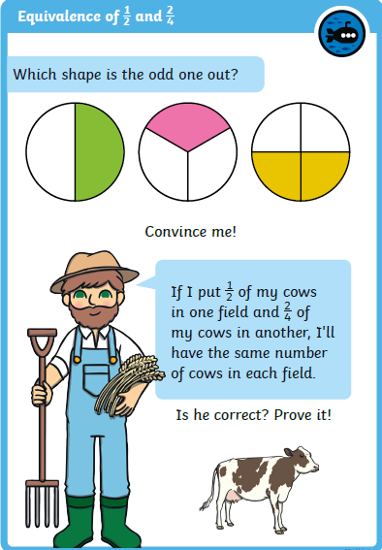
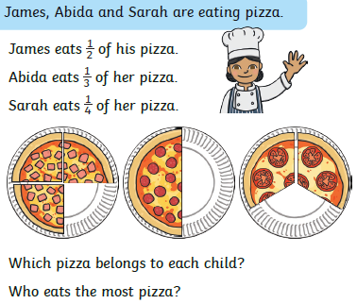
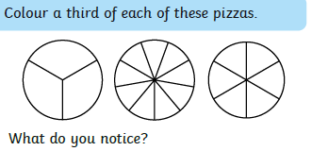
Home Learning Challenges - Maths
Day 4
Day 5

Slide 5
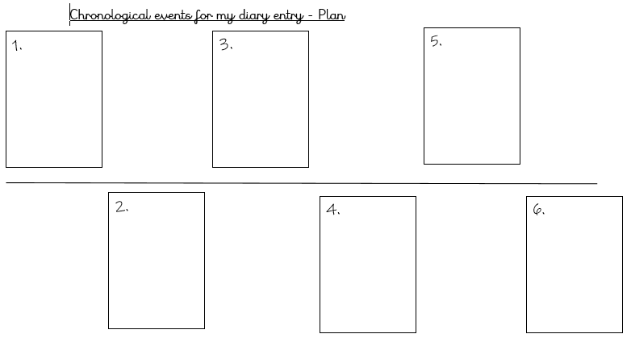
Home Learning Challenges – English
Write a Diary Entry.
Watch this video https://www.youtube.com/watch?v=weEveQ4nz4g
Imagine you were around when The Great Fire of London was happening.
Can you write a diary entry from September 1666?
Day 1 –Create a timeline of chronological events from the time of the fire e.g. 1 – woke up by screaming and looked outside. 2 – Collected my favourite toy and woke my family. After you have done this, can you narrate your events out loud so you know what you are going to write?
Day 2 – Verbally build each of your numbers in a sequence of sentences. Include adjectives, feelings, conjunctions and suffixes (e.g. amazement, hopeless) Draft numbers 1 – 3. Re-read to check your work makes sense.
Day 3 – The same as Day 2 for events 4-6. Can you write a closing detailing where you are and how you are feeling?
Day 4 – Edit and improve your sentences, Check your spelling, your sentences make sense, punctuation and conjunctions.
Day 5 – Publish, write up your diary entry in neat – you might even want to tea stain some paper so it looks old! Copy your edited draft using your best handwriting. Save your work to show me.

Slide 6
Home Learning Challenge - Spelling
Use look, cover, write, check to learn the spelling rules for the sound ‘or’ in words using ‘al’.
Look | Cover and say | Write and check | Amend errors | Repeat
all
call
ball
wall
fall
walk
talk
small
always
altogether

Slide 7
Home Learning Challenges – English example
Write a Diary Entry – here is the start of my diary entry. I have highlighted in red Year 2 writing features.
8th September 1666
Dear Diary,
What a dreadful few days it’s been! I’m so sorry that I haven’t managed to write but a huge, raging fire has burnt throughout the city of London and I’m very lucky to still be alive! I didn’t know if I was going to survive or not when I saw the immense flames leaping from building to building!
Let me tell you all about it.
In the early hours of September 2nd, I was woken up by the church bells ringing loudly outside. I crawled out of bed to look out of my window and do you know what I saw? Fierce, orange flames everywhere, lighting up the sky as far as I could see. Rapidly, I ran to my parents room, woke them up and we all ran out of the house because we needed to get to somewhere that was safe. Luckily, I managed to pick you up, Diary, before we left.
When we got outside, it was chaos. People were screaming and running frantically, the pavement was glowing golden and was hot under our feet and the heat was intense. Were we going to be safe if we got out of here?

Slide 8
Home Learning Recap - RE
RE – We are looking at the religion Islam, and how and why Muslims celebrate and worship.
Can you remember what the answer to these questions?
Where was Islam founded? Saudi Arabia.
What is the name of their God? Allah
Who was the founded of Islam? Muhammed (Peace be upon him)
What is the name of the Holy Book? The Qu’ran

Slide 9
Home Learning Challenge - RE
RE – We are going to be looking at stories from The Qu’ran.
Activity:
Retell the story using the comic strip below.
Watch the following clip about the story of Prophet Nuh:
https://www.youtube.com/watch?v=d2D6WuKlymM
What was the Prophet called?
What did Allah ask the Prophet to do?
What did he take on the ship with him?
What Bible story is this similar to? How?

Slide 10
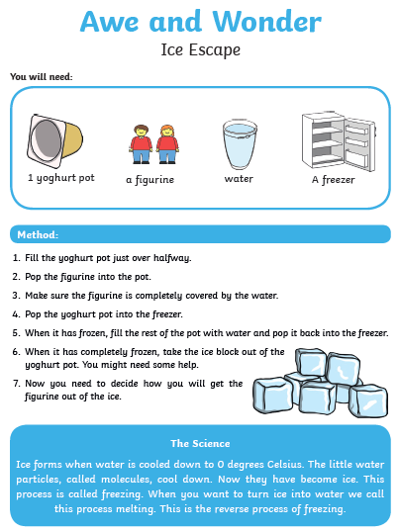
Home Learning Challenge - Science
Can you have a go at this experiment?
Can you write down all of the ways you could
free the figure from ice?
Can you predict (have a good guess) at what
Would be the best?
Can you explain how you tested the different
Ways of freeing the figure?

Slide 11
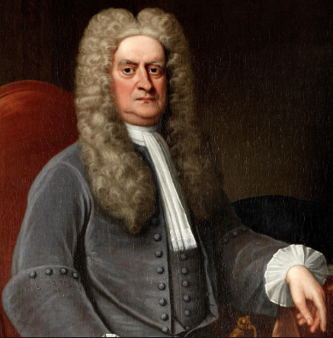
Home Learning Challenge - History
In History we are looking at Sir Isaac Newton.
Research and answer the following questions:
When was Isaac Newton born? When did he die?
Where was he from?
Why is he significant?
Activity:
Create a fact file about Sir Isaac Newton for others to read and learn about him.

Slide 12
Home Learning Challenge - PSHE
Relationships. Our Special People.
Who is special to you?
Think about your family and friends.
Draw pictures and write why they are special to you and how they show they care for you.

Slide 13
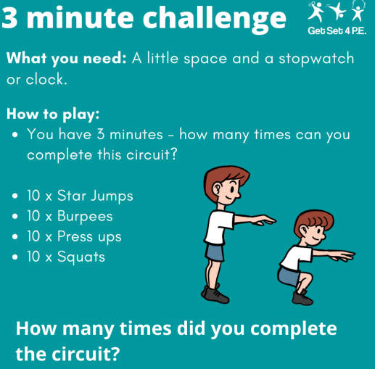
Home Learning- PE

Slide 14
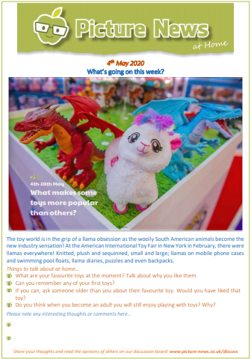
Home Learning
Collective worship from our friend Mr Buckeridge– Do we treat different people of having different worth? Today's CW explores the value God places on us all, no matter who we are, and how this should affect us in our own relationships. https://www.youtube.com/watch?v=y_kA3TpL5pA&feature=youtu.be
Picture news- please look on our website weekly for the latest picture news.

Slide 15
Home Learning Non Screen Activities

