Slide 1
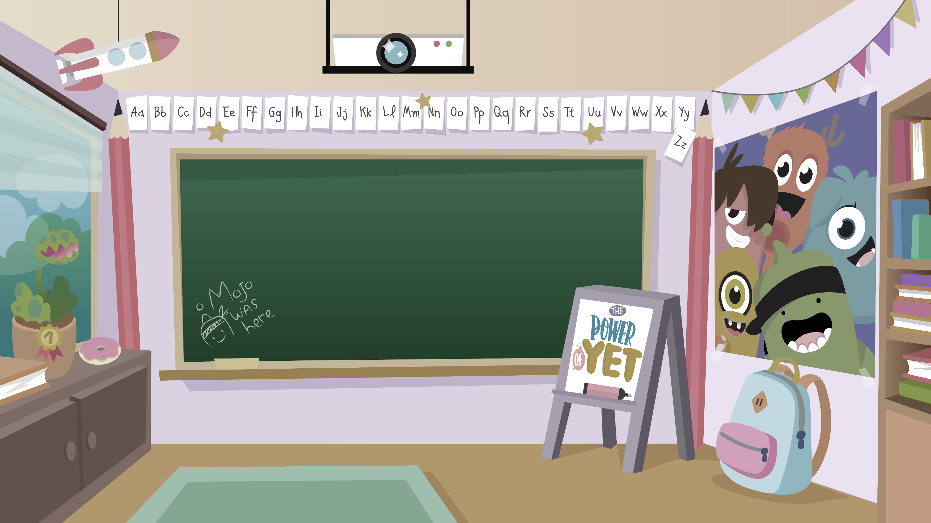
Home Learning activities WC 22.6.20
Year 1 CG
Teaching group.
Challenge

Slide 2
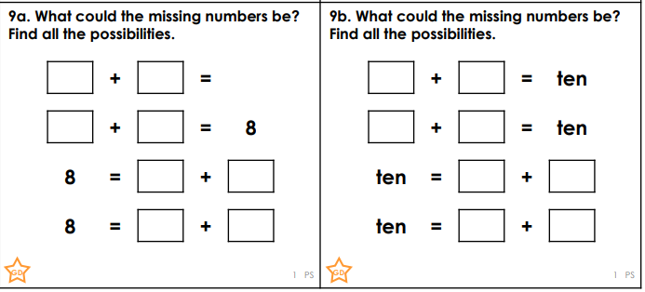
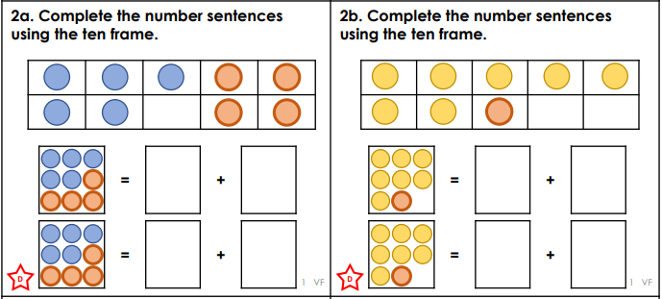
Home Learning Recap - Maths

Slide 3
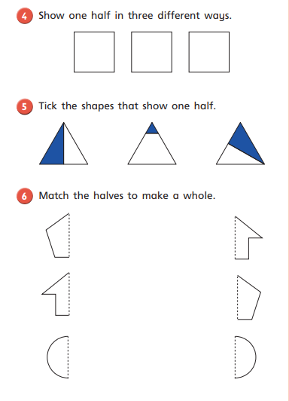
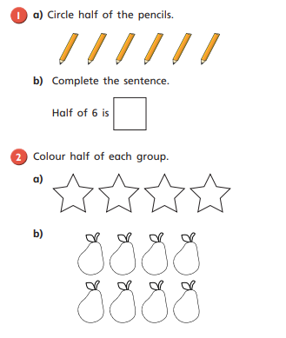
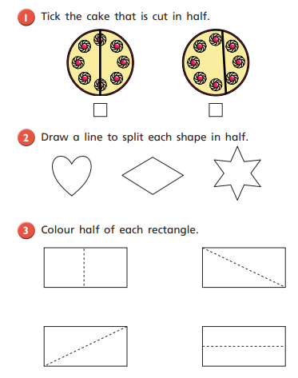
Home Learning Challenges - Maths
We are starting to look at fractions, In Year 1 we focus on halves and quarters. To find half we need 2 groups that are equal.

Slide 4
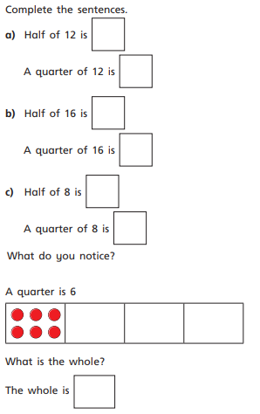
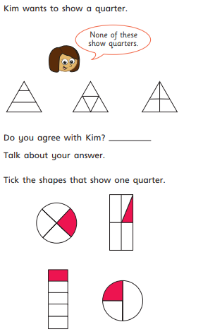
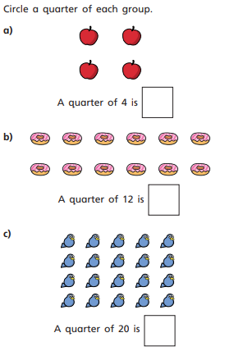
Home Learning Challenges - Maths
To find quarter we need 4 groups that are equal.

Slide 5
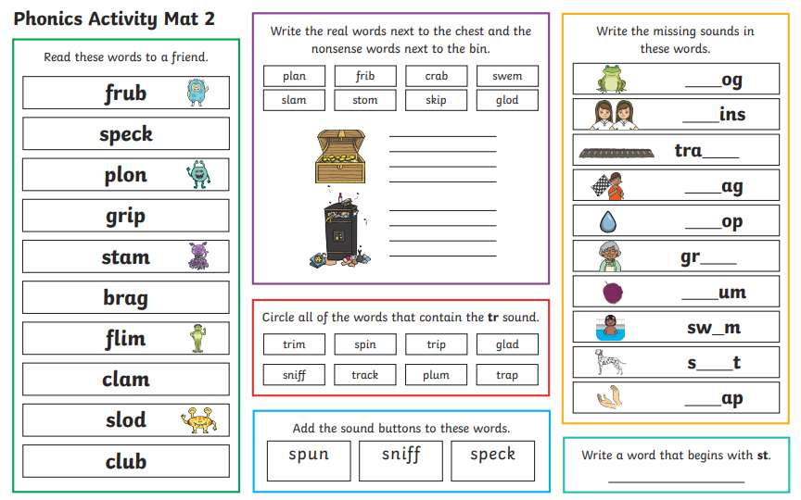
Home Learning Recap - Phonics

Slide 6

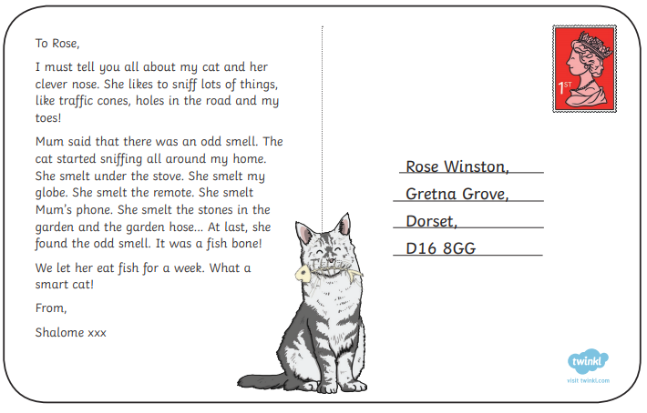
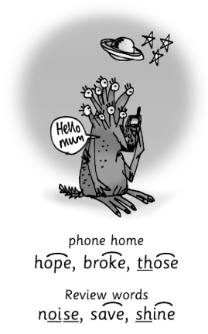
Home Learning Challenges - Phonics
Remember, there are some great videos on Youtube to help. Ruth Miskin Training set 3 speed sounds and spelling lessons are definitely worth while in teaching your child and set 2 are great for recap lessons.
Find the words that contain the split digraph o-e and read them.

Slide 7
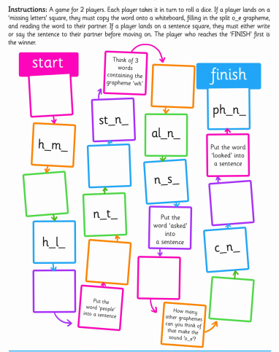
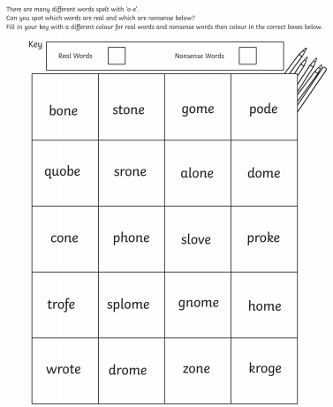
Home Learning Challenges - Phonics

Slide 8
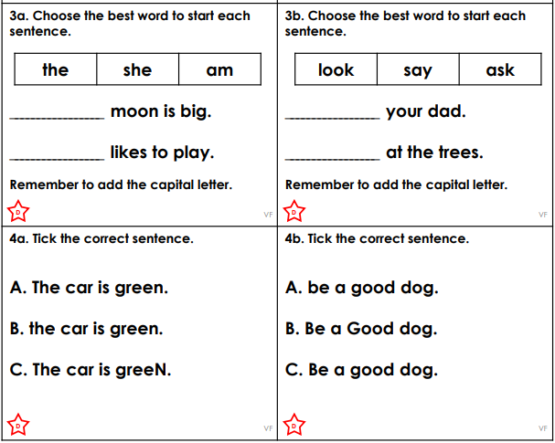
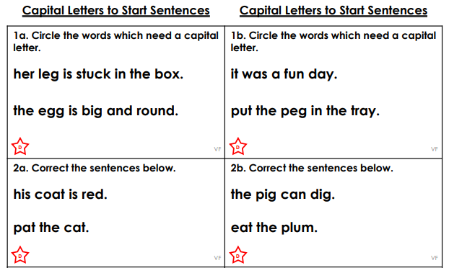
Home Learning Challenges – English

Slide 9
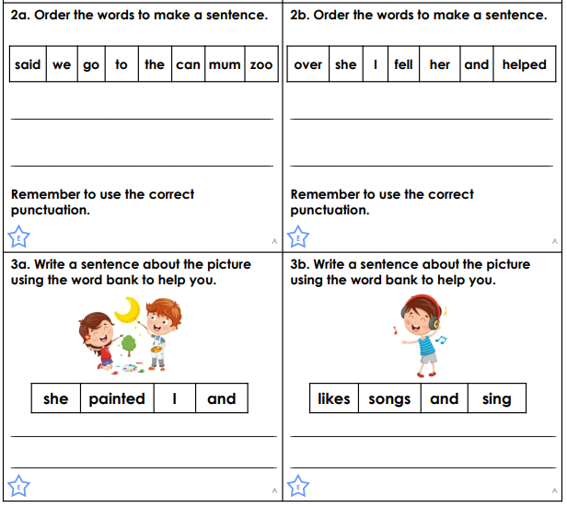

Home Learning Challenges – English
Think about all of the grammar work about capital letters and sentence structure and write some sentences about this picture.

Slide 10
Home Learning Challenge - Spelling
Use look, cover, write, check to learn the suffix words – adding ‘ed’ when no change is needed in the root word.
Look | Cover and say | Write and check | Amend errors | Repeat
hunted
buzzed
jumped
kicked
missed
played
cooked
rested
floated
walked
looked
zoomed

Slide 11
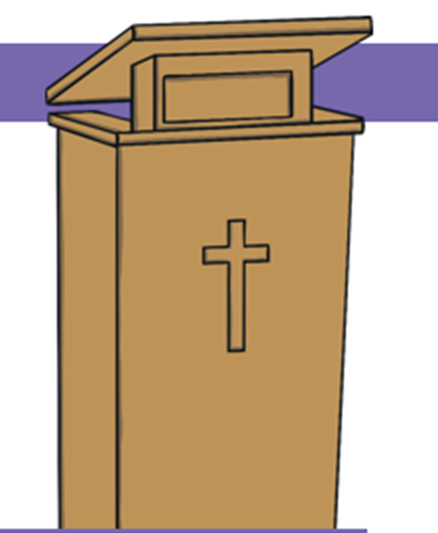

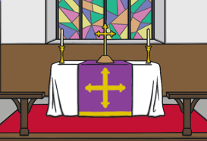
Home Learning Recap - RE
RE – This term we are looking at the Christian Church.
Can you name these 3 important parts of a Christian Church? What are they used for?

Slide 12
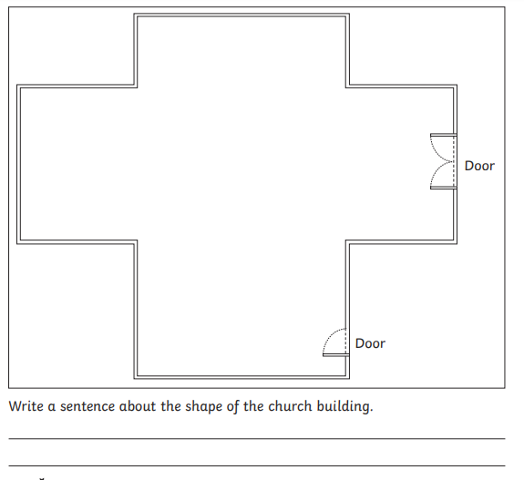
Home Learning Challenge - RE
Not all churches are the same but have the same important features. Can you design a Christian Church and then write about the shape of the building.

Slide 13
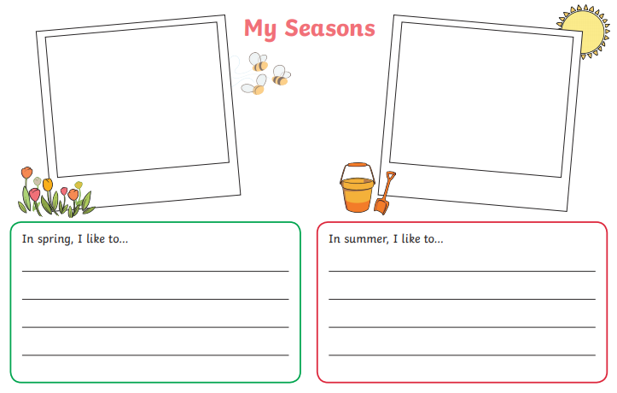
Home Learning Challenge – Science
The Seasons
https://www.youtube.com/watch?v=8ZjpI6fgYSY

Slide 14
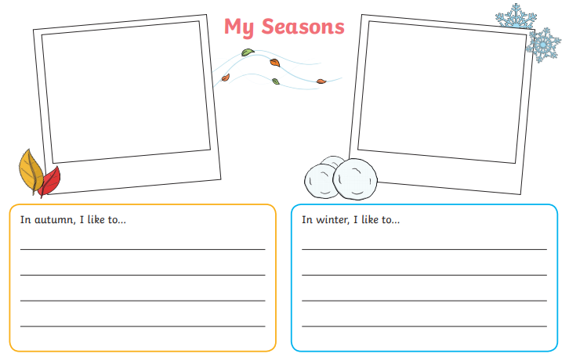
Home Learning Challenge – Science
The Seasons
https://www.youtube.com/watch?v=8ZjpI6fgYSY

Slide 15
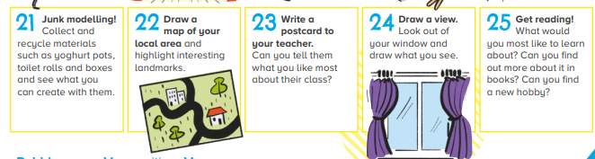
Home Learning –
Non-Screen Activities

