Slide 1
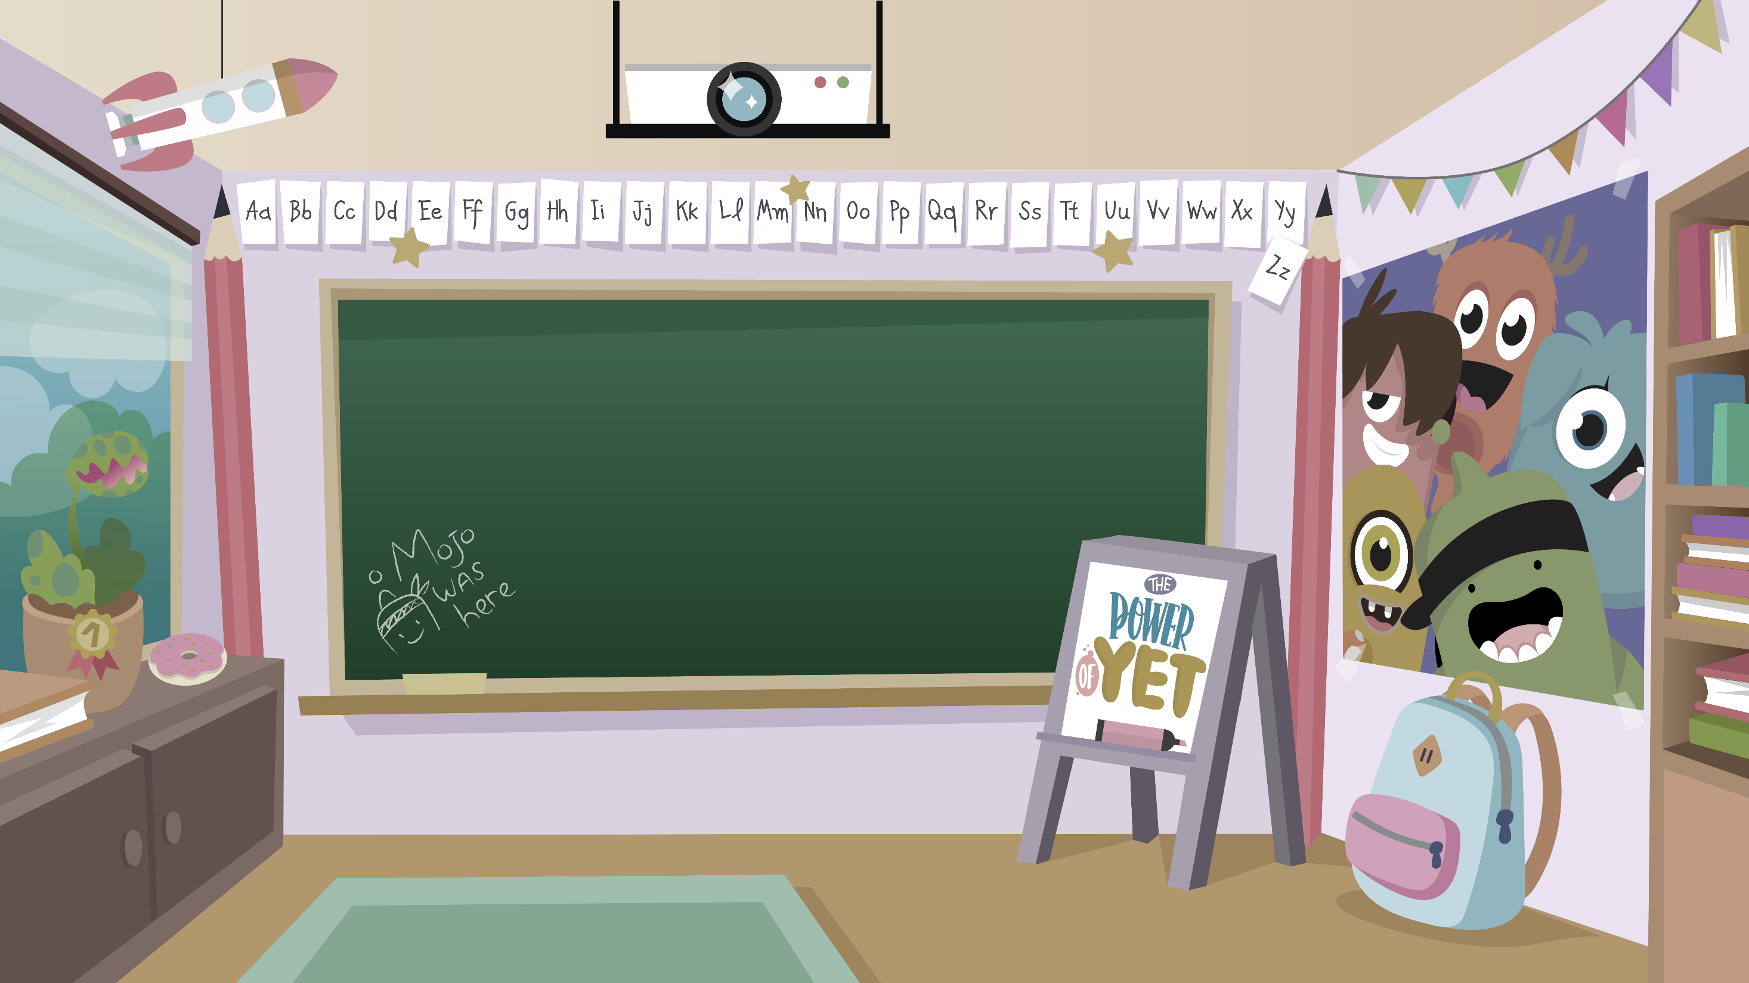
Home Learning activities WC 29.6.20 Year 1 CG Teaching group.
Challenge

Slide 2
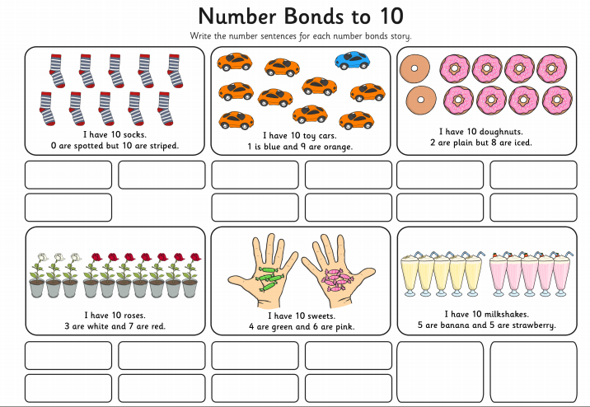
Home Learning Recap - Maths

Slide 3
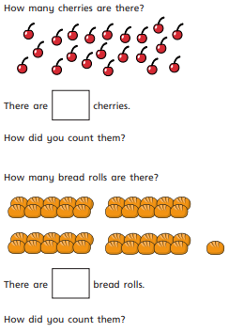
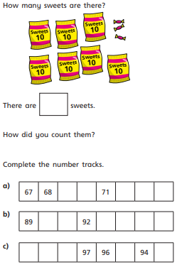
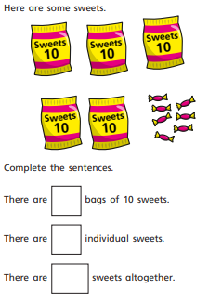
Home Learning Challenges - Maths
This week you will be thinking about numbers up to 100.

Slide 4
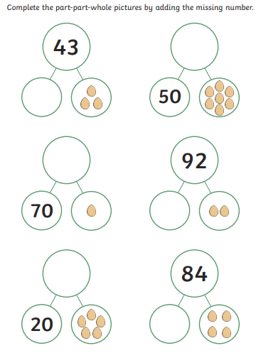
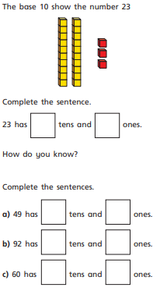
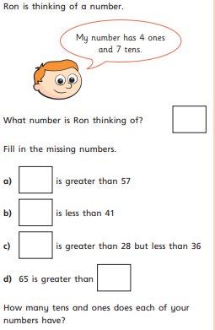
Home Learning Challenges - Maths

Slide 5
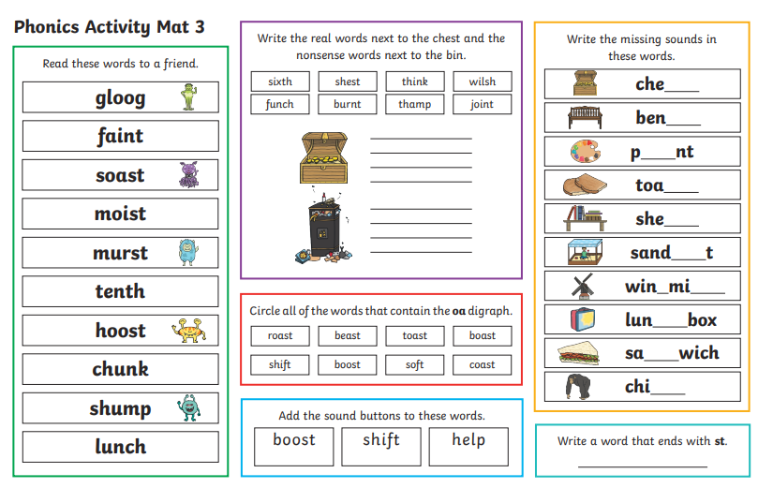
Home Learning Recap - Phonics

Slide 6

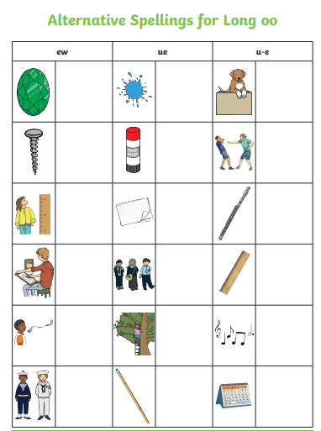
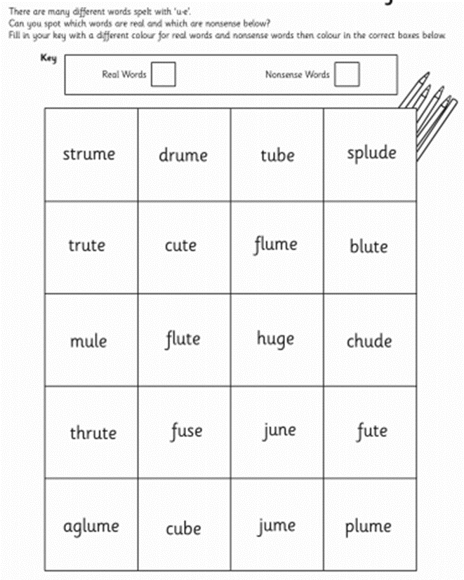
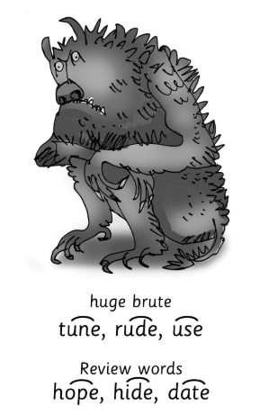
Home Learning Challenges - Phonics
Remember, there are some great videos on Youtube to help. Ruth Miskin Training set 3 speed sounds and spelling lessons are definitely worth while in teaching your child and set 2 are great for recap lessons.

Slide 7
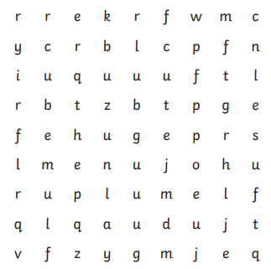
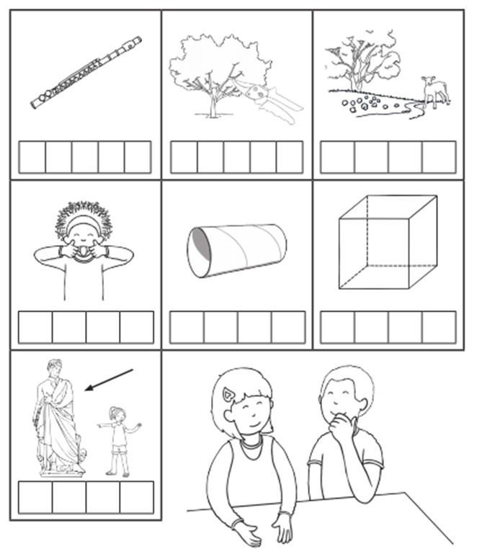
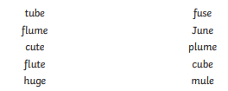
Home Learning Challenges - Phonics

Slide 8
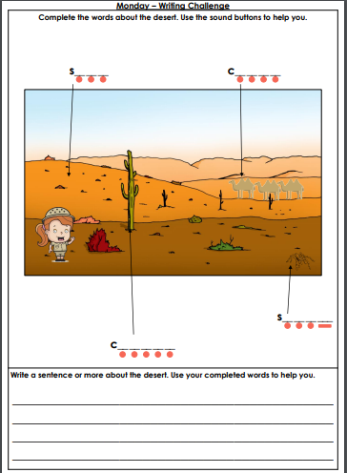
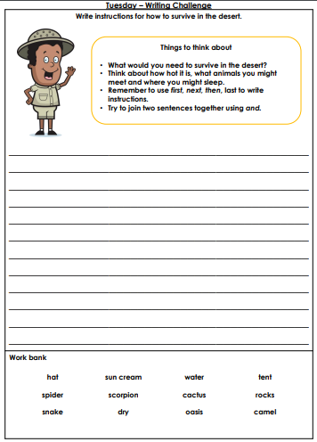
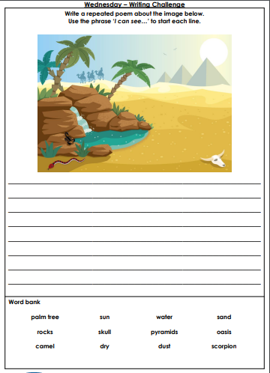
Home Learning Challenges – English

Slide 9
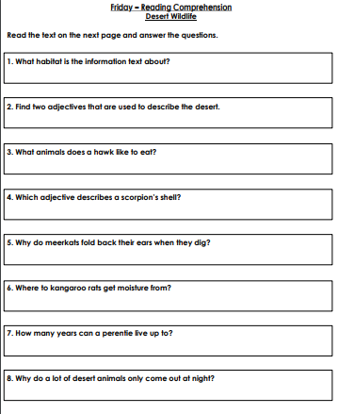
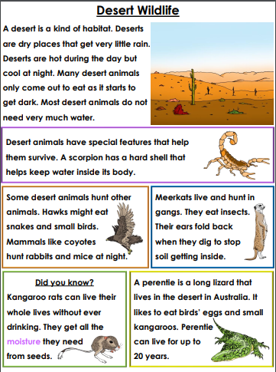
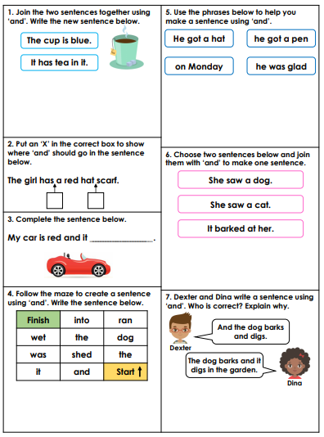
Home Learning Challenges – English

Slide 10
Home Learning Challenge - Spelling
Use look, cover, write, check to learn the suffix words – adding ‘er’ when no change is needed in the root word.
Look | Cover and say | Write and check | Amend errors | Repeat
hunter
buzzer
jumper
fresher
quicker
player
cooker
teacher
floater
walker
looker
faster

Slide 11
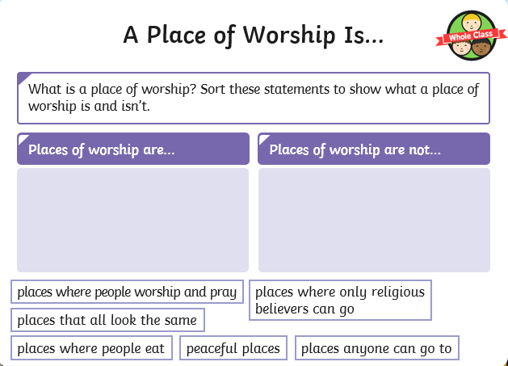
Home Learning Recap - RE
RE – This term we are looking at the Christian Church.

Slide 12
Home Learning Challenge - RE
Think about or research places of worship, and answer these questions.
What words can be used to describe places of worship? E.g. God, community
How do places of worship make people feel? E.g.. calm, peaceful
What kind of things happen in places of worship? E.g. Weddings, baptism
Use your words to create a simple poem or sentences to describe places of worship

Slide 13
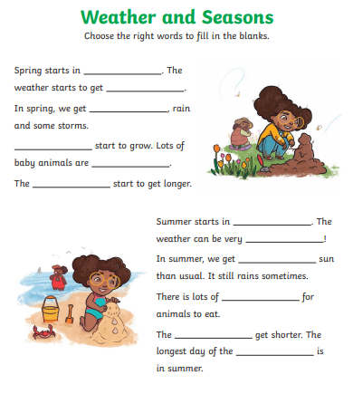

Home Learning Challenge – Science
The Seasons
https://www.youtube.com/watch?v=8ZjpI6fgYSY

Slide 14
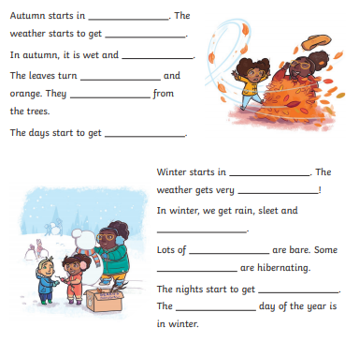

Home Learning Challenge – Science
The Seasons
https://www.youtube.com/watch?v=8ZjpI6fgYSY

Slide 15

Home Learning –
Non-Screen Activities

