Slide 1
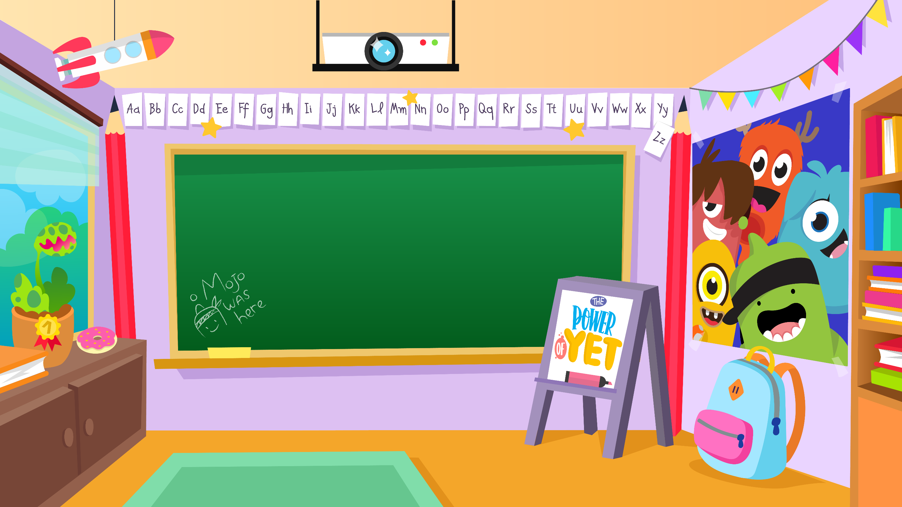
Home Learning activities WC 15.6.20 Teaching group. 1/2 SC and HS
Challenge

Slide 2
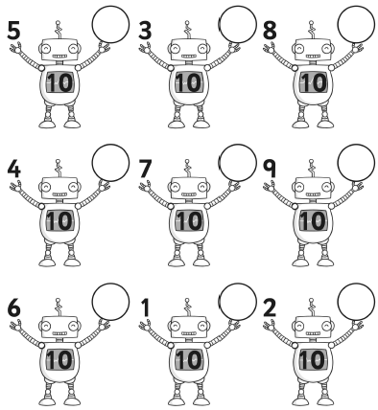
Home Learning Recap - Maths
Can you complete the number bonds to 10?
It is important that we know our bonds to 10 and to be able to speedily recall these.

Slide 3
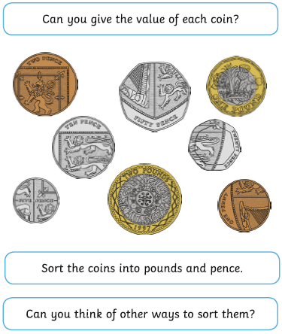
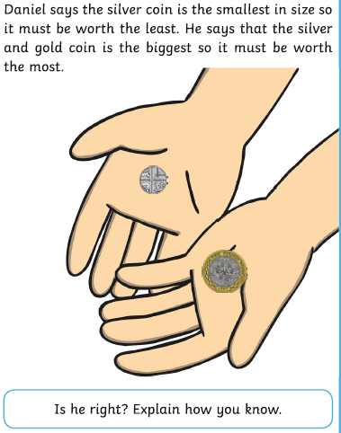
Home Learning Challenges - Maths
Weight/Mass
Children in Year Two should know and use appropriate standard units to estimate and measure mass (kg/g) using scales, thermometers. They should also be able to compare and order mass; record the results using >, < and =
Day 1
Day 2
Challenge
Which coin does Daniel have in his left hand?
How much is it worth?
Is it the lowest value coin?

Slide 4
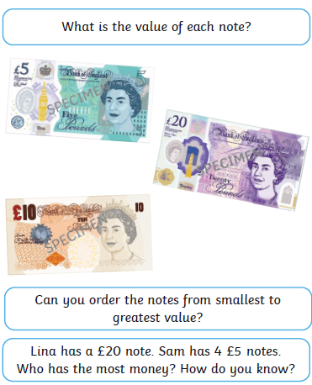
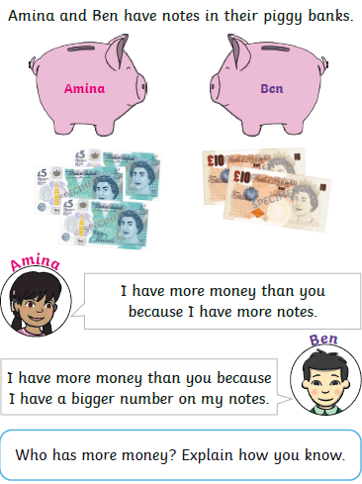
Home Learning Challenges - Maths
Day 3
Day4

Slide 5
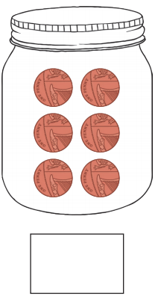
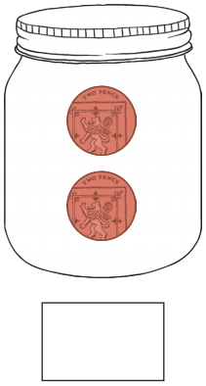
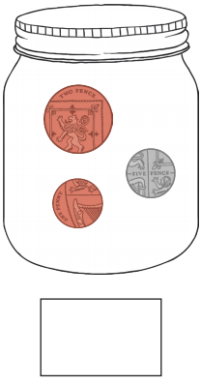
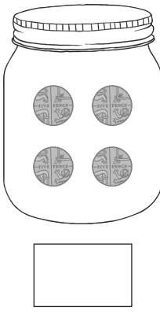
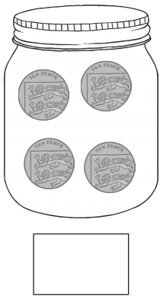
Home Learning Challenges - Maths
Day 5
How much money is in each jar?

Slide 6
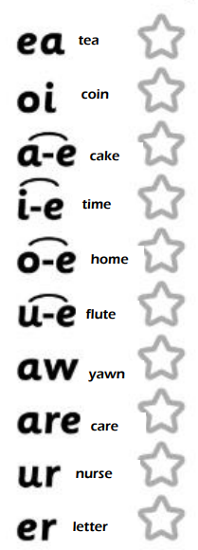
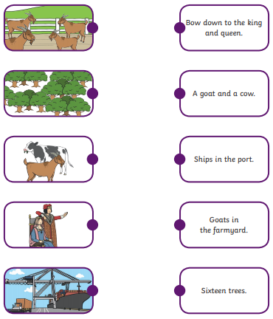
Home Learning Recap - Phonics
Match the picture to the sentence.
Colour the sounds that you know

Slide 7
Home Learning Challenges - Phonics
Remember, there are some great videos on Youtube to help. Ruth Miskin Training set 3 speed sounds and spelling lessons are definitely worth while in teaching your child and set 2 are great for recap lessons.
Here is the foil.
Will you boil the potatoes?
There is soil on the ground.
Look at the coins.
Can I go to the toilet?
There is lots of noise.
Point to the stars.
Find the words that contain the ‘oi’ sound. Colour them in when you find them.

Slide 8
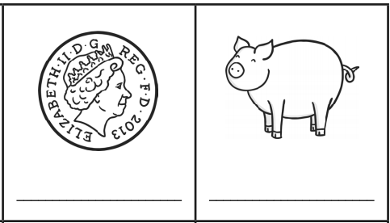
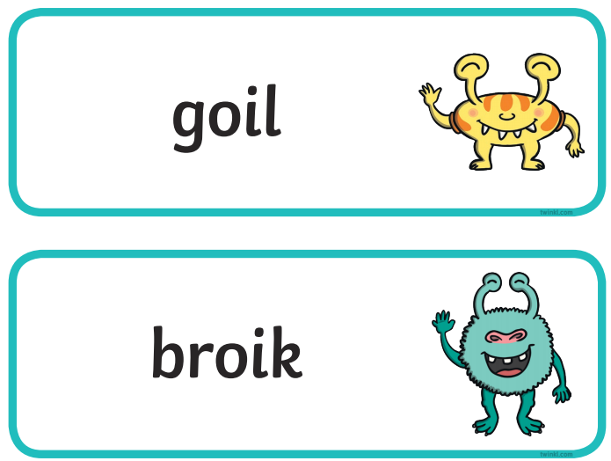
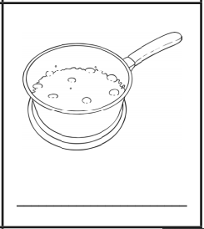
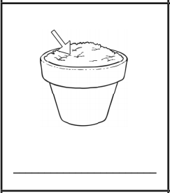
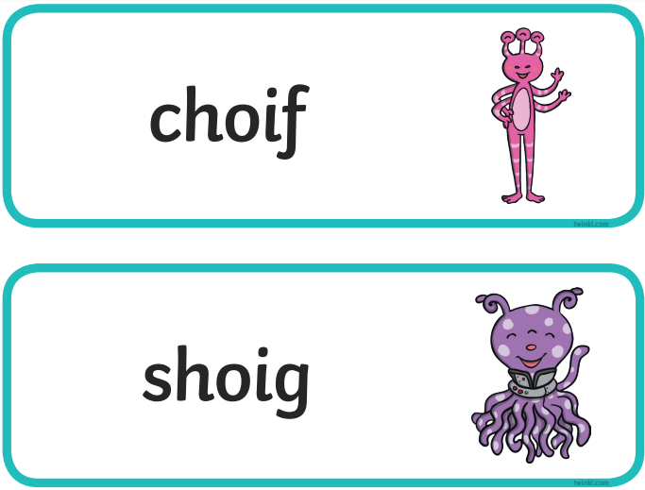
Home Learning Challenges - Phonics
Use fred fingers to spell the ‘oi’ word
Can you read the alien words?

Slide 9
Home Learning Challenges – English
Write a letter.
Can you write a diary of your weeks activities, Draw a picture that clearly shows what you are doing each day. Remember to include your finger spaces, capital letters and full stops. Can you include the word ‘and’ and ‘because’ in your writing?

Slide 10
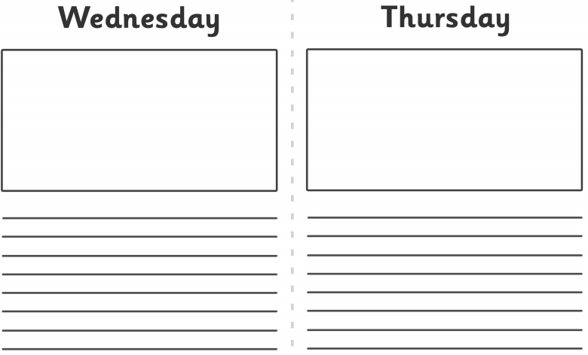
Home Learning – English

Slide 11
Home Learning Challenges – English example
Remember your:
Capital letters
Full Stops
Finger Spaces
Fred Fingers
‘Because’ ‘and’
On Monday I woke up and went downstairs for my breakfast. I then spent time completing my school work with my Mum to help me. I then had some soup for my dinner with some bread. After lunch I went for a walk by the canal with my family because we wanted to have some exercise. At the canal I saw some ducks and a massive swan.

Slide 12
Home Learning Challenge - Spelling
Use look, cover, write, check to learn the spelling rules for the sound ‘or’ in words using ‘al’.
Look | Cover and say | Write and check | Amend errors | Repeat
Right
Bright
Light
Night
Fright
Tight
The
To
Do
Said

Slide 13
Home Learning Recap - RE
RE – We are looking at the religion Islam, and how and why Muslims celebrate and worship.
Can you remember what the answer to these questions?
Where was Islam founded? Saudi Arabia.
What is the name of their God? Allah
Who was the founded of Islam? Muhammed (Peace be upon him)
What is the name of the Holy Book? The Qu’ran

Slide 14
Home Learning Challenge - RE
RE – We are going to be looking at stories from The Qu’ran.
Watch the following clip about the story of Prophet Isa:
https://www.youtube.com/watch?v=S-0oPjtxeMs
What was the Prophet called?
What Bible story is this similar to? How?
How are they similar?
How are they differesnt?

Slide 15
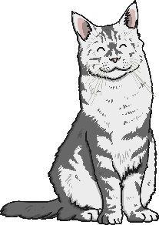
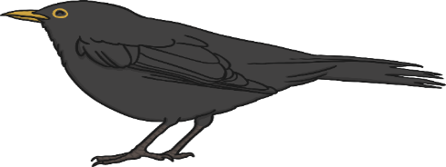
Home Learning Challenge - Science
What is a food chain?
A food chain shows how each animal gets its food. Food chains are one of the ways that living things depend on each other to stay alive.
Each food chain starts with a green plant.
Green plants are called producers because they produce their own food.
All animals are called consumers because they consume their food by eating plants and other animals.
Animals that eat other animals are called predators. The animals that they eat are called prey.
predator
producer
consumer
prey

Slide 16
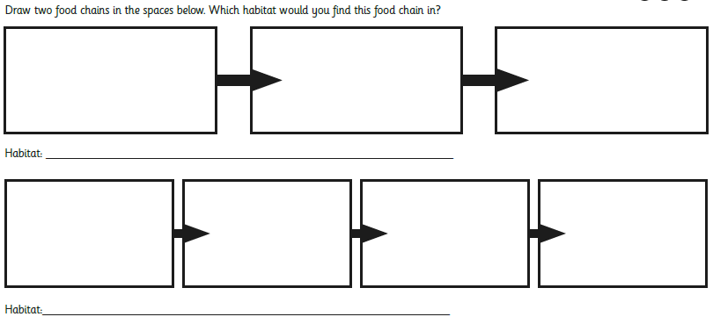
Home Learning Challenge - Science
What is the producer?
What is the consumer?
What is the prey?
Can you remember where green plants get their energy from?
Can you make a food chain that includes you?

Slide 17
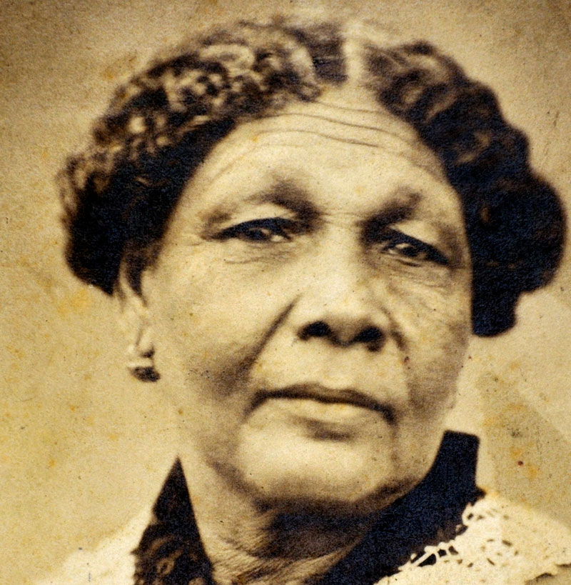
Home Learning Challenge - History
In History we are looking at Mary Seacole.
Research and answer the following questions:
When was Mary Seacole born? When did she die?
Where was she from?
Why is she significant?
Activity:
Create a fact file about Mary Seacole for others to read and learn about her.

Slide 18
Home Learning Challenge - PSHE
Relationships. Friends
Friends are people we like a lot and who we know well. They are people who we enjoy spending time with.
Think quietly about your friends.
What do you like about them?
Why do we need good friends in our lives?
Draw a picture of yourself in the middle of a flower and write the qualities that make you a good friend to others in the petals.

Slide 19
Home Learning- PE

Slide 20
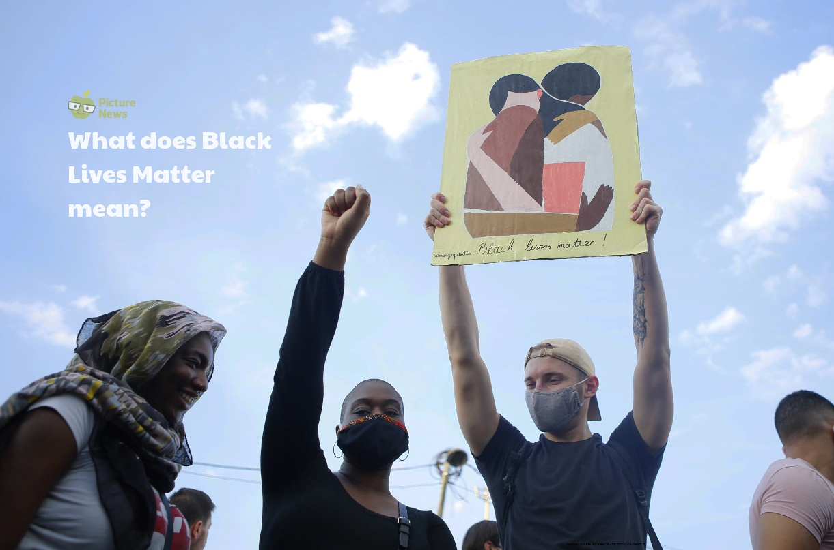
Home Learning
Collective worship from our friend Mr Buckeridge. TodayToday we explore how Jesus meeting with a leper shows us that compassion goes beyond simply feeling for someone, to actually doing something to help. https://www.youtube.com/watch?v=zkgyezVCD3w&list=PLzeI_liQYA2PmAsL2ZlgxrzDRui50S85X&index=8&t=0s
Picture news- please look on our website weekly for the latest picture news.
Challenge
Can you find out about and create a fact file from a person influential to the black civil rights movement e.g. Rosa Parks or Martin Luther King?

Slide 21
Home Learning Non Screen Activities

