Slide 1
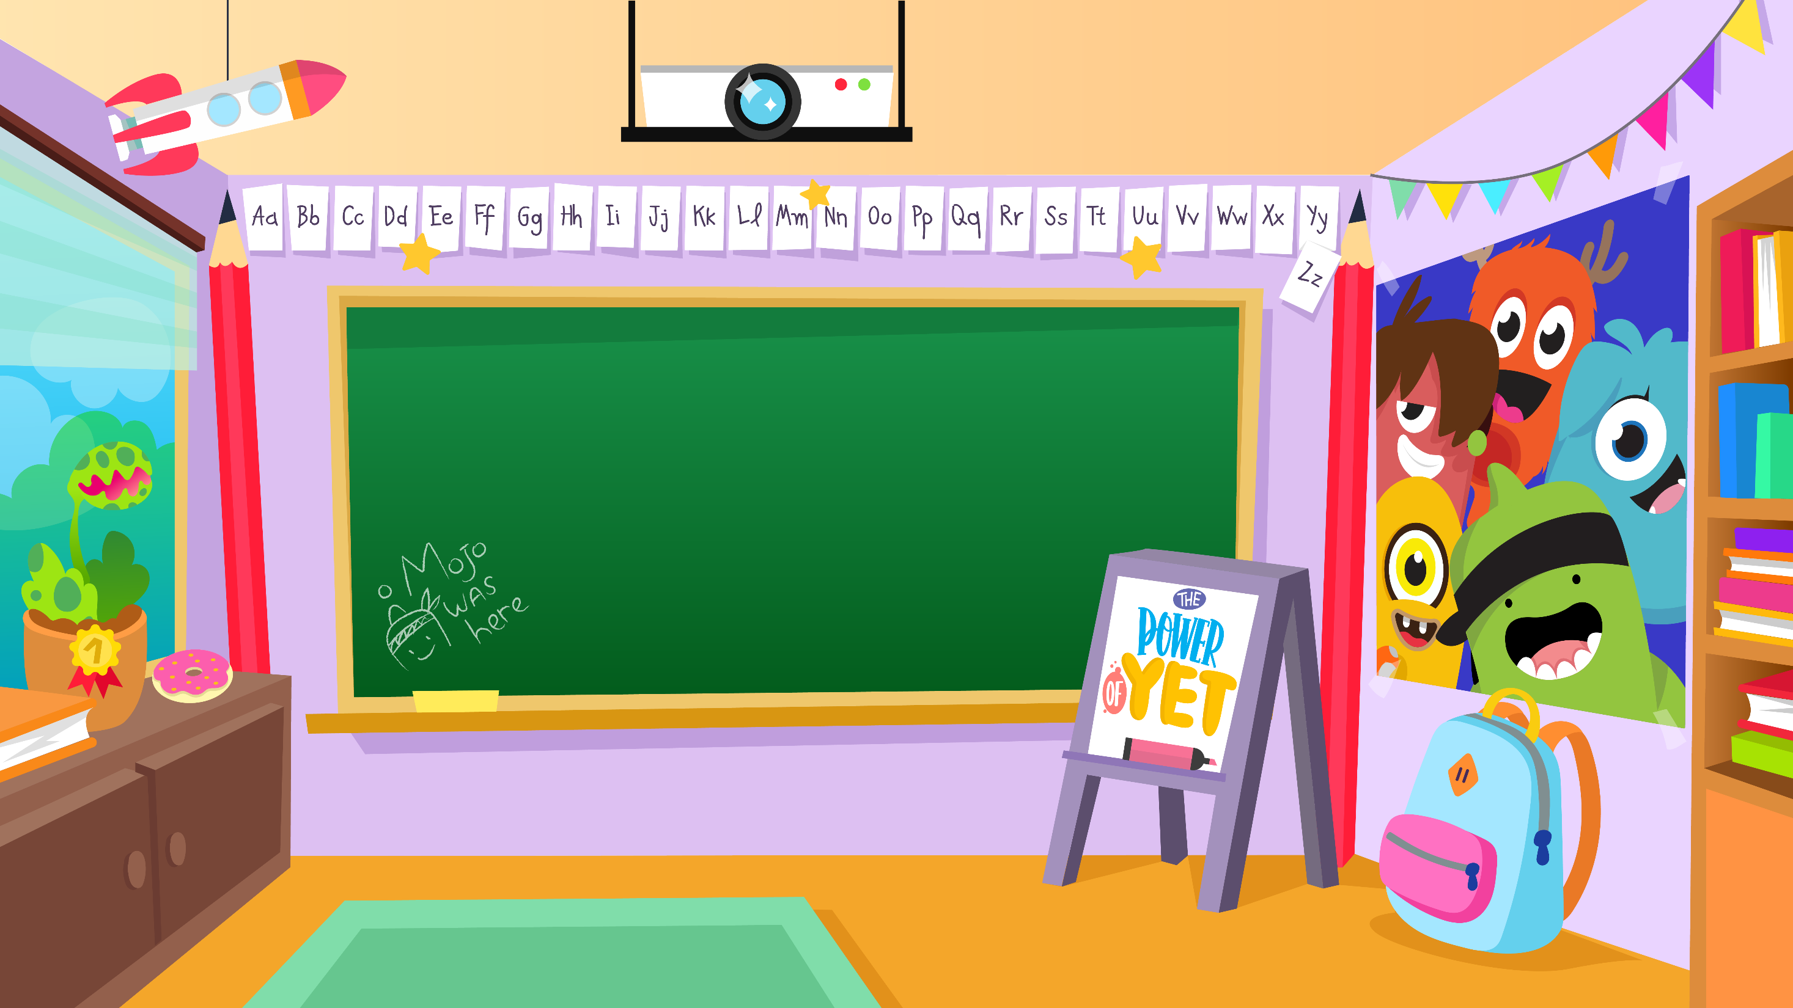
Home Learning activities WC 22.6.20 Year 1/2 SC/HS Teaching group.
Challenge

Slide 2
Home Learning Recap - Maths
Use your knowledge of 3D shapes to solve the problems. Find items around the home and use their shape to help you.

Slide 3
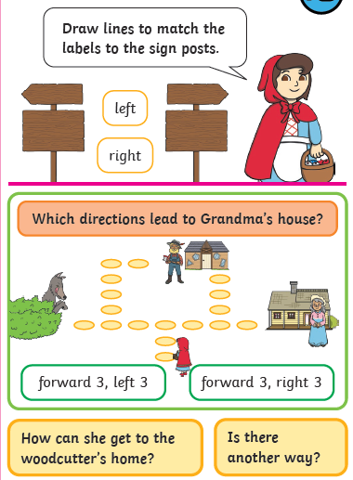
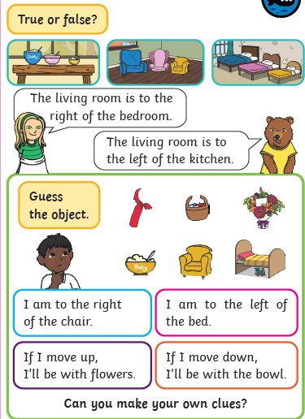
Home Learning Challenges - Maths
Position and Direction
Children should use mathematical vocabulary to describe position, direction and movement. They should be able to describe position, direction and movement, including whole, half, quarter and three-quarter turns
Day 1
Day 2
Challenge

Slide 4
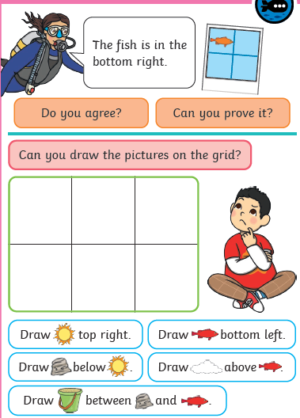
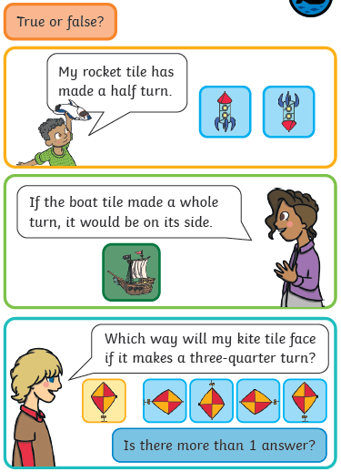
Home Learning Challenges - Maths
Day 3
Day 4
How far has the rocket turned?
What can you use to check?
Do you agree with the boy?
Does it matter which direction it turns?

Slide 5
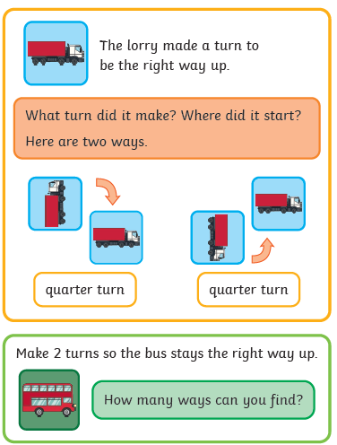
Home Learning Challenges - Maths
Day 5

Slide 6
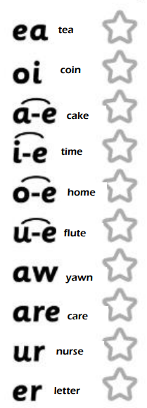
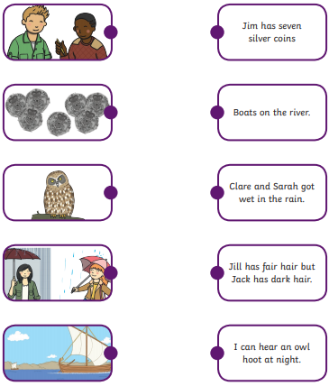
Home Learning Recap - Phonics
Match the picture to the sentence.
Colour the sounds that you know

Slide 7
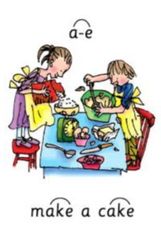
Home Learning Challenges - Phonics
Remember, there are some great videos on Youtube to help. Ruth Miskin Training set 3 speed sounds and spelling lessons are definitely worth while in teaching your child and set 2 are great for recap lessons.
A lion has a mane.
Look at my face.
I want to go to space.
I am packing my case.
Can you tie your laces?
She will win the race.
I made a mess.
I like to eat cake
Find the words that contain the ‘a-e’ sound. Colour them in when you find them.

Slide 8
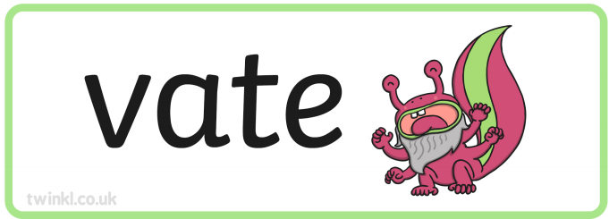
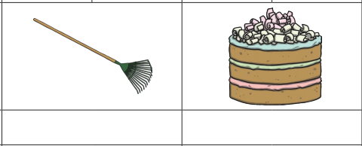
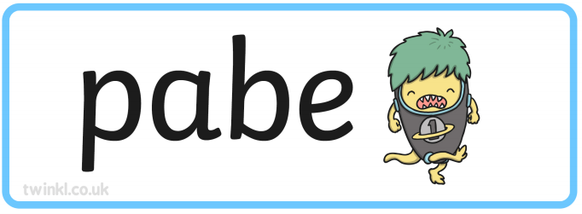
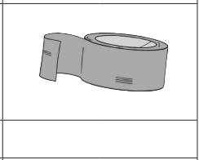
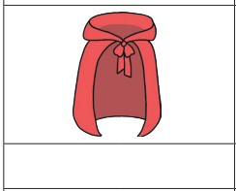
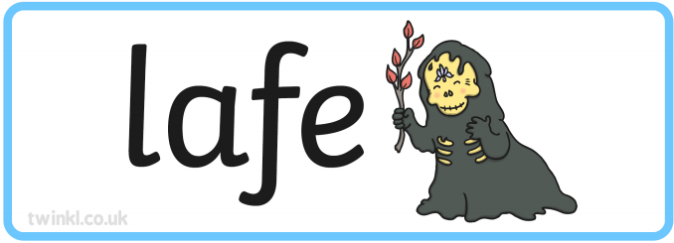
Home Learning Challenges - Phonics
Use fred fingers to spell the ‘oi’ word
Can you read the alien words?

Slide 9
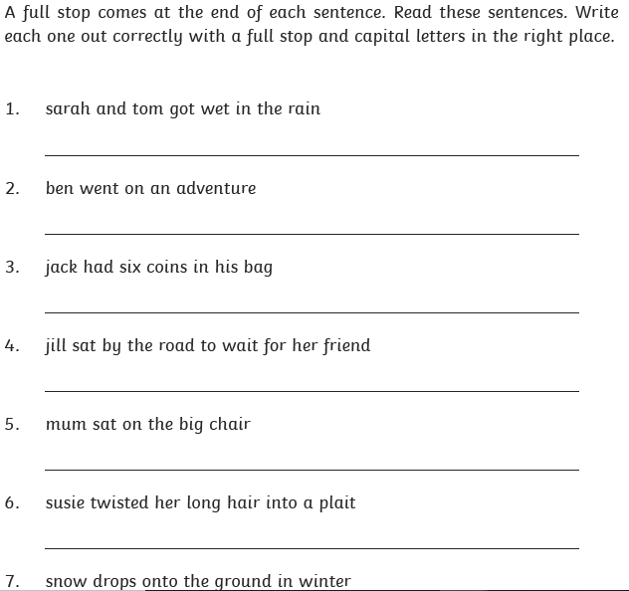
Home Learning Challenges – English
Look at the following images. Write a sentence about each picture and what the characters are doing. Remember your capital letters and full stops.
Remember: Saying your sentence aloud before you write it to check it makes sense

Slide 10
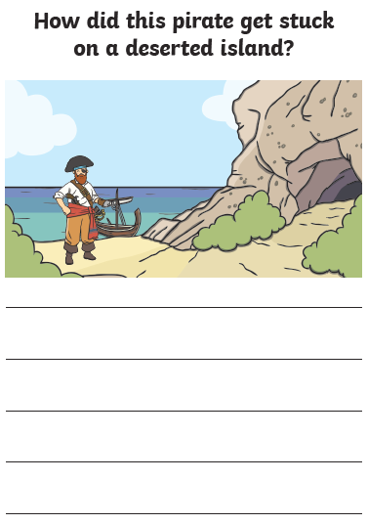
Home Learning Challenges – English
Look at the following images. Write a sentence about each picture and what the characters are doing. Remember your capital letters and full stops.
Remember: Saying your sentence aloud before you write it to check it makes sense

Slide 11
Home Learning Challenge - Spelling
Use look, cover, write, check to learn the spelling rules for the sound ‘or’ in words using ‘al’.
Look | Cover and say | Write and check | Amend errors | Repeat
Badly
Hopeless
Penniless
Happily
Lovely
Joyless
Slowly
Quickly
Careless
Fearless

Slide 12
Home Learning Recap - RE
RE – We are looking at the religion Islam, and how and why Muslims celebrate and worship.
Can you remember what the answer to these questions?
Where was Islam founded? Saudi Arabia.
What is the name of their God? Allah
Who was the founded of Islam? Muhammed (Peace be upon him)
What is the name of the Holy Book? The Qu’ran

Slide 13
Home Learning Challenge - RE
RE – We are going to be looking at stories from The Qu’ran.
Watch the following clip about the story of Prophet Isa:
https://www.youtube.com/watch?v=S-0oPjtxeMs
What was the Prophet called?
What Bible story is this similar to? How?
How are they similar?
How are they differesnt?

Slide 14
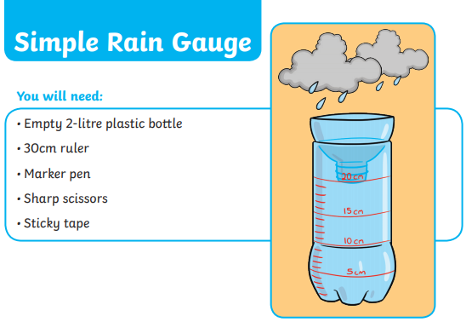
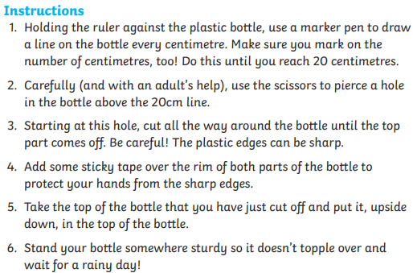
Home Learning Challenge - Science
Leave your rain gauge outside. Which day did it rain the most? Which day did it rain the least? How much rain fell all week?

Slide 15
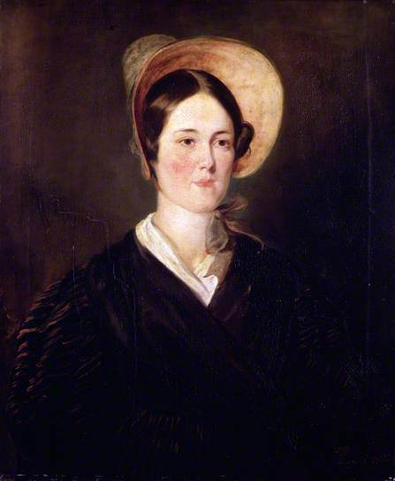
Home Learning Challenge - History
In History we are looking at Grace Darling.
Research and answer the following questions:
When was Grace Darling born? When did she die?
Where was she from?
Why is she significant?
Activity:
Create a fact file about Grace Darling for others to read and learn about her.

Slide 16
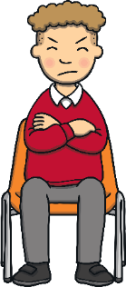
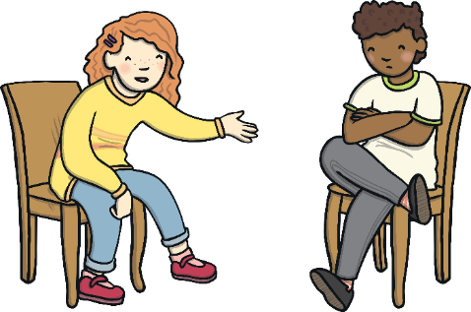
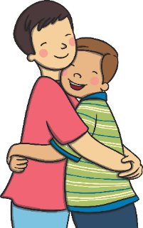
Home Learning Challenge - PSHE
Relationships. Falling out
Falling out and arguments happen but we can choose how we react to things we don’t agree with, or those that make us feel cross and sad.
We can choose to do and say things which help to work the problems out and stop the falling out from getting worse.
We can choose to treat people fairly, even if we are feeling cross with them. This helps things get better and not worse.

Slide 17
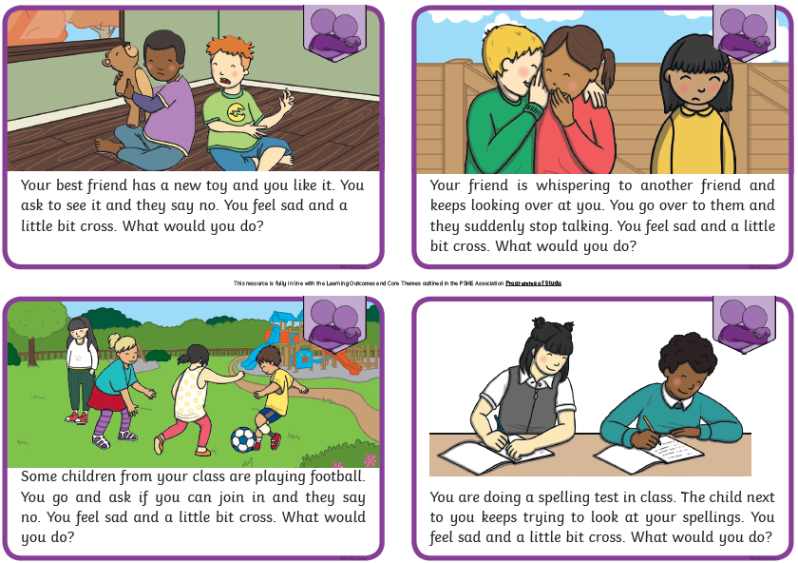
Home Learning Challenge - PSHE
Relationships. Falling out
What would you do in each of these scenarios?
What could you do to stop the falling out or argument getting worse?

Slide 18
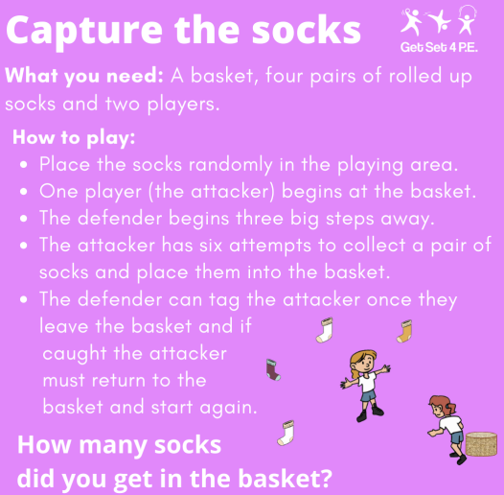
Home Learning- PE

Slide 19
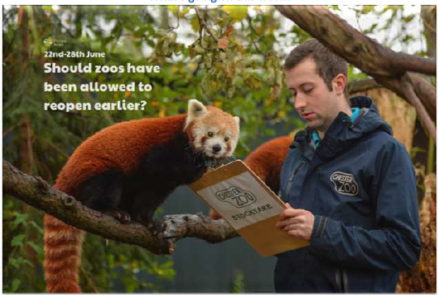
Home Learning
Collective worship from our friend Mr Buckeridge. This week we continue looking at the subject of compassion, this time through the meeting of Jesus with Blind Bartimaeus doing something to help.
https://www.youtube.com/watch?v=sNqhE-XoPKU&feature=youtu.be
Picture news- please look on our website weekly for the latest picture news.
Have you been to a zoo? Did you like it there? If not, would you like to visit a zoo. Why?
Some visitor attractions have not had staff at work during the lockdown period, but zoos have,
why do you think zoos need people working there all the time, even when they’re closed?

Slide 20
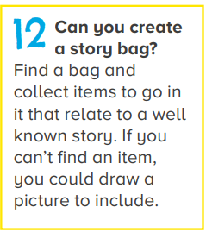
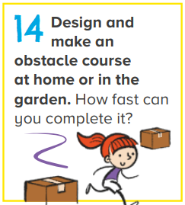
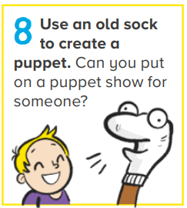
Home Learning Non Screen Activities

