Slide 1
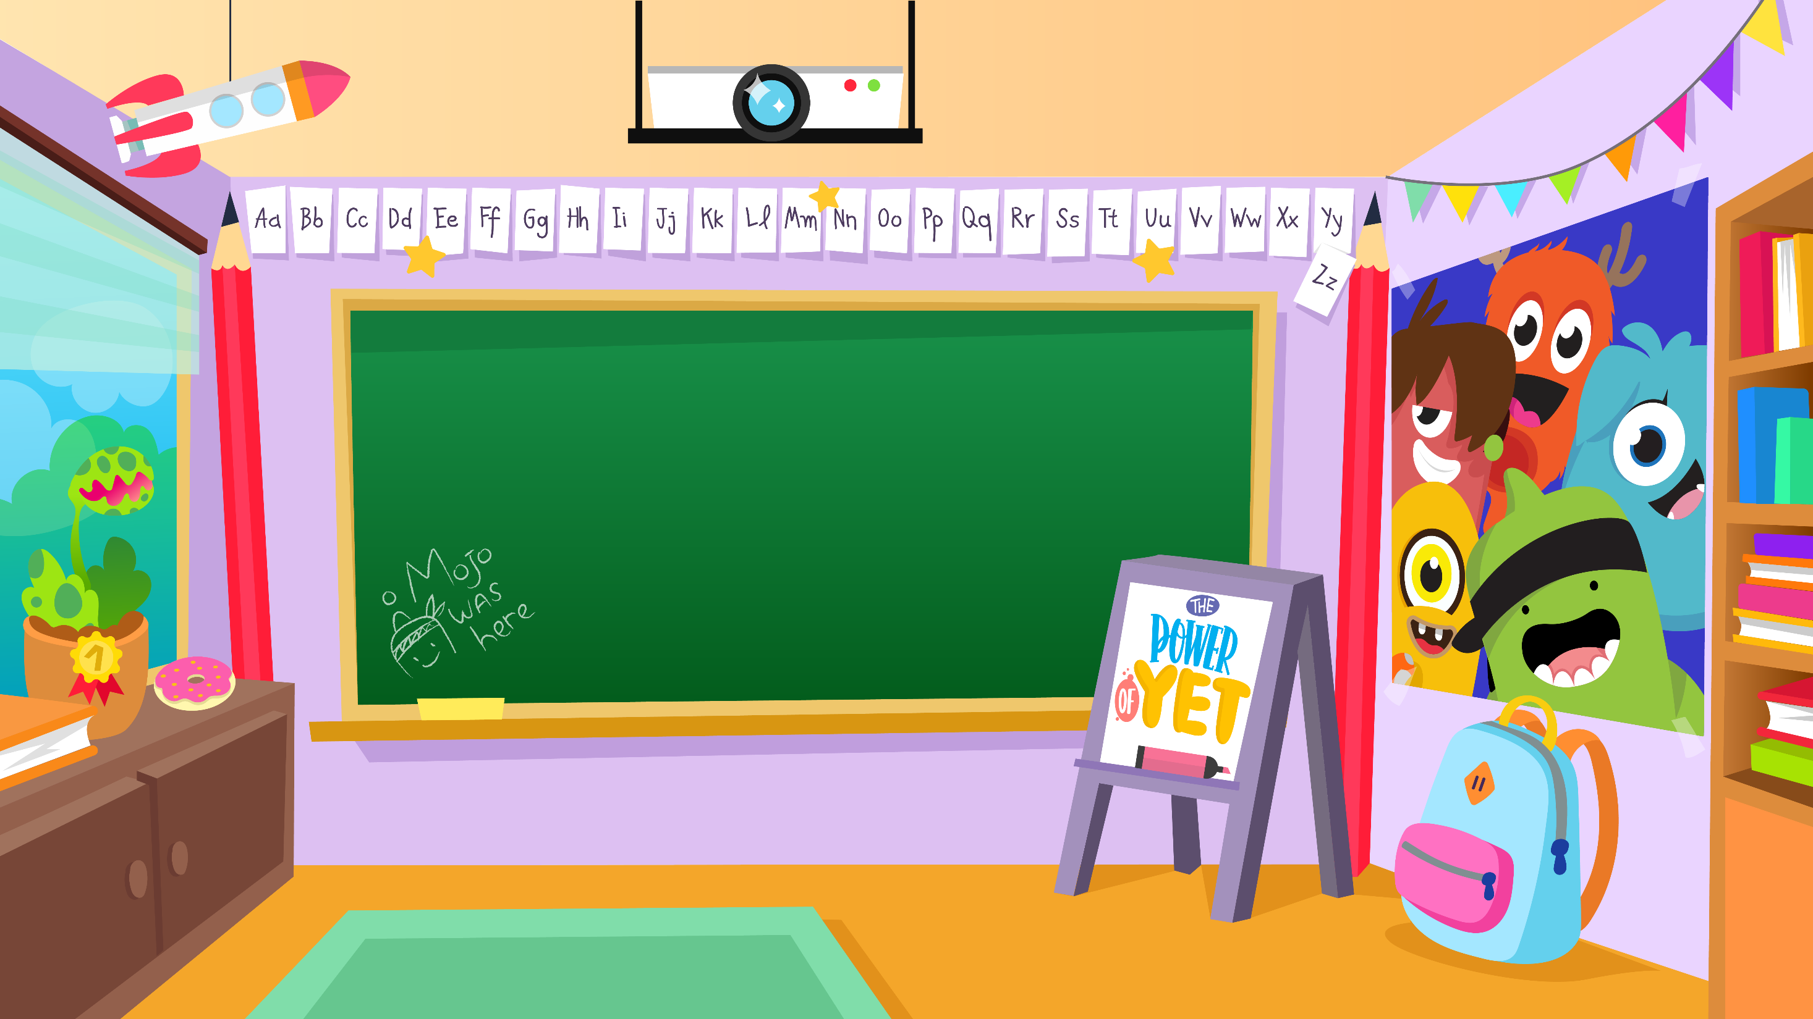
Home Learning Activities WC 8.6.20 Year 1/2 SC HS Teaching group.
Challenge

Slide 2
Hello year 1/2! I hope you have had an excellent week.
Here is this weeks home learning activities.
Don’t forget, there is work available on Purple Mash too and remember to send me some of your work through Class Dojo. I would love to see this!
I hope to see you all soon
Mr Cowan

Slide 3
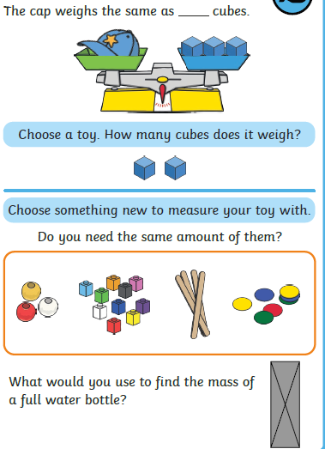
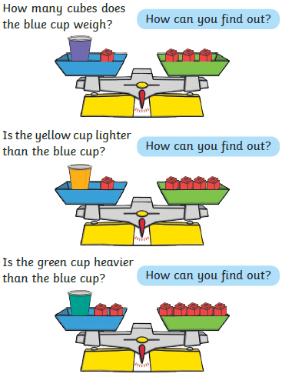
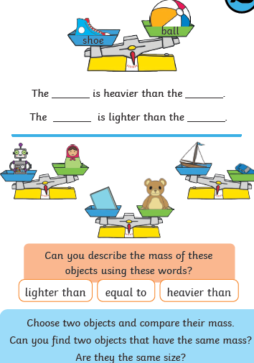
Home Learning Challenges - Maths
Weight/Mass
Children in should be able to compare weights of two or more items. They should use language such as heavier than, lighter than, weighs more than/ less than.
Day 1
Day 2

Slide 4
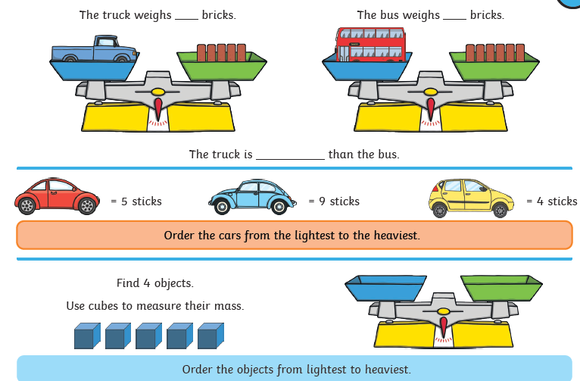
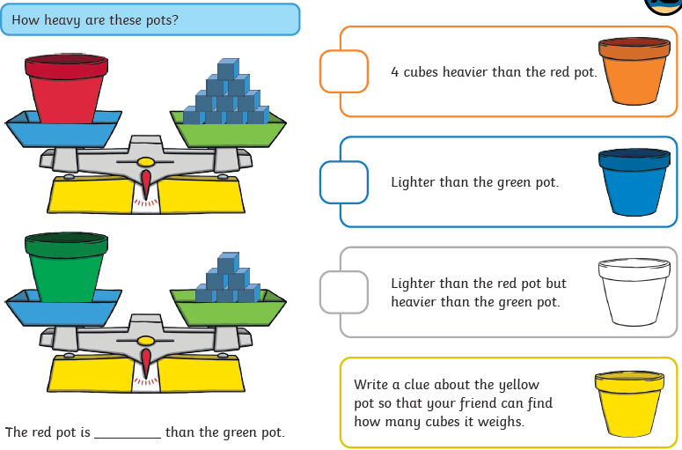
Home Learning Challenges - Maths
Day 4
Day 5

Slide 5
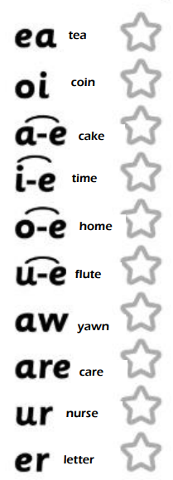
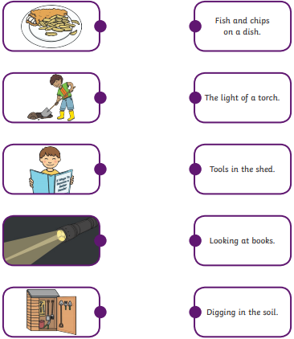
Home Learning Recap - Phonics
Match the picture to the sentence.
Colour the sounds that you know

Slide 6
Home Learning Challenges - Phonics
Remember, there are some great videos on Youtube to help. Ruth Miskin Training set 3 speed sounds and spelling lessons are definitely worth while in teaching your child and set 2 are great for recap lessons.
At least we can eat meat as a treat.
We can sit on a seat and read books by the sea.
Can a sheep repeat a beat?
I can her a dream but what does it mean?
Some seals steal jeans and others drink tea.
We will eat green beans and aspe at the feast.
Jean will clean the flea if he says please.
Find the words that contain the ‘ea’ sound. Colour them in when you find them.

Slide 7
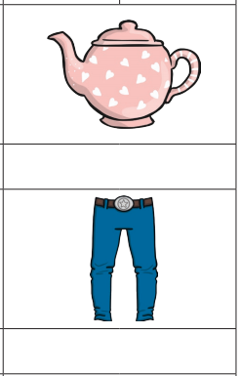
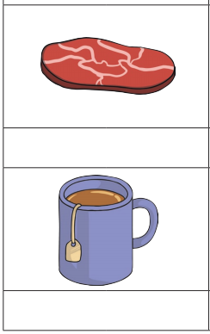
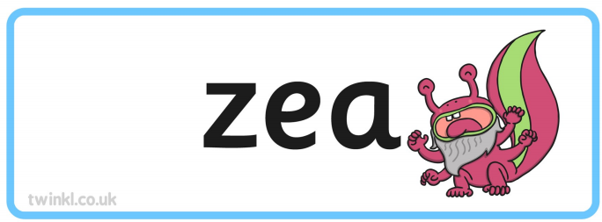
Home Learning Challenges - Phonics

Slide 8
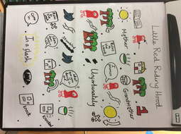
Home Learning Challenges – English
Retell a story.
Watch this video on Hansel and Gretal https://www.youtube.com/watch?v=ELbcakxFvfc
Can you retell this traditional tale?
Day 1 –Create a story map for the tale of Hansel and Gretal.
Day 2 – Verbally build each of your pictures into a sequence of sentences. Include adjectives and conjunctions (because, and). Draft the first half of your story map. Re-read to check your work makes sense.
Day 3 – The same as Day 2 for the second half of your story. . Make sure you have the ending to the story.
Day 4 – Edit and improve your sentences, Check your spelling, your sentences make sense, punctuation and conjunctions.
Day 5 – Publish, write up your story retell in neat! Copy your edited draft using your best handwriting. Save your work to show me.
A story map for Little Red Riding Hood.

Slide 9
Home Learning Challenges – English example
Retell a traditional tale – here is the start of my story retell for Little Red Riding Hood. I have highlighted in red important writing features.
Little Red Riding Hood went to visit her Grandmother and she took a basket of food with her. On her way, Little Red Riding Hood met a wolf who asked where she was going. The wolf ran to Grandmother’s house because he wanted to eat them both.
Little Red Riding Hood knocked on the door and went inside. Little Red Riding Hood went over to Grandmother’s bed. “Oh Granny, what big ears you have,” she said. “All the better to hear you with,” answered the wolf.
“Oh Granny, what big eyes you have,” said Little Red Riding Hood. “All the better to see you with,” replied the wolf.
Oh Granny, what big teeth you have,” said Little Red Riding Hood. “All the better to eat you with,” said the wolf.
Little Red Riding Hood ran away because she knew it was the wolf in her grandmother’s bed. A woodcutter was nearby. The woodcutter hit the wolf over the head. The wolf ran away and Little Red Riding Hood never saw him again.

Slide 10
Home Learning Challenge - Spelling
Use look, cover, write, check to learn the spelling rules for the sound ‘or’ in words using ‘al’.
Look | Cover and say | Write and check | Amend errors | Repeat
Car
Start
Park
Arm
Garden
Artist
Star
Are
Were
Our

Slide 11
Home Learning Recap - RE
RE – We are looking at the religion Islam, and how and why Muslims celebrate and worship.
Can you remember what the answer to these questions?
Where was Islam founded? Saudi Arabia.
What is the name of their God? Allah
Who was the founded of Islam? Muhammed (Peace be upon him)
What is the name of the Holy Book? The Qu’ran

Slide 12
Home Learning Challenge - RE
RE – We are going to be looking at stories from The Qu’ran.
Activity:
Retell the story using the comic strip below.
Watch the following clip about the story of Prophet Nuh:
https://www.youtube.com/watch?v=d2D6WuKlymM
What was the Prophet called?
What did Allah ask the Prophet to do?
What did he take on the ship with him?
What Bible story is this similar to? How?

Slide 13
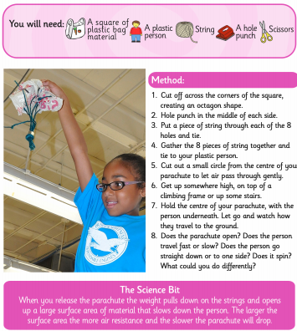
Home Learning Challenge - Science
Can you have a go at this experiment?
Can you write down the difference in using different size bags?
Why do you think this difference occurs?
Can you predict (have a good guess) at what would happen if you used a heavier toy figure?

Slide 14
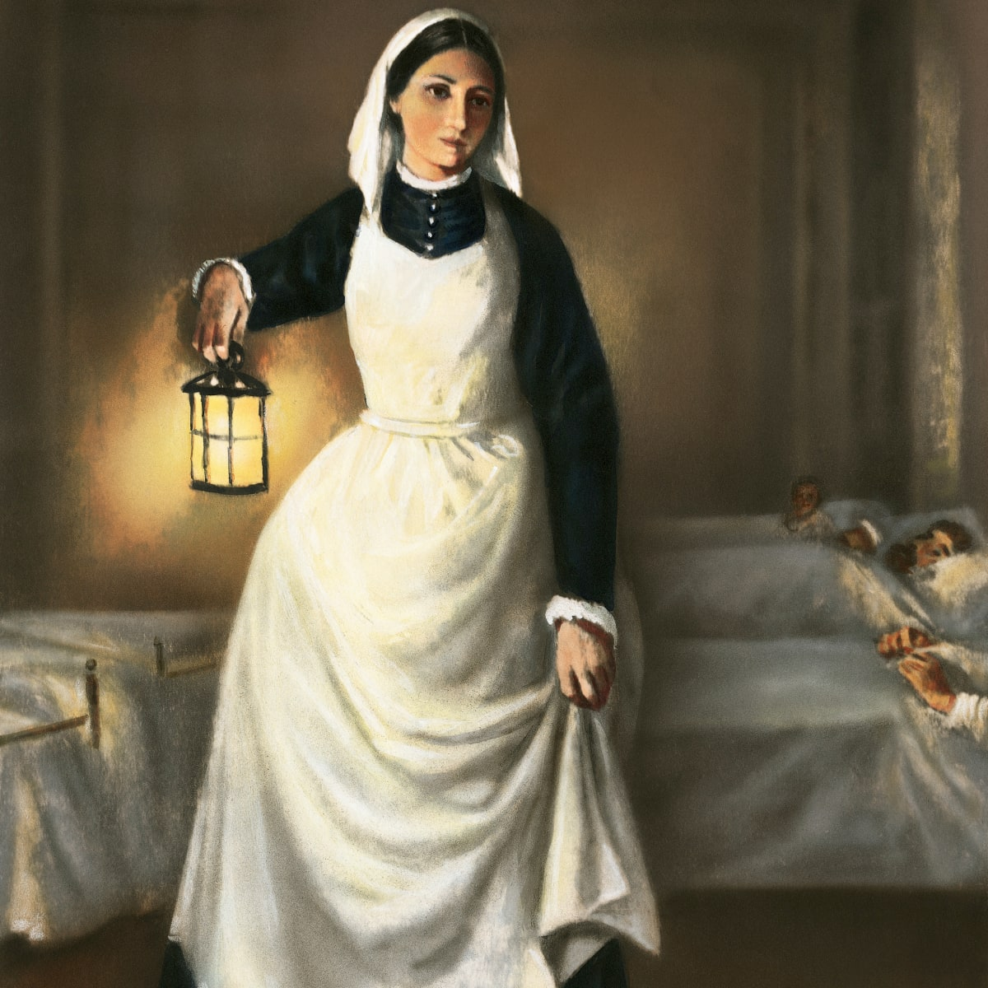
Home Learning Challenge - History
In History we are looking at Florence Nightingale.
Research and answer the following questions:
When was Florence Nightingale born? When did she die?
Where was she from?
Why is she significant?
Activity:
Create a fact file about Florence Nightingale for others to read and learn about her.

Slide 15
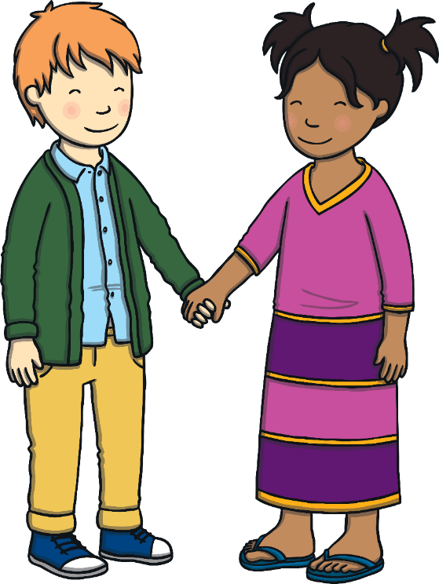
Home Learning Challenge - PSHE
Relationships. Differences and Similarities
List the ways that you are different to and the same as other people.
Would life be as fun if we all looked the same and thought the same things?
What could you do if you see discrimination happening? Who could you tell at school, at home, or in the community?

Slide 16
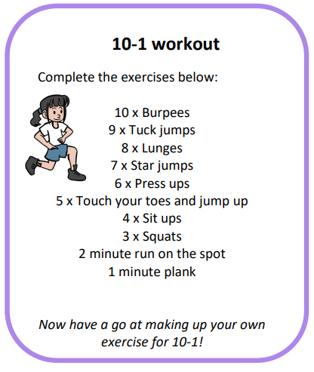
Home Learning- PE

Slide 17
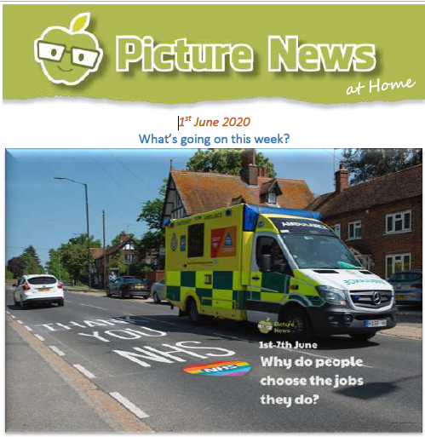
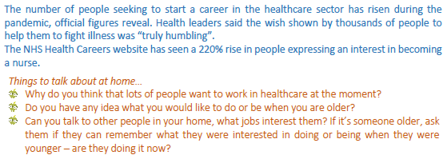
Home Learning
Collective worship from our friend Mr Buckeridge. Today, we briefly revisit the Good Samaritan story, the Samaritan Woman and Angola as we try to understand what our attitude should be towards those from other places. https://www.youtube.com/watch?v=Ct-hxU9Tl6Q&list=PLzeI_liQYA2PmAsL2ZlgxrzDRui50S85X&index=2&t=7s
Picture news- please look on our website weekly for the latest picture news.

Slide 18
Home Learning Non Screen Activities

