Slide 1
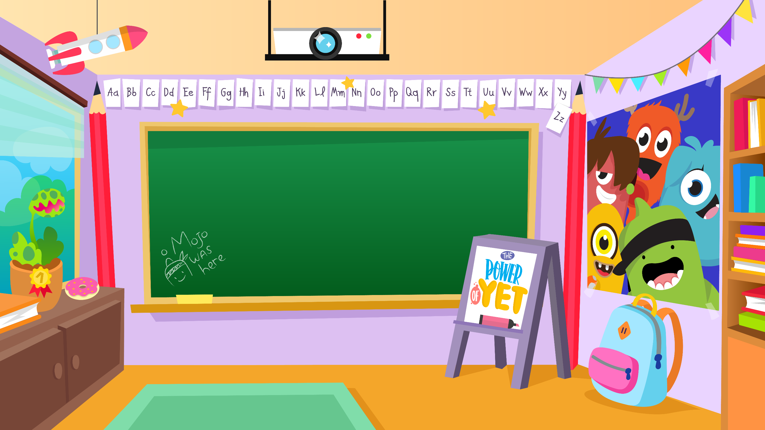
Home Learning activities WC 22.6.20 Year 2 AC Teaching group.
Challenge

Slide 2
Home Learning Recap - Maths
Use your knowledge of division and multiplication to find the answers

Slide 3
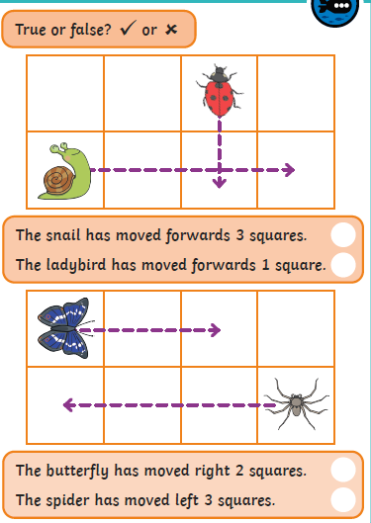
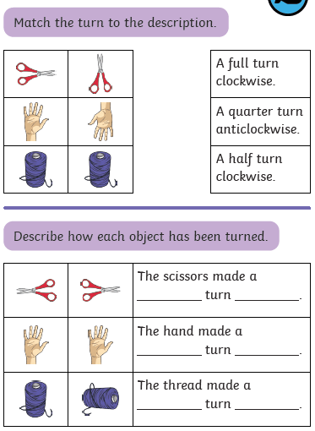
Home Learning Challenges - Maths
Position and Direction
Children in Year Two should use mathematical vocabulary to describe position, direction and movement, including movement in a straight line and distinguishing between rotation as a turn and in terms of right angles for quarter, half and three-quarter turns (clockwise and anti-clockwise)
Day 1
Day 2
Challenge
What does clockwise mean?
What does anti-clockwise mean?
How else could the object have been turned?

Slide 4
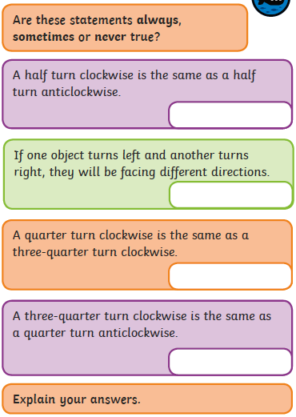
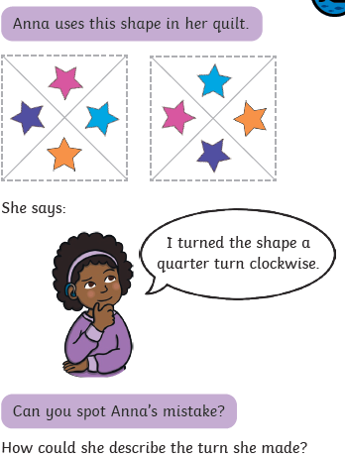
Home Learning Challenges - Maths
Day 3
Day 4
How far has the shape been turned?
How would the shape look if Anna was correct?

Slide 5
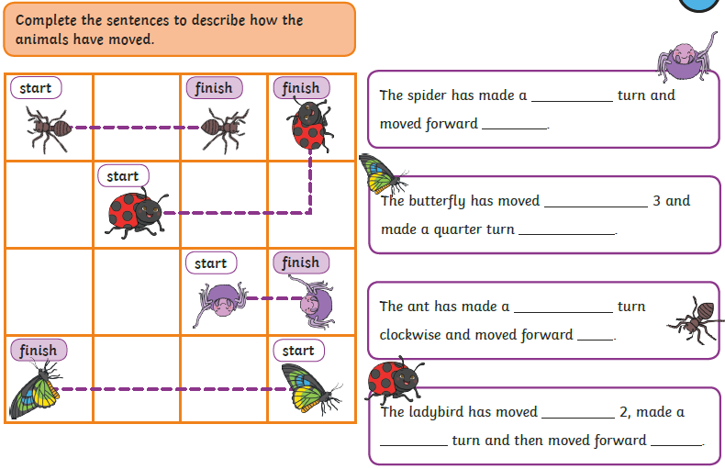
Home Learning Challenges - Maths
Day 5

Slide 6
Home Learning Challenges – English
Create a shape poem
Can you create a shape poem all about summer. Think about what you like about summer, what can you do in summer?
A shape poem is a poem that describes an object, person or animal.
The special thing about a shape poem is that the words of the poem form the shape of the object, person or animal being described.
Shape poems don’t have to rhyme!
Shape poems can use full stops and capital letters like sentences.
Shape poems often use alliteration or similes.
Day 1 – Create an ideas map for what you wish to include in your poem
Day 2 – Verbally build each of your ideas into a sequence of sentences. Include adjectives, feelings, conjunctions, commas in a list and suffixes (e.g. amazement, hopeless) Draft the poem. Re-read to check your work makes sense.
Day 3 – The same as Day 2 for the second half of your poem.
Day 4 – Edit and improve your sentences, Check your spelling, your sentences make sense, punctuation and conjunctions.
Day 5 – Publish, write up your poem in neat! Copy your edited draft using your best handwriting. Save your work to show me.

Slide 7
Home Learning Challenges – English example
Choose or create your own summer shape poem

Slide 8
Home Learning Challenges – English example
Lick!
a thousand
Have a look at the shape poem that I created all about my favourite summer ice-cream.
coloured jewels
glistening in the sun,
swept aside to dance and waltz on my tongue
Strawberry sauce oozes like lava down
sweet slopes.
A mountain
melting,
falling
down…
down…
down.
Lick!
Ah!

Slide 9
Home Learning Challenge - Spelling
Use look, cover, write, check to learn the spelling rules for the sound ‘or’ in words using ‘al’.
Look | Cover and say | Write and check | Amend errors | Repeat
Badly
Hopeless
Penniless
Happily
Lovely
Joyless
Slowly
Quickly
Careless
Fearless

Slide 10
Home Learning Recap - RE
RE – We are looking at the religion Islam, and how and why Muslims celebrate and worship.
Can you remember what the answer to these questions?
Where was Islam founded? Saudi Arabia.
What is the name of their God? Allah
Who was the founded of Islam? Muhammed (Peace be upon him)
What is the name of the Holy Book? The Qu’ran

Slide 11
Home Learning Challenge - RE
RE – We are going to be looking at Islam and their traditions.
A baby is born!
When a baby is first born in a Muslim family, the first thing the baby hears is the call to prayer - Adhan. This is whispered into the baby’s right ear. Anyone can whisper this to the child but it is usually the baby’s father. The command to worship is whispered into the baby’s left ear.
The first taste experienced by the new born baby is some sweet liquid (such as date juice) put into the mouth. This is so that the baby grows up to have a sweet nature.
Talk to your grown ups.
How is this different to when you were born?
What happened when you were born?
What were the first words you heard?
What did you taste first?
How is this different to Islam?
Do you know what the first sounds you heard when you were born were?
Do you know what the first thing you tasted was?

Slide 12
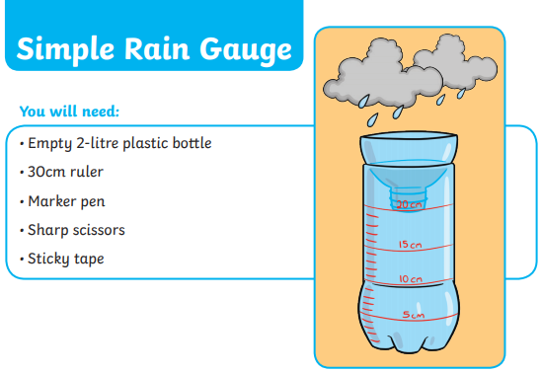
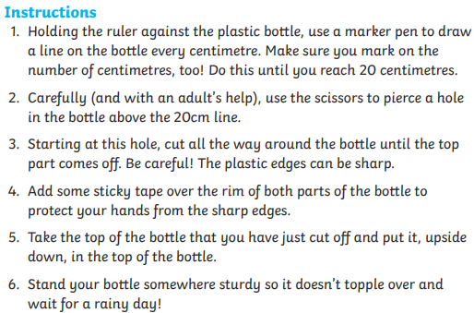
Home Learning Challenge - Science
Leave your rain gauge outside. Which day did it rain the most? Which day did it rain the least? How much rain fell all week?

Slide 13
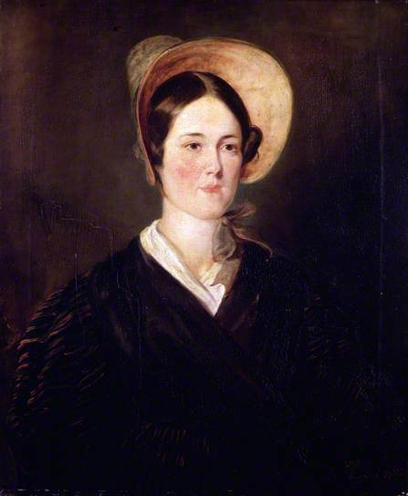
Home Learning Challenge - History
In History we are looking at Grace Darling.
Research and answer the following questions:
When was Grace Darling born? When did she die?
Where was she from?
Why is she significant?
Activity:
Create a fact file about Grace Darling for others to read and learn about her.

Slide 14
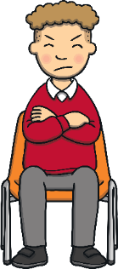
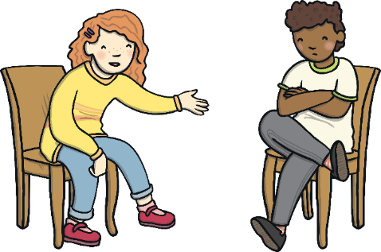
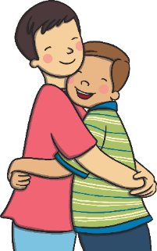
Home Learning Challenge - PSHE
Relationships. Falling out
Falling out and arguments happen but we can choose how we react to things we don’t agree with, or those that make us feel cross and sad.
We can choose to do and say things which help to work the problems out and stop the falling out from getting worse.
We can choose to treat people fairly, even if we are feeling cross with them. This helps things get better and not worse.

Slide 15
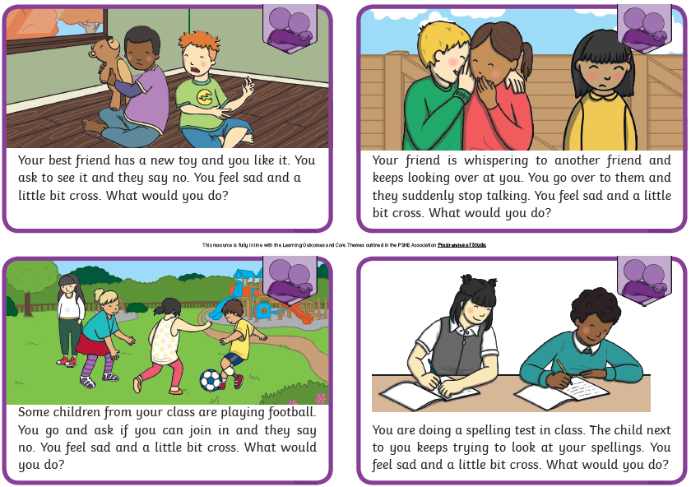
Home Learning Challenge - PSHE
Relationships. Falling out
What would you do in each of these scenarios?
What could you do to stop the falling out or argument getting worse?

Slide 16
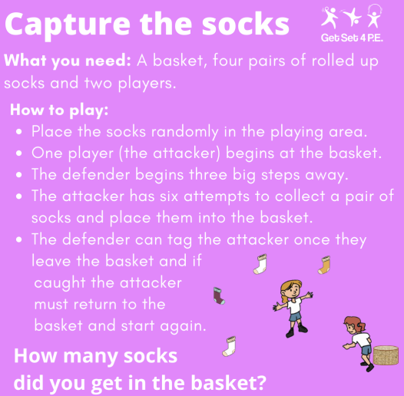
Home Learning- PE

Slide 17
Home Learning
Collective worship from our friend Mr Buckeridge. This week we continue looking at the subject of compassion, this time through the meeting of Jesus with Blind Bartimaeus doing something to help.
https://www.youtube.com/watch?v=sNqhE-XoPKU&feature=youtu.be
Picture news- please look on our website weekly for the latest picture news.
Challenge
Can you find out about and create a fact file from a person influential to the black civil rights movement e.g. Rosa Parks or Martin Luther King?

Slide 18
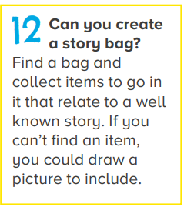
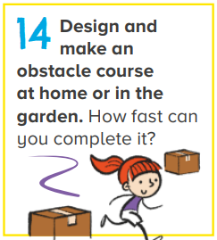
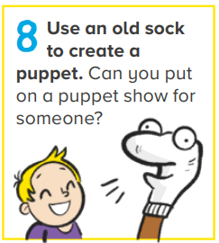
Home Learning Non Screen Activities

