Slide 1
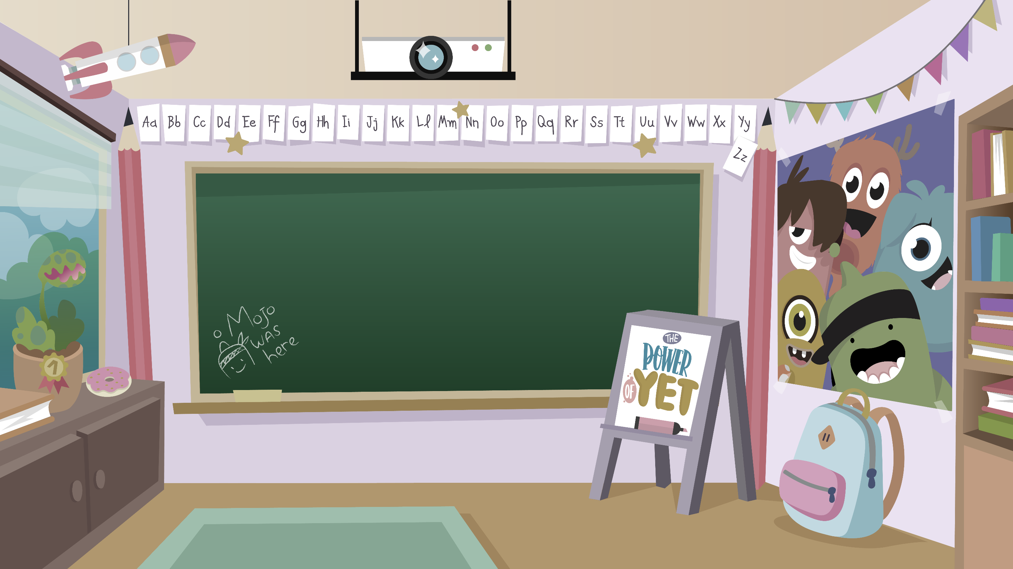
Home Learning activities WC 8.6.20 Year 1 CG Teaching group.
Challenge

Slide 2
Hello year 1! I hope that you are all keeping well.
Here is some more learning activities for you to do at home, though I do wish we were in the classroom learning together.
Don’t forget, there is work available on Purple Mash too and remember to send me some of your work through Class Dojo.
I hope to see you all soon
Mrs Gliddon

Slide 3
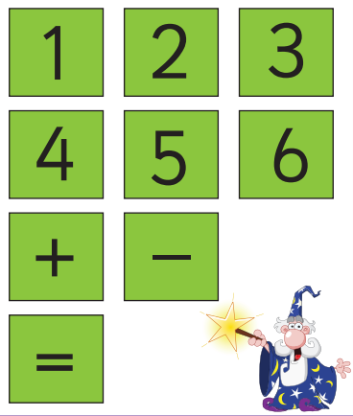
Home Learning Recap - Maths
How many ways can you make 4 using these cards?
You can use the cards as many times as you like.

Slide 4
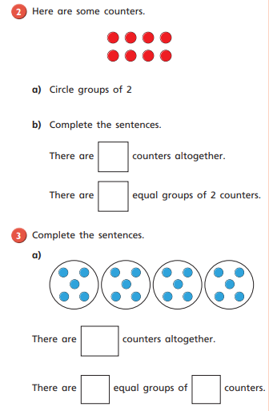
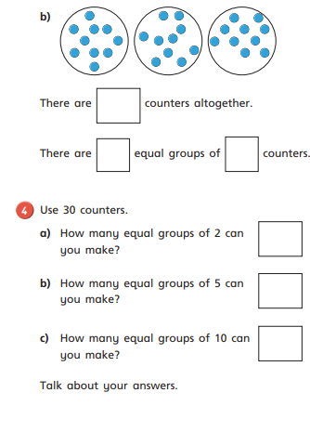
Home Learning Challenges - Maths
We are starting to look at multiplication and division, You can use step counting!
Challenge

Slide 5
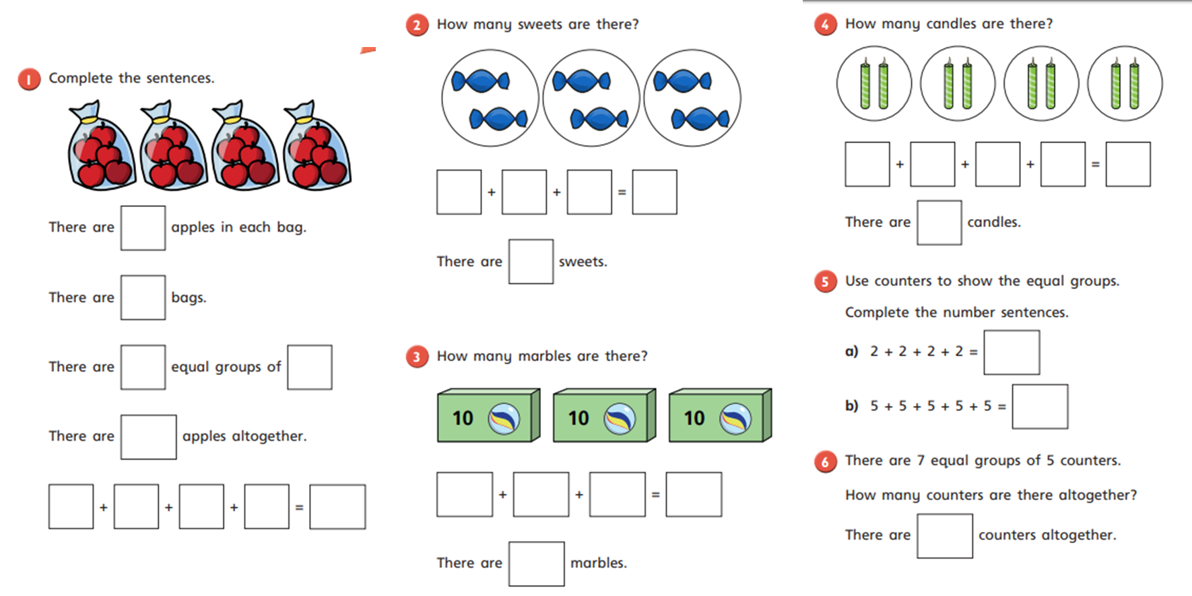
Home Learning Challenges - Maths

Slide 6
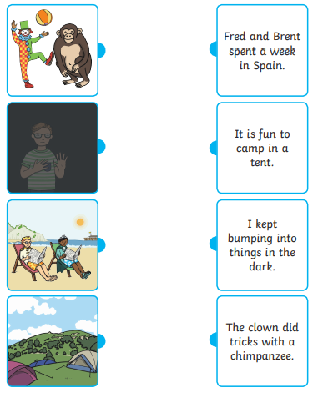
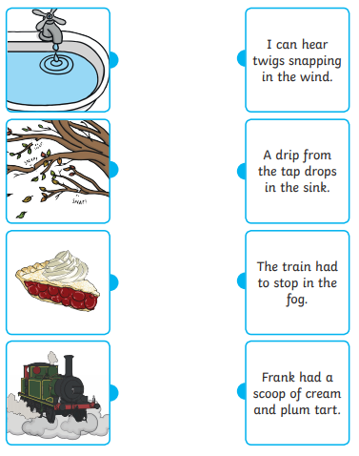
Home Learning Recap - Phonics

Slide 7
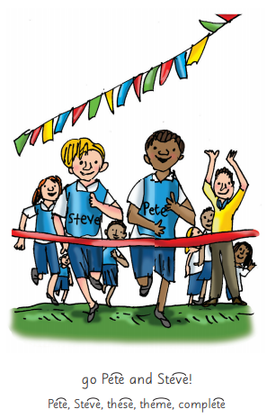
Home Learning Challenges - Phonics
Remember, there are some great videos on Youtube to help. Ruth Miskin Training set 3 speed sounds and spelling lessons are definitely worth while in teaching your child and set 2 are great for recap lessons.
Find the words that contain the split digraph e-e and read them.

Slide 8
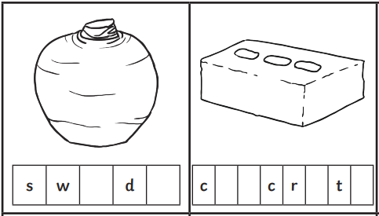
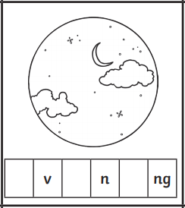
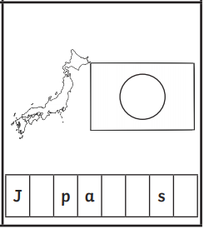
Home Learning Challenges - Phonics

Slide 9
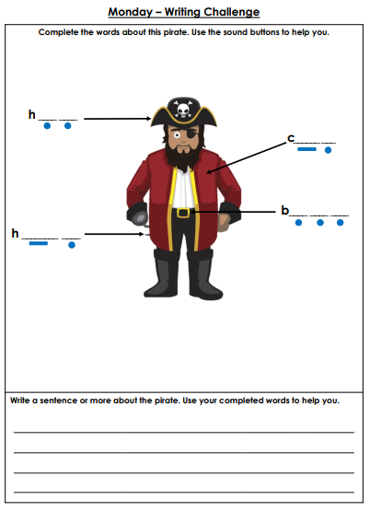
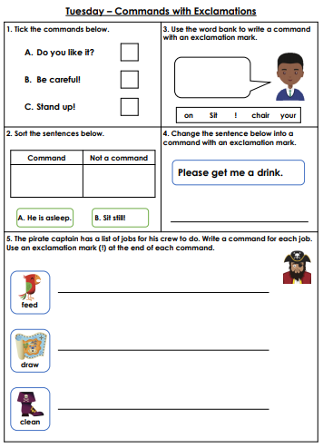
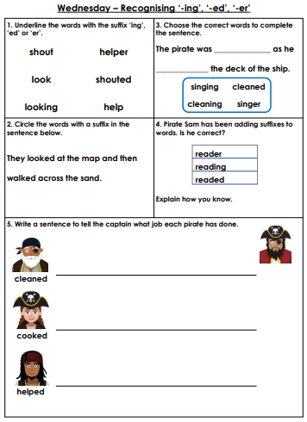
Home Learning Challenges – English

Slide 10
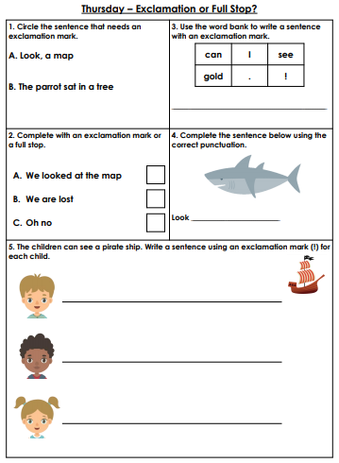
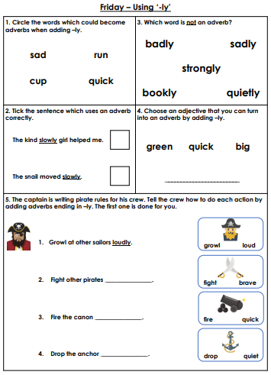
Home Learning Challenges – English

Slide 11
Home Learning Challenge - Spelling
Use look, cover, write, check to learn the common Exception words.
Look | Cover and say | Write and check | Amend errors | Repeat
friend
school
put
push
pull
full
house
our
we
boxes
brushes
benches

Slide 12
Home Learning Recap - RE
RE – This term we are looking at the Christian Church.
What is the name of the Holy Book of Christianity?
What is the name of the Holy Book of Islam?
How are they similar?
How are they different?

Slide 13
Home Learning Challenge - RE
Not all churches are the same but there are some things that you will find in most churches. This week we will look at the font. Read the information and write the answer to the question.

Slide 14
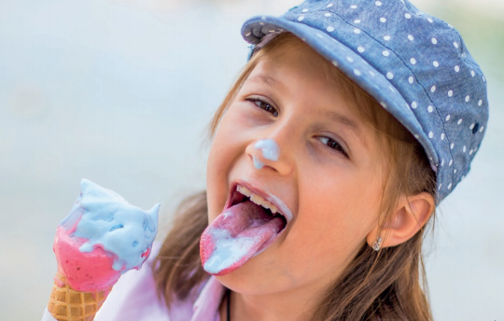
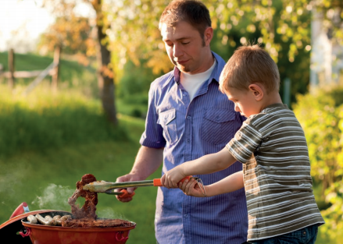
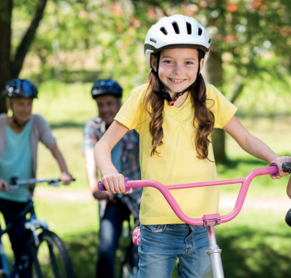
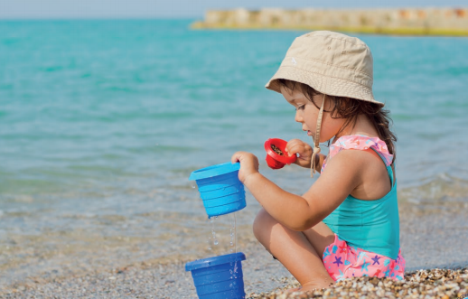
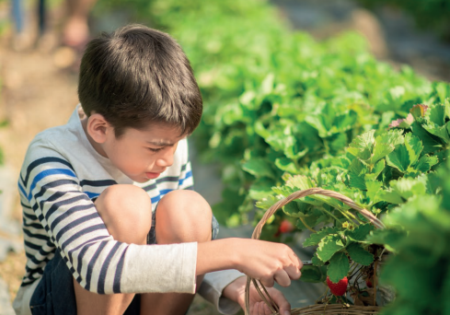
Home Learning Challenge – Science
The Seasons
Have a look at these images and create a ‘summer’ word bank. Use these words to cerate some descriptive sentences about what you can do in the Summer.
https://www.bbc.co.uk/teach/class-clips-video/the-changing-seasons/zh4rkmn

