Slide 1
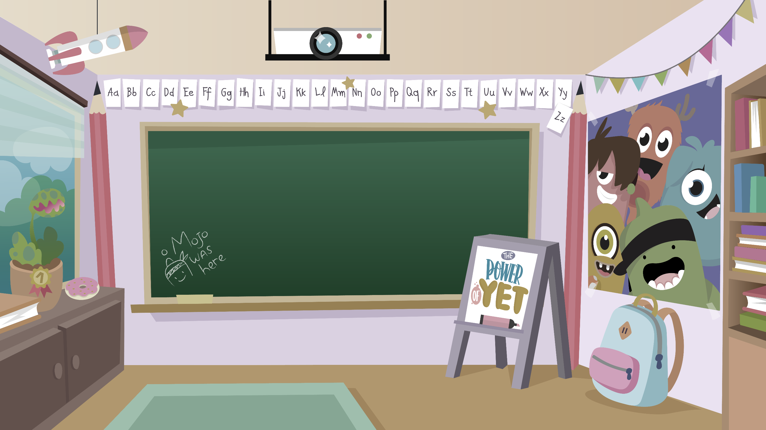
Home Learning activities WC 15.6.20 Year 1 CG Teaching group.
Challenge

Slide 2
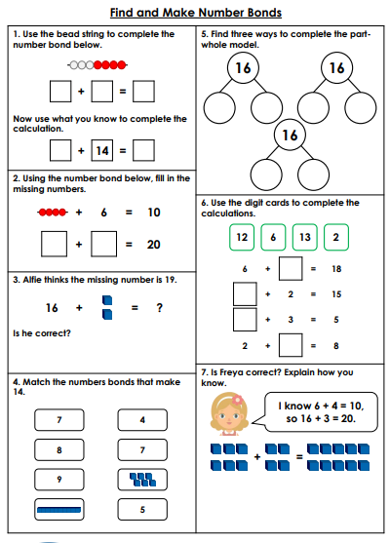
Home Learning Recap - Maths

Slide 3
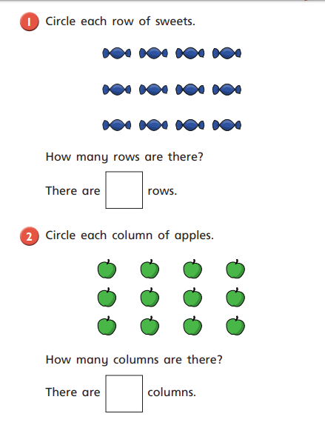
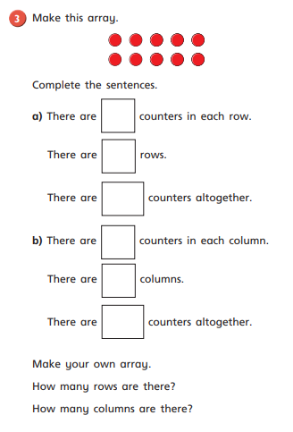
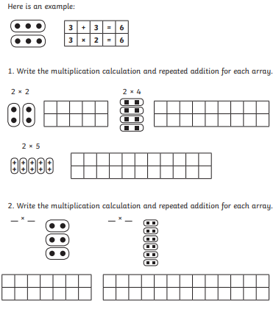
Home Learning Challenges - Maths
We are starting to look at multiplication and division,
These arrangements all have something in common; they are all in rows, across and columns, down. An arrangement of objects, pictures, or numbers in columns and rows is called an array. Arrays are useful representations of multiplication concepts. ... When equal groups are arranged in equal rows, an array is formed.

Slide 4
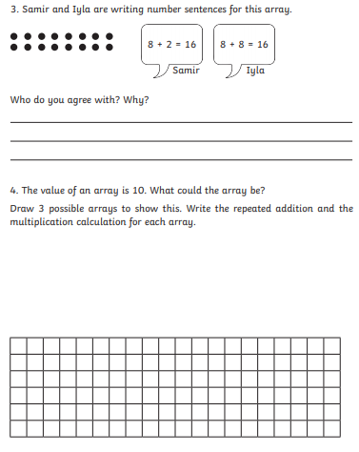
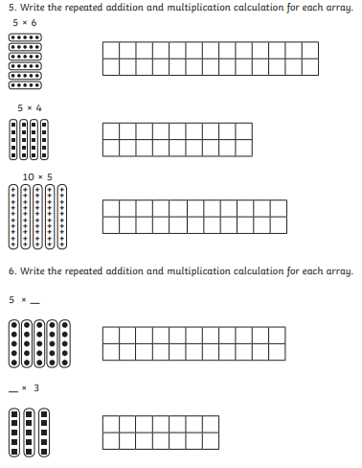
Home Learning Challenges - Maths

Slide 5
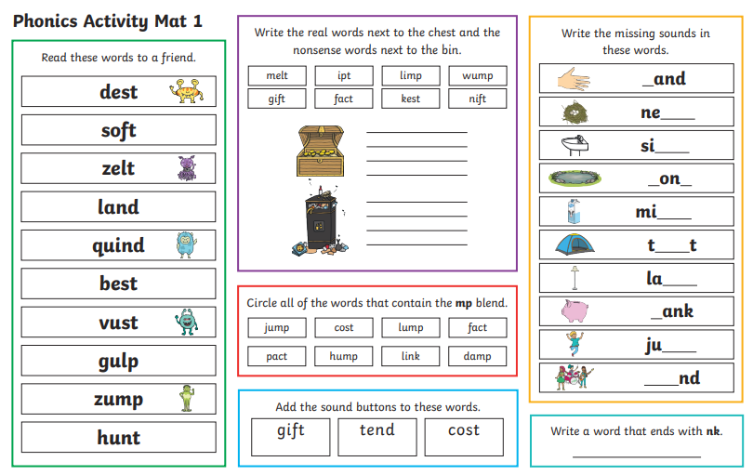
Home Learning Recap - Phonics

Slide 6
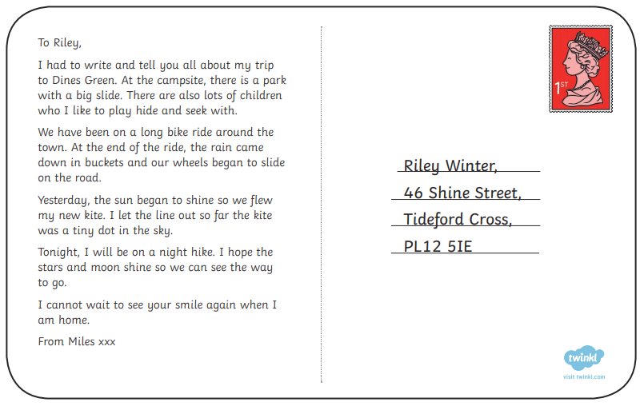
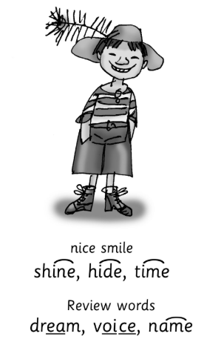
Home Learning Challenges - Phonics
Remember, there are some great videos on Youtube to help. Ruth Miskin Training set 3 speed sounds and spelling lessons are definitely worth while in teaching your child and set 2 are great for recap lessons.
Find the words that contain the split digraph i-e and read them.

Slide 7
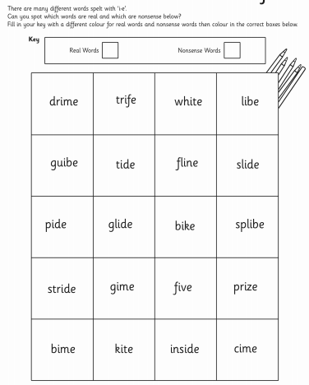
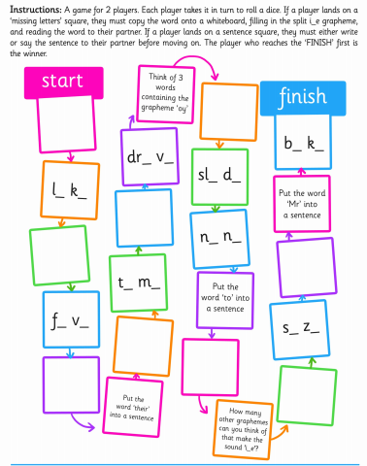
Home Learning Challenges - Phonics

Slide 8
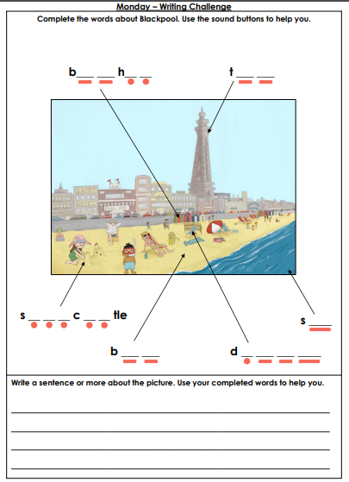
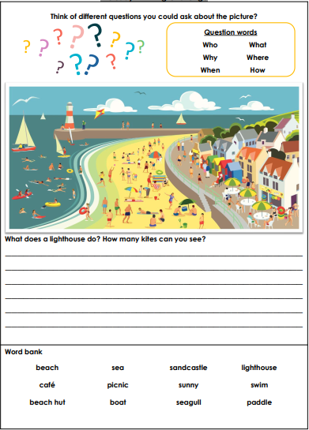
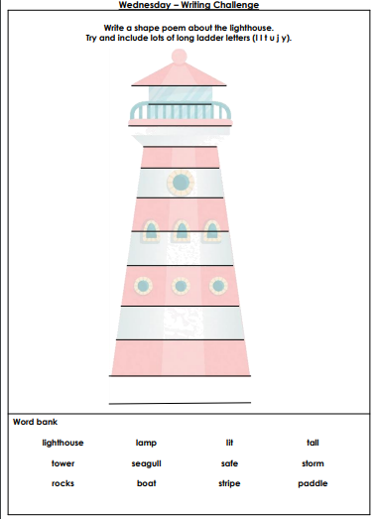
Home Learning Challenges – English

Slide 9
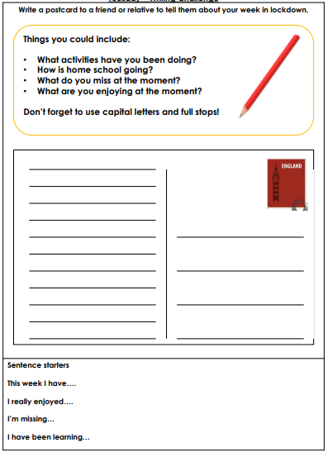
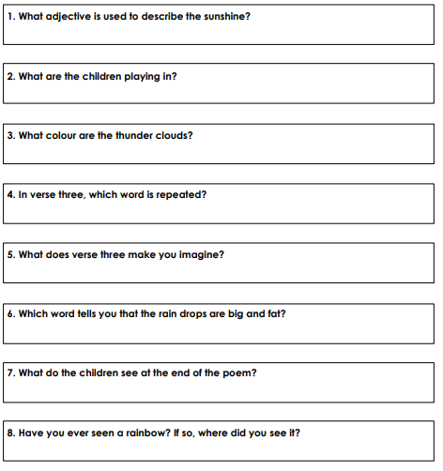
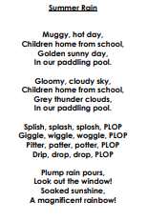
Home Learning Challenges – English
Read the poem and answer the questions

Slide 10
Home Learning Challenge - Spelling
Use look, cover, write, check to learn the suffix words – adding ‘ing’ when no change is needed in the root word.
Look | Cover and say | Write and check | Amend errors | Repeat
hunting
buzzing
jumping
kicking
eating
playing
cooking
drawing
floating
going
looking
standing

Slide 11
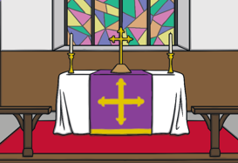
Home Learning Recap - RE
RE – This term we are looking at the Christian Church.
Which one is the altar?
Which one is the font?
What are the font and altar used for?

Slide 12
Home Learning Challenge - RE
Not all churches are the same but there are some things that you will find in most churches. This week we will look at the lectern. Read the information and write the answer to the question.

Slide 13
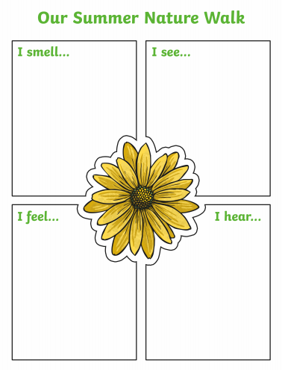
Home Learning Challenge – Science
The Seasons
https://www.bbc.co.uk/teach/class-clips-video/the-changing-seasons/zh4rkmn
Once the rain has stopped get outside for a walk or in a garden and complete the grid about summer.

Slide 14
#BlackLivesMatter

