Slide 1
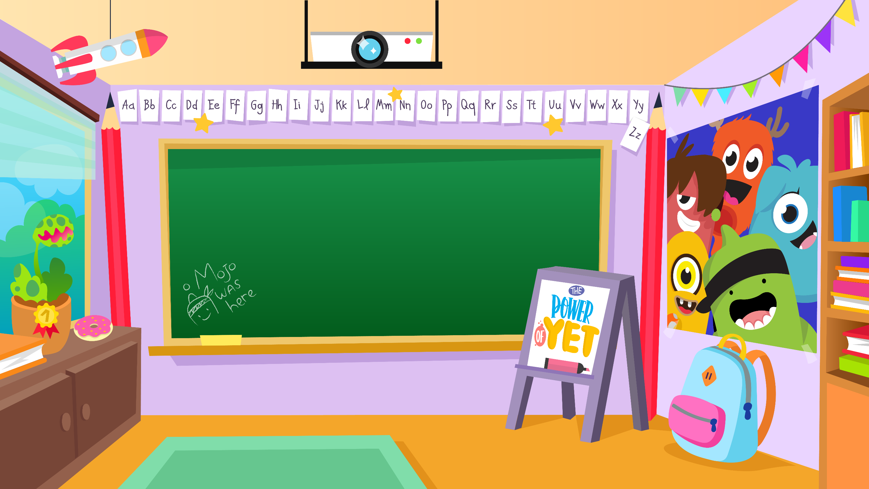
Home Learning activities WC 29.6.20 Year 2 AC Teaching group.
Challenge

Slide 2
Home Learning Recap - Maths
Use your knowledge of division and multiplication to find the answers

Slide 3
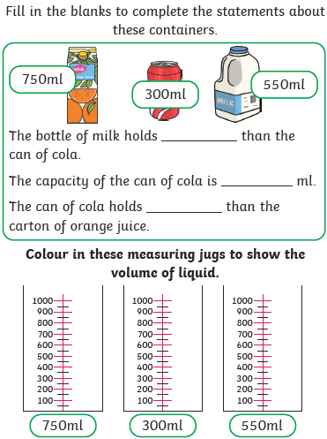
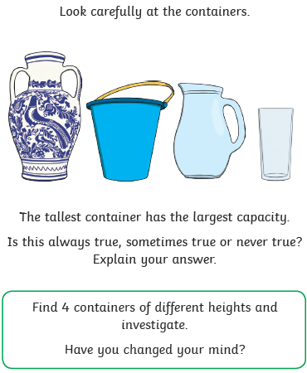
Home Learning Challenges - Maths
Measurement – Capacity and Volume
Children in Year Two should use mathematical vocabulary to measure and compare volume/capacity.
Day 1
Day 2
Challenge
What does clockwise mean?
What does anti-clockwise mean?
How else could the object have been turned?

Slide 4
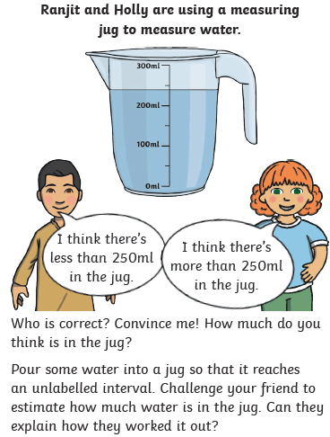
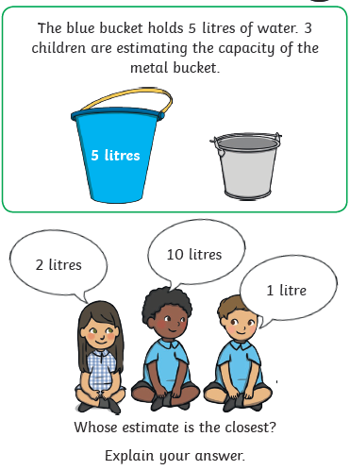
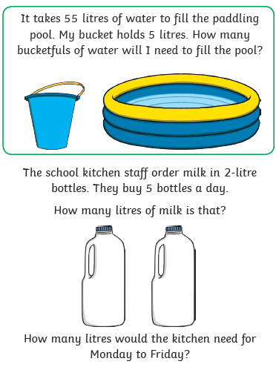
Home Learning Challenges - Maths
Day 3
Day 4
Day 5

Slide 5
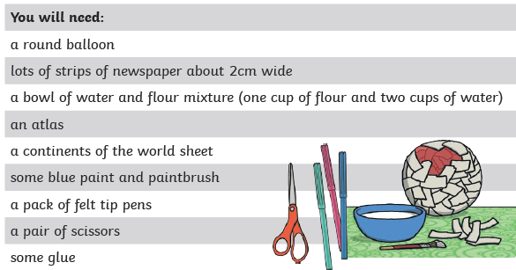
Home Learning Challenges – English
Create instructions for a creative activity
Can you create a set of instructions about a creative activity? Think about what you like about summer, what can you do in summer?
Day 1 – Decide on the creative activity you wish to write instructions for. Draw and make notes of the steps you will follow
Day 2 – Verbally build each of your steps into a sequence of sentences. Include adjectives, verbs adverbs, conjunctions, commas in a list and suffixes (e.g. slowly, careful) Draft the first half of your instructions. Re-read to check your work makes sense.
Day 3 – The same as Day 2 for the second half of your instructions.
Day 4 – Edit and improve your sentences, Check your spelling, your sentences make sense, punctuation and conjunctions. Can you add words to improve it?
Day 5 – Publish, write up your instructions in neat! Copy your edited draft using your best handwriting. Save your work to show me.. Do you think someone can follow your instructions?
Don’t forget to include a list of the items that you will need for your activity.

Slide 6
Home Learning Challenges – English example
First of all, blow up the balloon gently. Don’t let it burst. Ask a grown-up to help you tie the balloon if it is tricky.
Carefully, dip the strips of newspaper in the flour and water mix and slowly wrap the strips all around the balloon until it is covered.
Next, cover the balloon at least three or four times with the newspaper. Leave the balloon to go solid when you have done this.
After your globe has dried, paint the whole globe blue to show the water and leave to dry.
While your globe is drying, colour in the seven continents neatly on the activity sheet.
Then, cut out the continents but be careful with the scissors because you might hurt yourself.
When you have cut the continents out, stick them in the right position on the globe. Use an atlas to help you if you are unsure.
After that, label the oceans and carefully draw the line of the equator.
Finally, label the continents of North America, South America, Africa, Antarctica, Australasia, Europe and Asia.
Here are some instructions that I created to make a paper mache globe. When writing yours, think carefully about past and present tense.

Slide 7
Home Learning Challenge - Spelling
Use look, cover, write, check to learn the spelling rules for the sound ‘or’ in words using ‘al’.
Look | Cover and say | Write and check | Amend errors | Repeat
Station
Fiction
Motion
National
Section
Addition
Subtraction
Potion
Option
Introduction

Slide 8
Home Learning Recap - RE
RE – We are looking at the religion Islam, and how and why Muslims celebrate and worship.
Can you remember what the answer to these questions?
Where was Islam founded? Saudi Arabia.
What is the name of their God? Allah
Who was the founded of Islam? Muhammed (Peace be upon him)
What is the name of the Holy Book? The Qu’ran

Slide 9
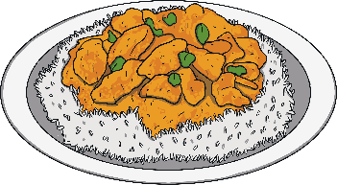
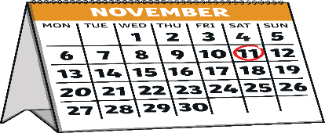
Home Learning Challenge - RE
RE – We are going to be looking at Islam and their traditions.
In the Islamic faith, Muslims welcome babies in a ceremony called the Aqiqah (pronounced Ak-kee-ka).
This is when the baby is introduced to family and friends. They celebrate and share a meal together. They join with loved ones to thank Allah (God) for giving them a child.
The Aqiqah is hosted by the parents of the new baby and may be held in their own home or in a hall or community centre.
Why do you think people celebrate a new baby being born?
The Aqiqah is usually held on the seventh day after the baby is born. If this is not possible, it might be held on the 14th or the 21st day after the baby’s birth.
Guests often bring along cards and gifts for the baby. The hall or home where the Aqiqah is held may be decorated with balloons and other decorations.
What gift would you bring a new baby?

Slide 10
Home Learning Challenge - Science
Think carefully about the materials that you require to make a boat.
What will be suitable/ unsuitable materials?
Can you add a sail or a propeller to your boat to make it move?
How much cargo can your boat hold?
What could you change about your boat to make it hold more cargo?

Slide 11
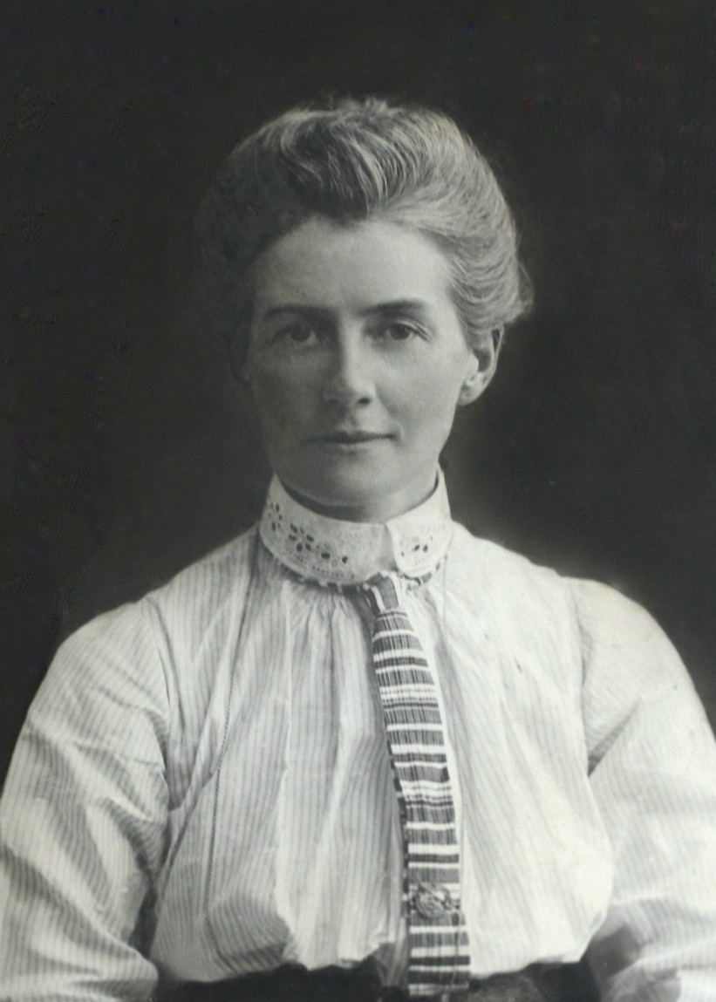
Home Learning Challenge - History
In History we are continuing to look at individuals who have helped other people. This week we are looking at Edith Cavell.
Research and answer the following questions:
When was Edith Cavell born? When and how did she die?
Where was she from?
Why is she significant?
Activity:
Can you present your information to a family member?

Slide 12
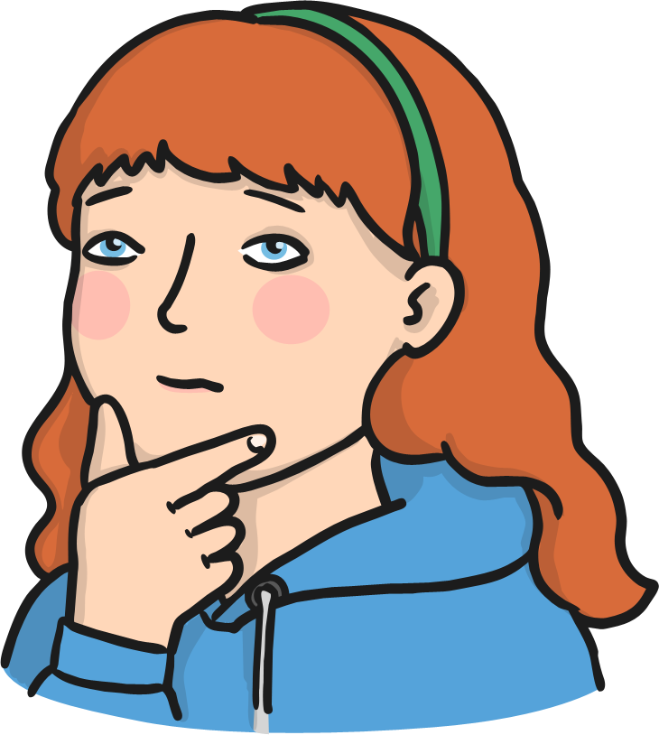
Home Learning Challenge - PSHE
Relationships. Working Together
Working together and cooperating with others can help us achieve lots of wonderful things - we can have great fun too!
When we cooperate with others we need to use a lot of different skills. We need to listen to everyone’s ideas, share the jobs, give help to others and look after everyone’s feelings.
Why do you think these skills are important when we cooperate
with others?
What does cooperation mean?
Can you think of any times when you have cooperated with others to achieve something?

Slide 13
Home Learning Challenge - PSHE
Relationships. Working together
We can achieve wonderful things when we cooperate and work together – we can have a lot of fun too!
Draw a picture of you and your friends working cooperatively on a task.
Write a description under your picture of what you are doing and the skills you are using.

Slide 14
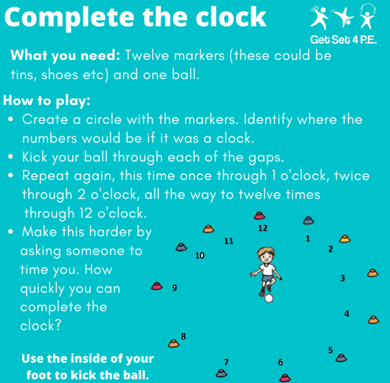
Home Learning- PE

Slide 15
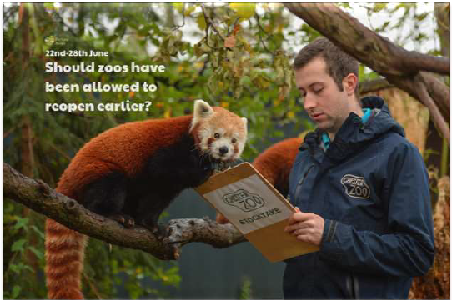
Home Learning
Collective worship from our friend Mr Buckeridge. Join Mr Buckeridge as we enjoy some food, have a story about a picnic and ask why Jesus likened Himself to Bread! https://www.youtube.com/watch?v=fewiLGIDy_w&feature=youtu.be
Picture news- please look on our website weekly for the latest picture news.
Challenge
Have you been to a zoo? Did you like it there? If not, would you like to visit a zoo. Why?
Some visitor attractions have not had staff at work during the lockdown period, but zoos have, why do you think zoos need people working there all the time, even when they’re closed?

Slide 16
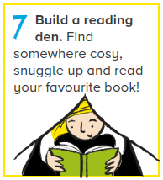
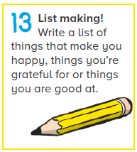
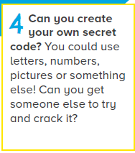
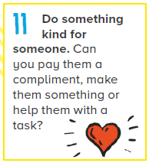
Home Learning Non Screen Activities

