Slide 1
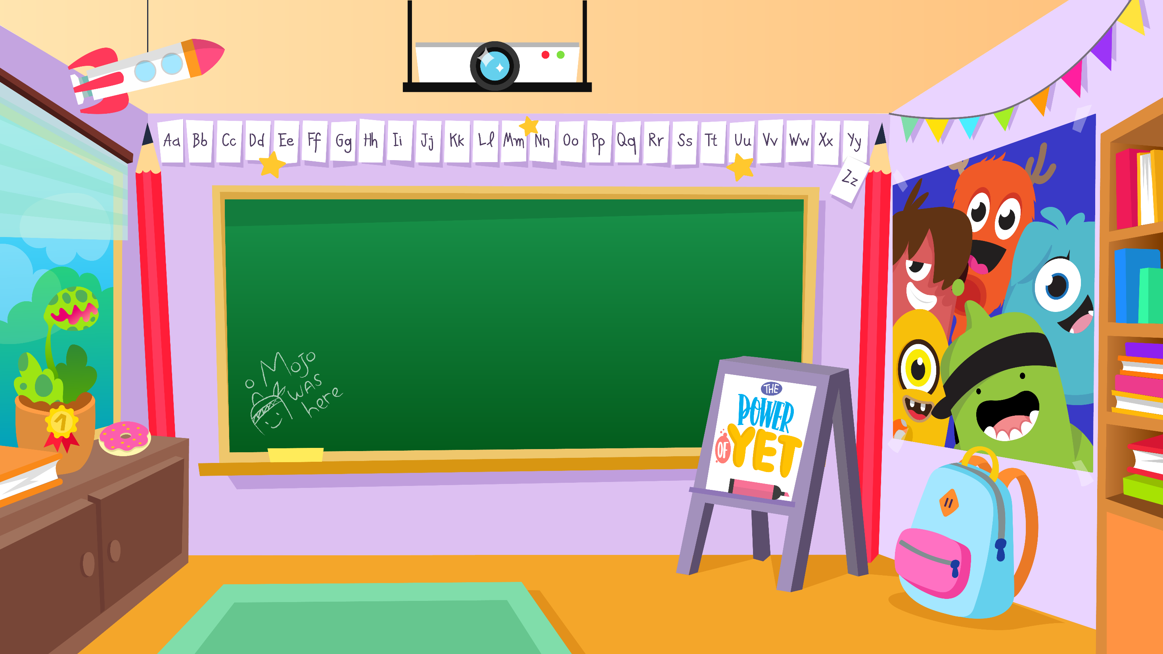
Home Learning activities WC 8.6.20 Year 2 AC Teaching group.
Challenge

Slide 2
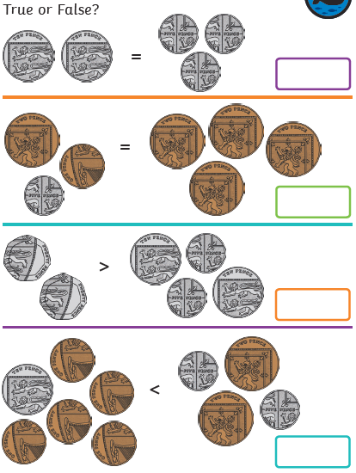
Home Learning Recap - Maths
We use money in every day life. Let’s recap counting money. What is the best strategy to use when counting money?
Think about these questions when counting:
Is it harder to count a group of coins if they are not all the same?
How can you do that efficiently?
Does the group with the most coins have the highest value?
Can you correct the false statements?

Slide 3
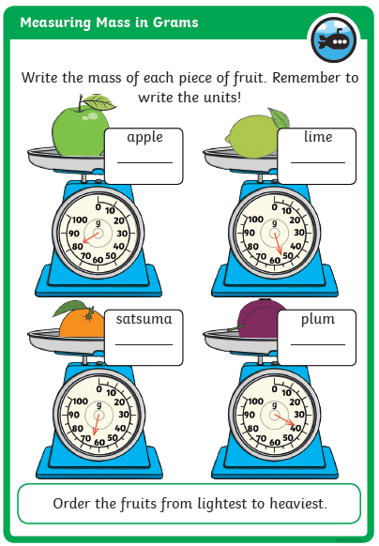
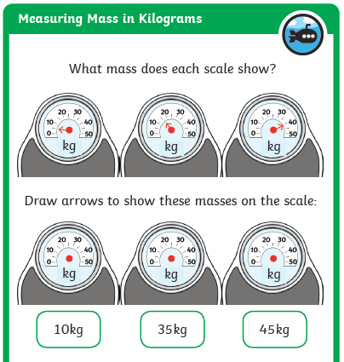
Home Learning Challenges - Maths
Weight/Mass
Children in Year Two should know and use appropriate standard units to estimate and measure mass (kg/g) using scales, thermometers. They should also be able to compare and order mass; record the results using >, < and =
Day 2
Day 1
Challenge

Slide 4

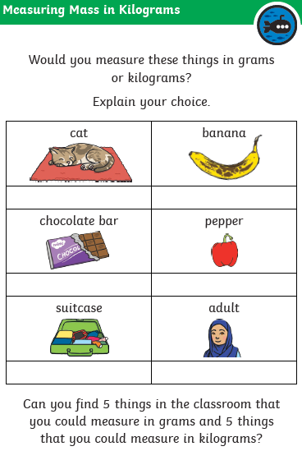
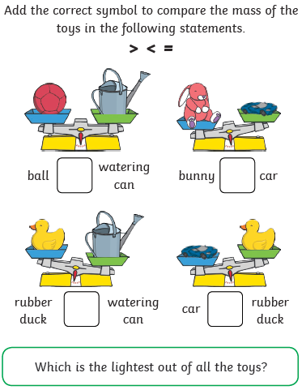
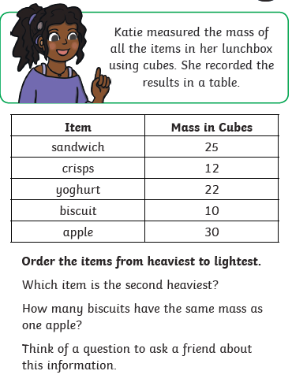
Home Learning Challenges - Maths
Day 4
Day 5

Slide 5
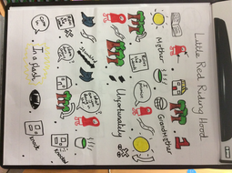
Home Learning Challenges – English
Retell a story.
Watch this video on Hansel and Gretal https://www.youtube.com/watch?v=ELbcakxFvfc
Can you retell this traditional tale?
Day 1 –Create a story map for the tale of Hansel and Gretal.
Day 2 – Verbally build each of your pictures into a sequence of sentences. Include adjectives, feelings, conjunctions and suffixes (e.g. amazement, hopeless) Draft the first half of your story map. Re-read to check your work makes sense.
Day 3 – The same as Day 2 for the second half of your story. . Make sure you have the ending to the story.
Day 4 – Edit and improve your sentences, Check your spelling, your sentences make sense, punctuation and conjunctions.
Day 5 – Publish, write up your story retell in neat! Copy your edited draft using your best handwriting. Save your work to show me.
A story map for Little Red Riding Hood.

Slide 6
Home Learning Challenges – English example
Retell a traditional tale – here is the start of my story retell for Little Red Riding Hood. I have highlighted in red Year 2 writing features.
Once upon a time there lived a little old woman and a little old man. The little old woman loved to bake and one day she made a Gingerbread Man. He had black raisins for eyes, a bow tie and three colourful buttons. The little old woman smiled because she was very pleased with him.
The little old woman slowly opened the oven door when the Gingerbread Man was ready but he jumped off the baking tray and suddenly ran out of the house. The little old woman and the little old man quickly chased after the Gingerbread Man and yelled for him to stop but they couldn’t catch him. The Gingerbread Man just laughed. “Run, run as fast as you can! You can’t catch me I’m the Gingerbread Man!”

Slide 7
Home Learning Challenge - Spelling
Use look, cover, write, check to learn the spelling rules for the sound ‘or’ in words using ‘al’.
Look | Cover and say | Write and check | Amend errors | Repeat
key
donkey
monkey
chimney
valley
trolley
turkey
hockey
parsley
journey

Slide 8
Home Learning Challenge - RE
RE – We are going to be looking at stories from The Qu’ran. This week, we will be learning about
The Prophet Isa.
Activity:
Can you retell the story?
Watch the following clip about the story of Prophet Isa (EE-sah):
https://www.youtube.com/watch?v=S-0oPjtxeMs
What was the Prophet called?
Does this story remind you of
someone from the Bible?
Jesus

Slide 9

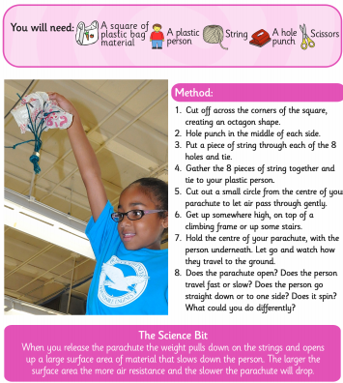
Home Learning Challenge - Science
Can you have a go at this experiment?
Can you write down the difference in using different size bags?
Why do you think this difference occurs?
Can you predict (have a good guess) at what would happen if you used a heavier toy figure?

Slide 10
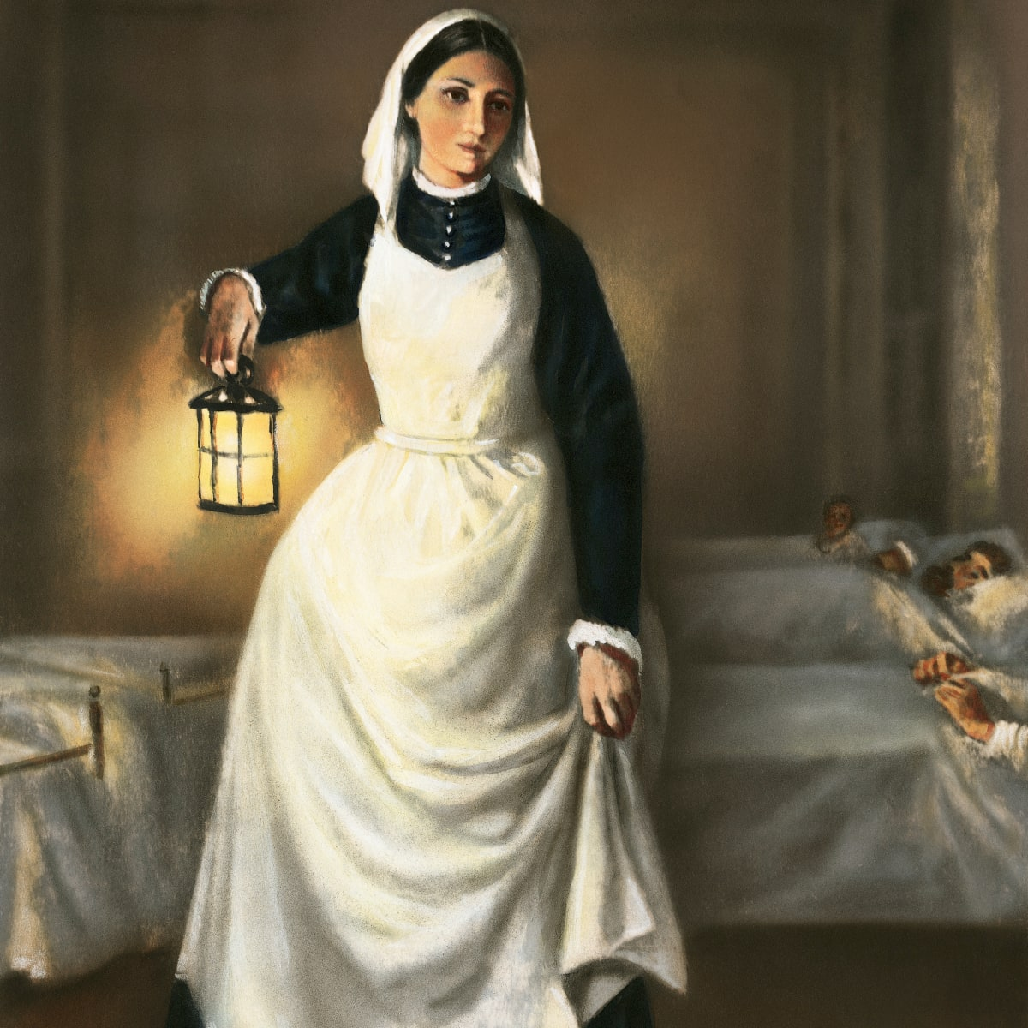
Home Learning Challenge - History
In History we are looking at Florence Nightingale.
Research and answer the following questions:
When was Florence Nightingale born? When did she die?
Where was she from?
Why is she significant?
Activity:
Create a fact file about Florence Nightingale for others to read and learn about her.

Slide 11
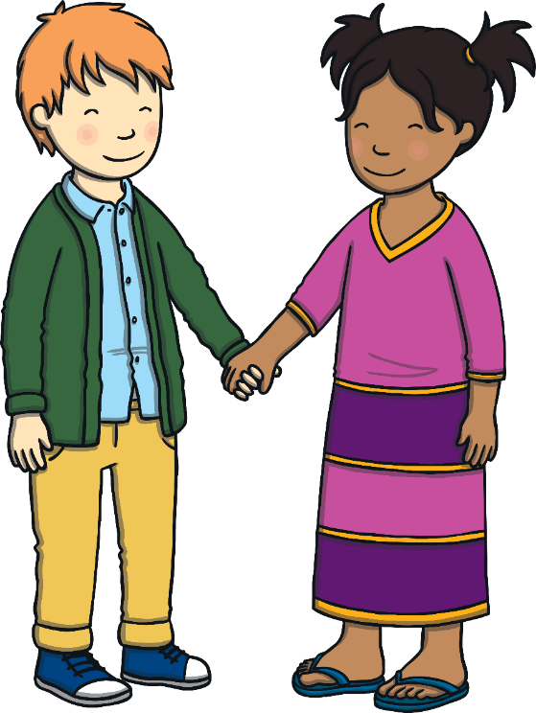
Home Learning Challenge - PSHE
Relationships. Differences and Similarities
List the ways that you are different to and the same as other people.
Would life be as fun if we all looked the same and thought the same things?
What could you do if you see discrimination happening? Who could you tell at school, at home, or in the community?

Slide 12
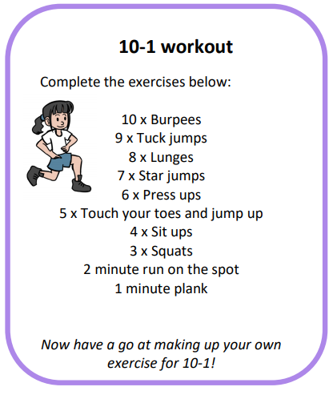
Home Learning- PE

Slide 13
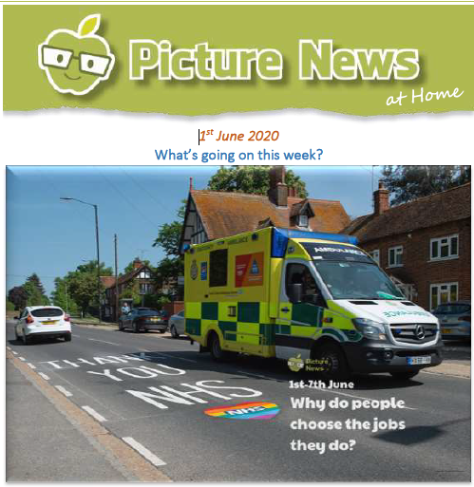
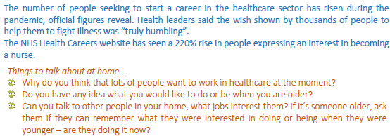
Home Learning
Collective worship from our friend Mr Buckeridge. Today, we briefly revisit the Good Samaritan story, the Samaritan Woman and Angola as we try to understand what our attitude should be towards those from other places. https://www.youtube.com/watch?v=Ct-hxU9Tl6Q&list=PLzeI_liQYA2PmAsL2ZlgxrzDRui50S85X&index=2&t=7s
Picture news- please look on our website weekly for the latest picture news.

Slide 14
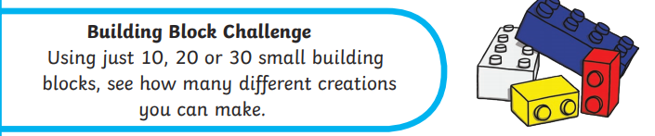
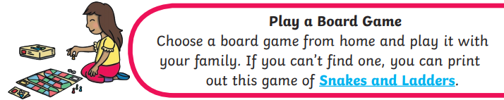
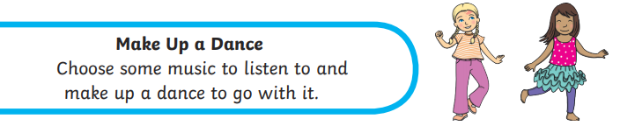
Home Learning Non Screen Activities

