Slide 1
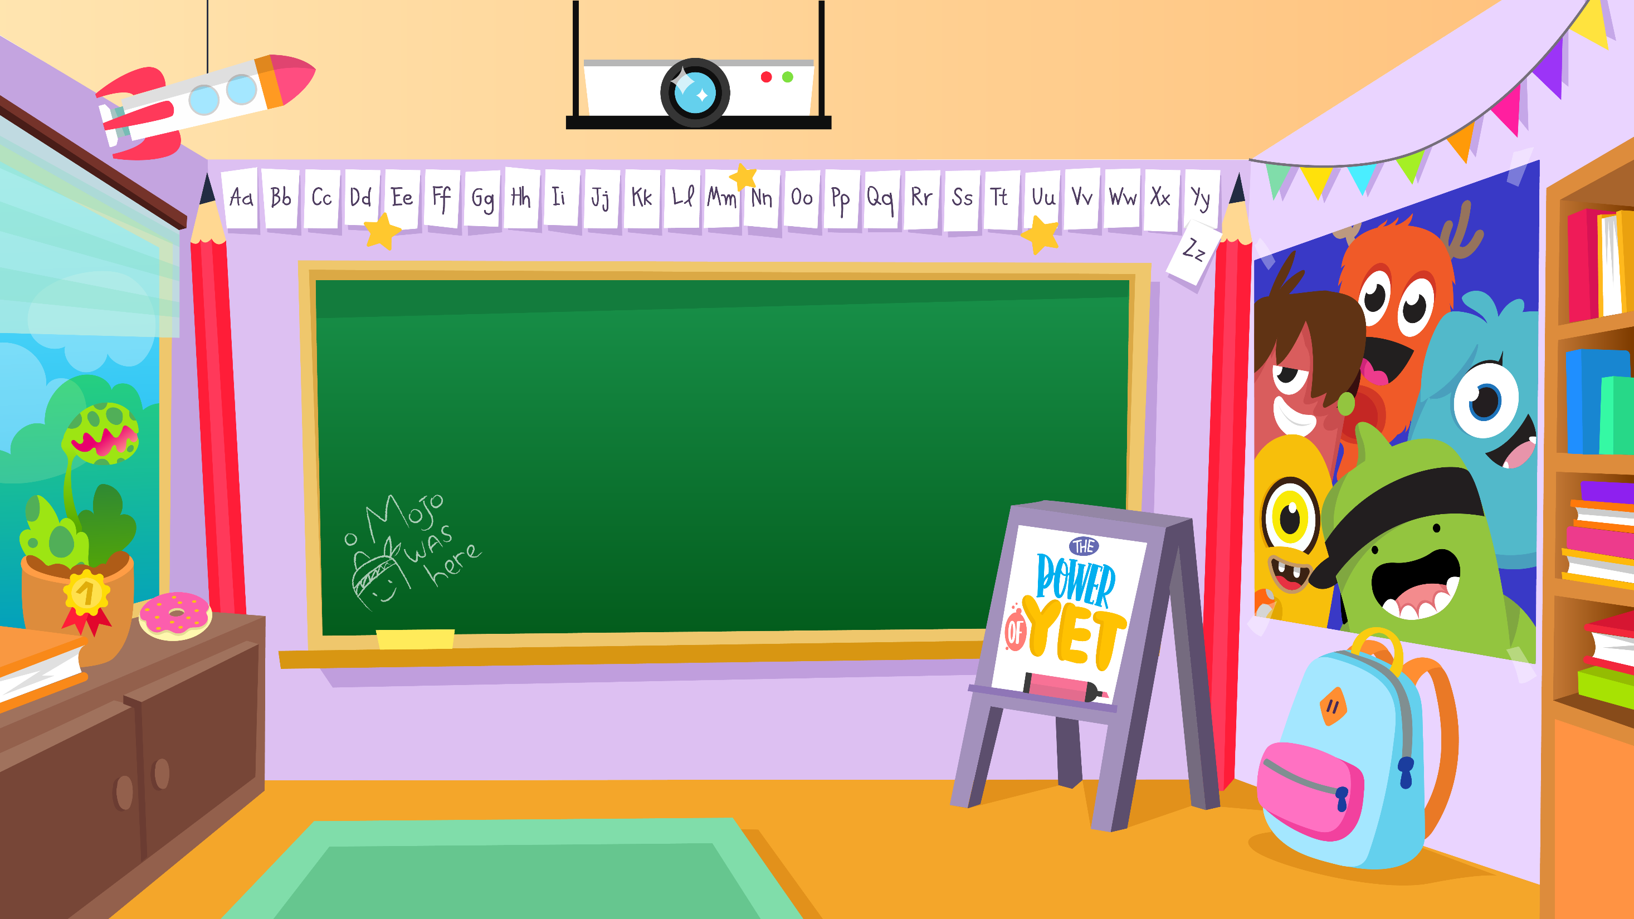
Home Learning activities WC 15.6.20 Year 2 AC Teaching group.
Challenge

Slide 2
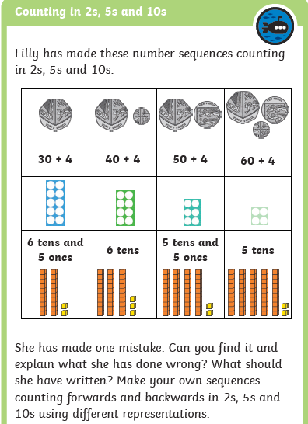
Home Learning Recap - Maths
Can you describe the sequences?
Are the numbers getting larger or smaller?
What sized steps are the numbers counting in?
Can you find any patterns?
Which one is incorrect?
How do you know?
What should Lilly have done?
What would be the 5th number in each sequence?

Slide 3
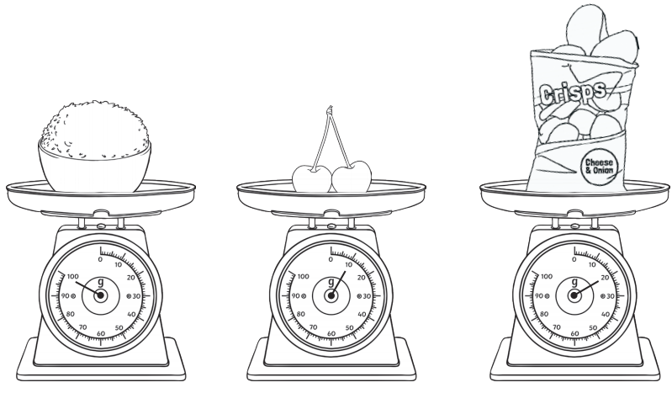
Home Learning Challenges - Maths
Weight/Mass
Children in Year Two should know and use appropriate standard units to estimate and measure mass (kg/g) using scales, thermometers. They should also be able to compare and order mass; record the results using >, < and =
Day 1
Challenge
Which is the heaviest?
Which is the lightest?
How many more grams does the rice weigh than the crisps?

Slide 4
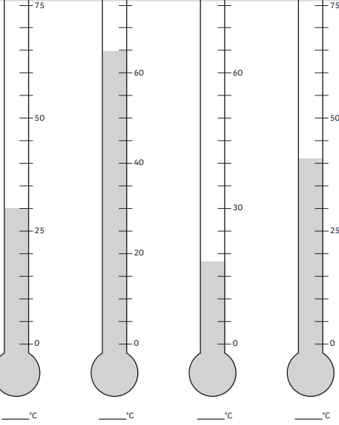
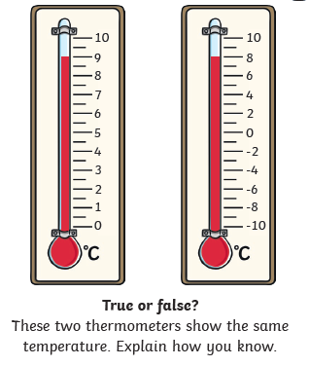
Home Learning Challenges - Maths
Day 2
Day 3
Which thermometer has the highest temperature?
Which thermometer has the lowest temperature?
What is the difference in temperature between the warmest and coolest thermometer?

Slide 5
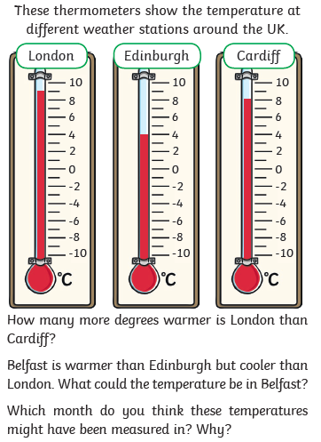
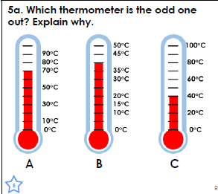
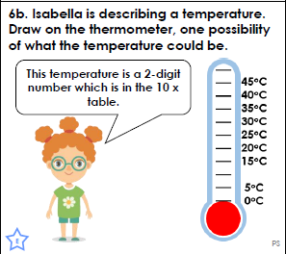
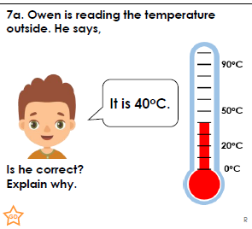
Home Learning Challenges - Maths
Day 4
Day 5

Slide 6
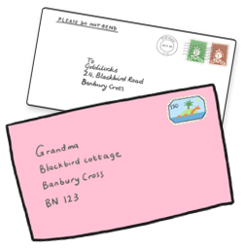
Home Learning Challenges – English
Write a letter.
Can you write a letter to someone who you are missing and haven’t seen in a while? You could write to your grandparents, aunties, uncles, friends or even your teachers.
Day 1 –Draw pictures and write brief notes about what you want to include in your letter..
Day 2 – Verbally build each of your pictures into a sequence of sentences. Include adjectives, feelings, conjunctions and suffixes (e.g. amazement, hopeless) Draft the first half of your letter. Re-read to check your work makes sense.
Day 3 – The same as Day 2 for the second half of your letter.
Day 4 – Edit and improve your sentences, Check your spelling, your sentences make sense, punctuation and conjunctions.
Day 5 – Publish, write up your letter in neat. Copy your edited draft using your best handwriting. You can include pictures, drawings etc. Send your letter to the person you are writing to.
Checklist
Senders address
Todays date
Greeting
Introduction
Main body of letter
Conclusion
Sign off your letter

Slide 7
Home Learning Challenges – English example
Write a letter to someone you have not seen or spoken to in a while. Let them know what you have been doing. Ask them what they have been doing.
Stone Cottages
Old Road
Dawling
DW72 5HY
10th June 2020
Dear Grandma,
I am writing to you to tell you how much I miss you during this lockdown and that I love you very much. How are you doing? It has been extremely wet here this last week so I have had to play inside. What have you been doing?
Challenge! Could you include some of your spelling words this week in your letter?

Slide 8
Home Learning Challenges – English example
Write a letter to someone you have not seen or spoken to in a while. Let them know what you have been doing. Ask them what they have been doing.
My Mum has been keeping me awfully busy. Every day I try my hardest to complete my school work and sometimes my Mum will have to help me. After I have finished my work I am allowed to choose what to do. I like to choose to play with my Lego, toy cars, football in the garden or go on my trampoline. My mum said I need to be careful and shouldn’t bounce too high on this. Once I have had lunch I get excited because we get to go for a walk. I get to take my scooter if I would like to. We like to play games when walking such as who can see the most red cars or count the most rainbows. I always win but I think Mum lets me. I have been helping to tidy the house, do the hoovering and making dinner.
I really miss you and Grandad and hope that we can see each soon. What a long time it has been! I look forward to hearing back from you and finding out what you have been up to.
Yours faithfully
Tommy

Slide 9
Home Learning Challenge - Spelling
Use look, cover, write, check to learn the spelling rules for the sound ‘or’ in words using ‘al’.
Look | Cover and say | Write and check | Amend errors | Repeat
enjoyment
sadness
careful
playful
plainness
argument
merriment
happiness
plentiful
cheerful

Slide 10
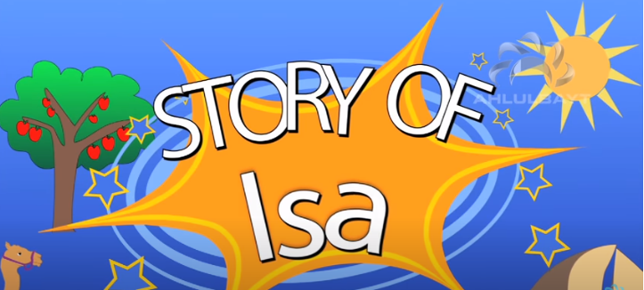
Home Learning Challenge - RE
RE – We are going to be looking at stories from The Qu’ran.
Watch the following clip about the story of Prophet Isa:
https://www.youtube.com/watch?v=S-0oPjtxeMs
What was the Prophet called?
What Bible story is this similar to? How?
How are they similar?
How are they differesnt?

Slide 11

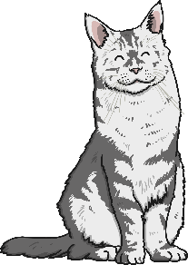
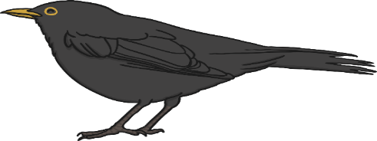

Home Learning Challenge - Science
What is a food chain?
A food chain shows how each animal gets its food. Food chains are one of the ways that living things depend on each other to stay alive.
Each food chain starts with a green plant.
Green plants are called producers because they produce their own food.
All animals are called consumers because they consume their food by eating plants and other animals.
Animals that eat other animals are called predators. The animals that they eat are called prey.
predator
producer
consumer
prey

Slide 12
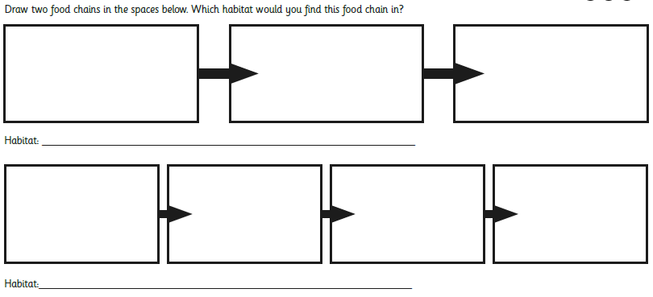
Home Learning Challenge - Science
What is the producer?
What is the consumer?
What is the prey?
Can you remember where green plants get their energy from?
Can you make a food chain that includes you?

Slide 13
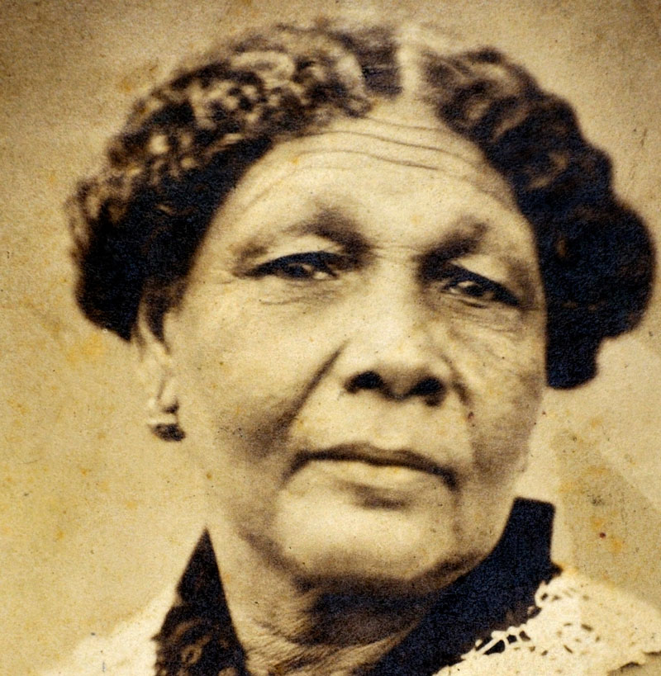
Home Learning Challenge - History
In History we are looking at Mary Seacole.
Research and answer the following questions:
When was Mary Seacole born? When did she die?
Where was she from?
Why is she significant?
Activity:
Create a fact file about Mary Seacole for others to read and learn about her.

Slide 14

Home Learning Challenge - PSHE
Relationships. Friends
Friends are people we like a lot and who we know well. They are people who we enjoy spending time with.
Think quietly about your friends.
What do you like about them?
Why do we need good friends in our lives?
Draw a picture of yourself in the middle of a flower and write the qualities that make you a good friend to others in the petals.

Slide 15
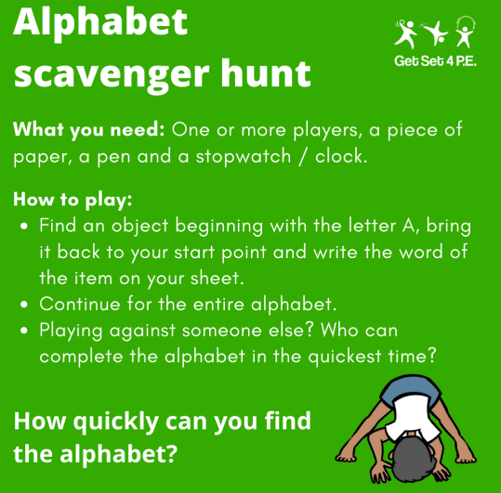
Home Learning- PE

Slide 16
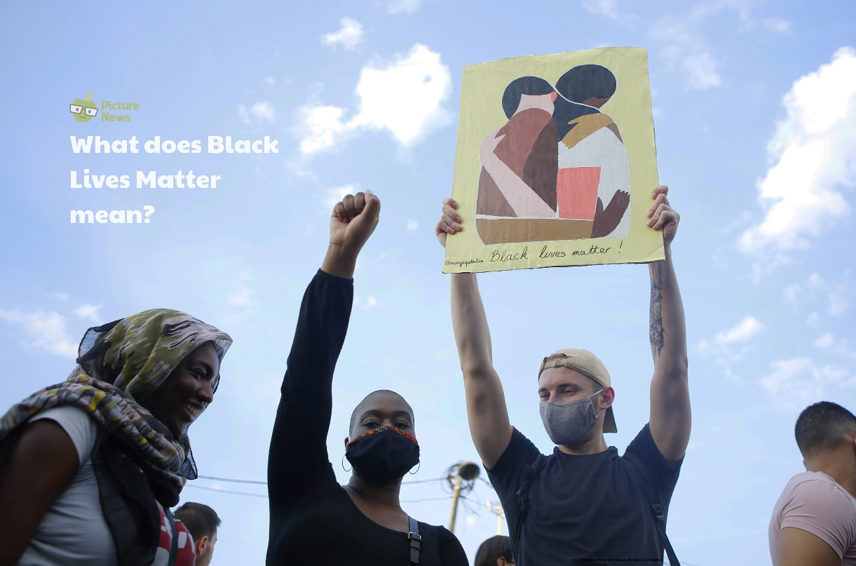
Home Learning
Collective worship from our friend Mr Buckeridge. Today we explore how Jesus meeting with a leper shows us that compassion goes beyond simply feeling for someone, to actually doing something to help. https://www.youtube.com/watch?v=zkgyezVCD3w&list=PLzeI_liQYA2PmAsL2ZlgxrzDRui50S85X&index=8&t=0s
Picture news- please look on our website weekly for the latest picture news.
Challenge
Can you find out about and create a fact file from a person influential to the black civil rights movement e.g. Rosa Parks or Martin Luther King?

Slide 17
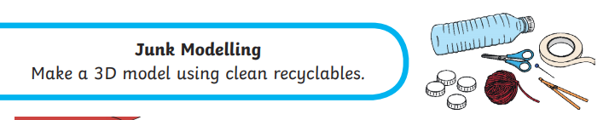
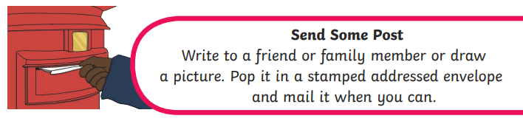
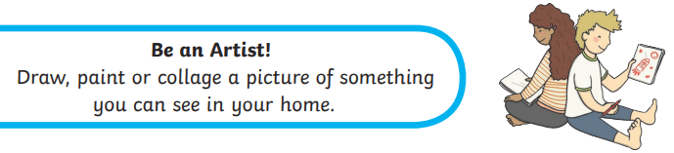
Home Learning Non Screen Activities

