Slide 1


Relative Clauses
What is a relative clause?
How can we write them?

Slide 2

Relative clauses can give more information about a noun or pronoun.
They usually begin with a relative pronoun.
Tell me more about the design.
The design covers the box.
The design, which appeared overnight, covers the box.
The design, which is brightly coloured, covers the box.
The design, which expresses gratitude, covers the box.
Relative Pronouns (& Relative Adverbs)
who, which, whom, whose, that, (where, when)
Notes:
Teachers’ Note: Relative pronouns often introduce a relative clause. The relative adverbs, where and when, can also be used in this way. It is not important for children to distinguish between adverbs and pronouns in this situation but for children to be able to identify relative clauses and when a word is introducing the relative cause.

Slide 3
Relative clauses can give more information about a noun or pronoun.
They usually begin with a relative pronoun.
Tell me more about the box.
The design covers the box.
The design covers the box which had been rather dull-looking.
The design covers the box that no-one had noticed before.
The design covers the box whose exact purpose no-one knew.
Relative Pronouns (& Relative Adverbs)
who, which, whom, whose, that, (where, when)
Notes:
Teachers’ Note: Relative pronouns often introduce a relative clause. The relative adverbs, where and when, can also be used in this way. It is not important for children to distinguish between adverbs and pronouns in this situation but for children to be able to identify relative clauses and when a word is introducing the relative cause.

Slide 4

Relative clauses can also relate to whole clauses.
This is a clause.
Anna hated the art.
Anna hated the art which annoyed Mckenzie.
It was not the art that annoyed Mckenzie: it was that Anna hated it. The relative clause relates to the whole clause.

Slide 5

Punctuating Relative Clauses
When the order is main clause + relative clause →no comma.
relative clause
main clause
subordinate clause
There were four hands that were shaped to spell ‘Love’.
A comma would create an unnecessary break in the sentence.
The relative clause tells us extra information about the main clause.

Slide 6

Punctuating Relative Clauses
When the relative clause splits the main clause→ commas.
main, relative clause, clause
Placing the clause in the middle is called embedding.
relative clause
main clause
subordinate clause
main clause
The design, which includes a toilet roll,, is striking and skilful.
Commas separate the relative clause from the main clause.

Slide 7

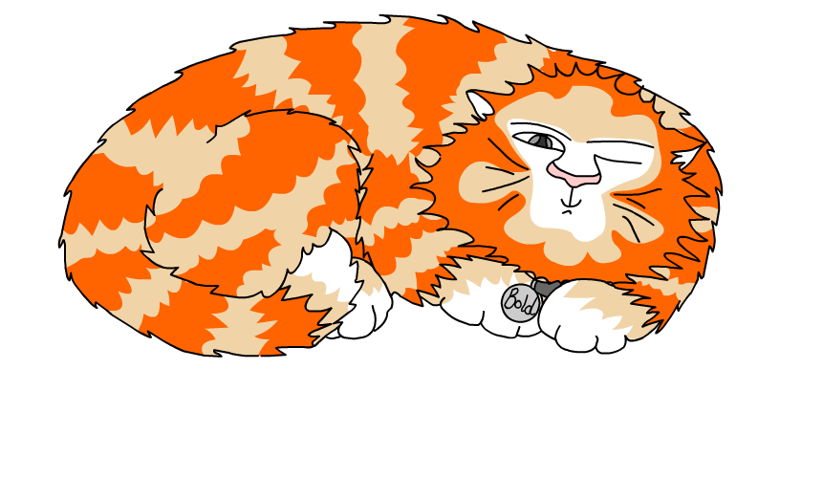
Explore more Hamilton Trust Learning Materials at https://wrht.org.uk/hamilton/ .

