Slide 1
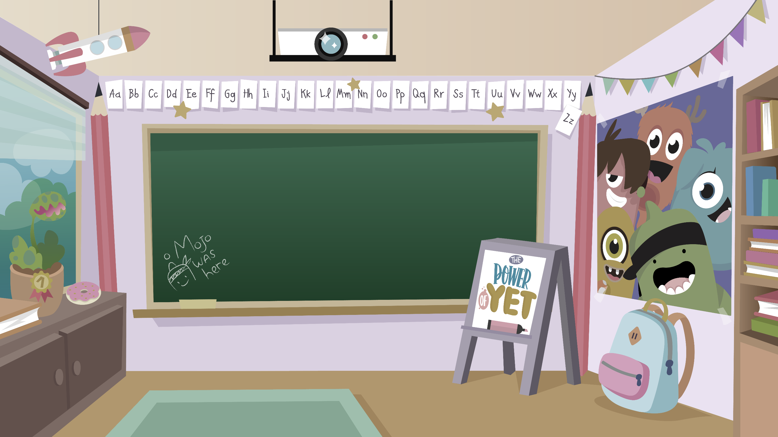
Home Learning activities WC 6.7.20 Year 1 CG Teaching group.
Challenge

Slide 2
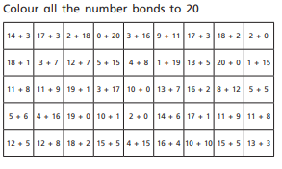
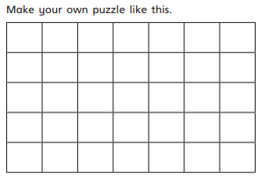
Home Learning Recap - Maths

Slide 3
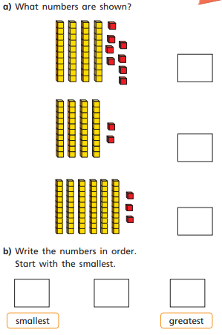
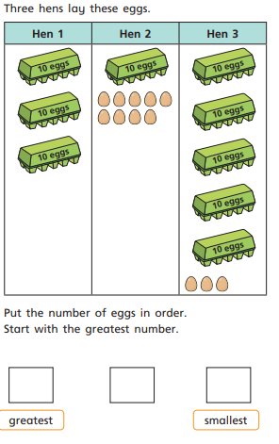
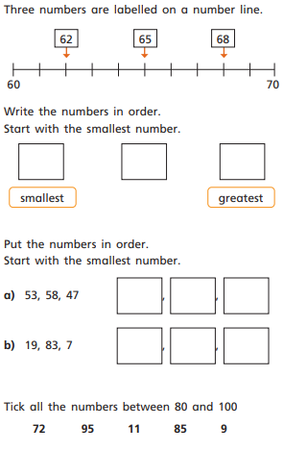
Home Learning Challenges - Maths
This week you will be thinking comparing numbers. – Where it says make a number, draw it instead.

Slide 4
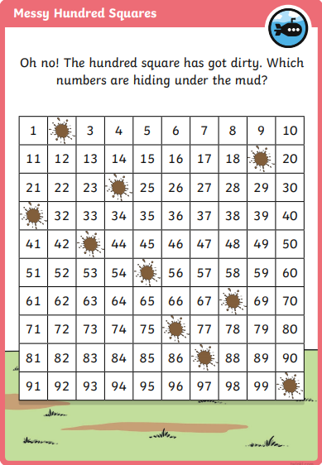
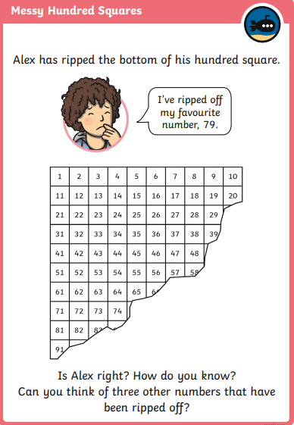
Home Learning Challenges - Maths

Slide 5
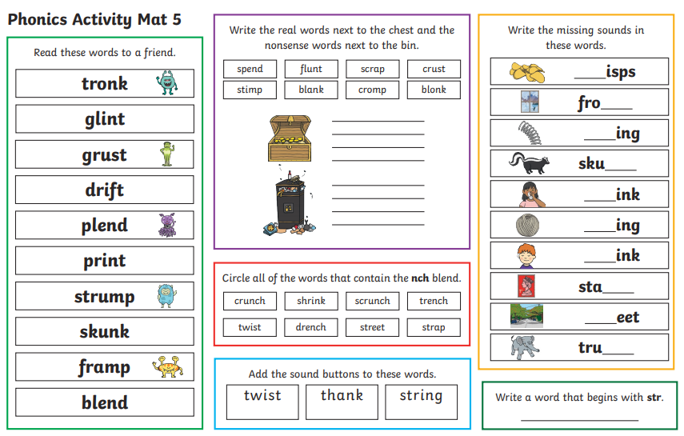
Home Learning Recap - Phonics

Slide 6
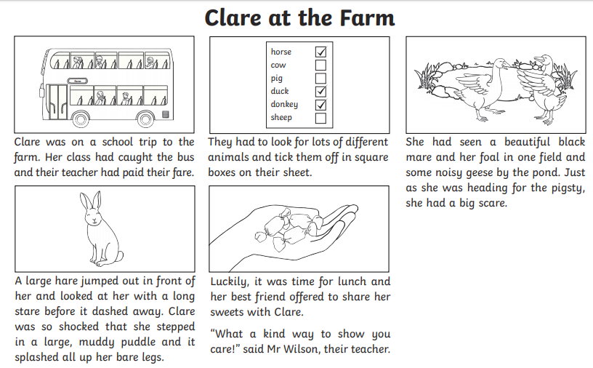
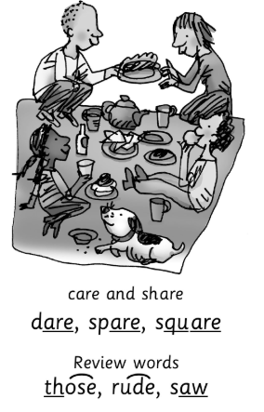
Home Learning Challenges - Phonics
Remember, there are some great videos on Youtube to help. Ruth Miskin Training set 3 speed sounds and spelling lessons are definitely worth while in teaching your child and set 2 are great for recap lessons.
Can you find all of the words that contain ‘are’?

Slide 7
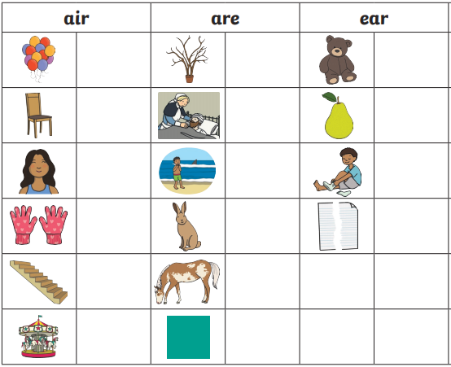
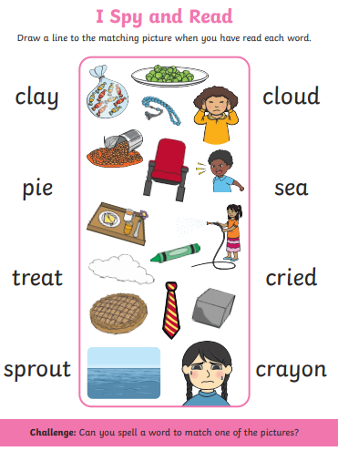
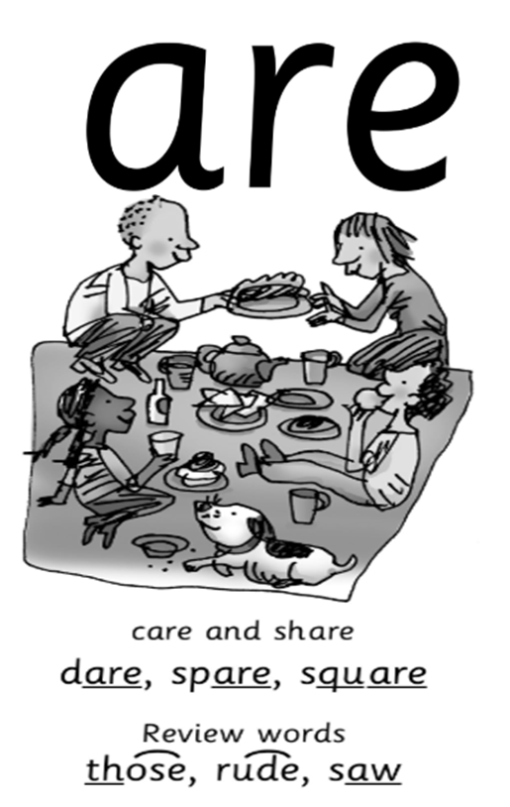
Home Learning Challenges - Phonics

Slide 8
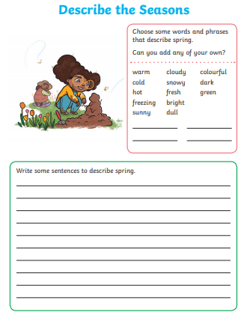
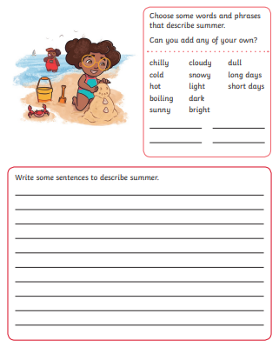
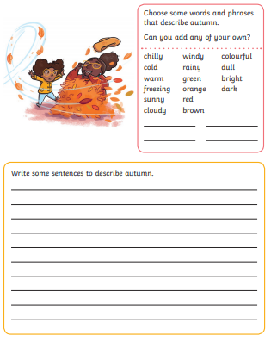
Home Learning Challenges – English

Slide 9
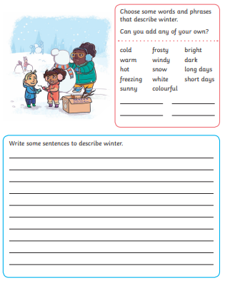
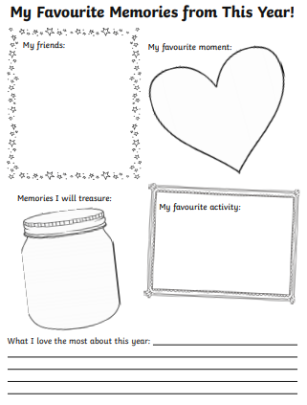
Home Learning Challenges – English

Slide 10
Home Learning Recap - RE
RE – This term we have been looking at the Christian Church.
For our final week we will look at Christian Symbols

Slide 11
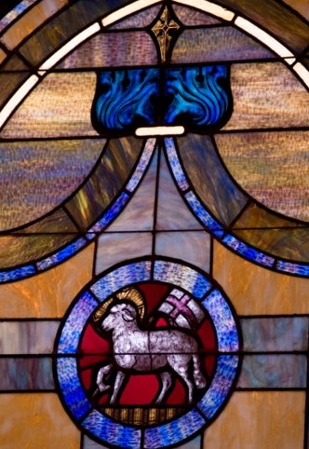
Home Learning Challenge - RE
Your task –
Design your own symbols to represent important things in your lives including people, pets, hobbies or faith.

Slide 12
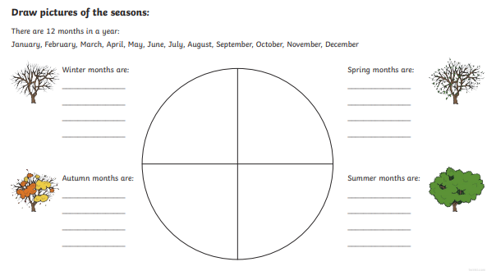
Home Learning Challenge – Science
The Seasons
https://www.youtube.com/watch?v=8ZjpI6fgYSY

Slide 13
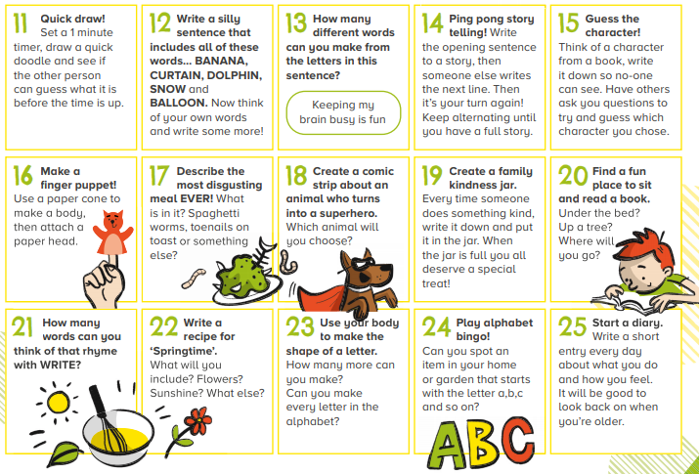
Home Learning –
Non-Screen Activities

