Slide 1
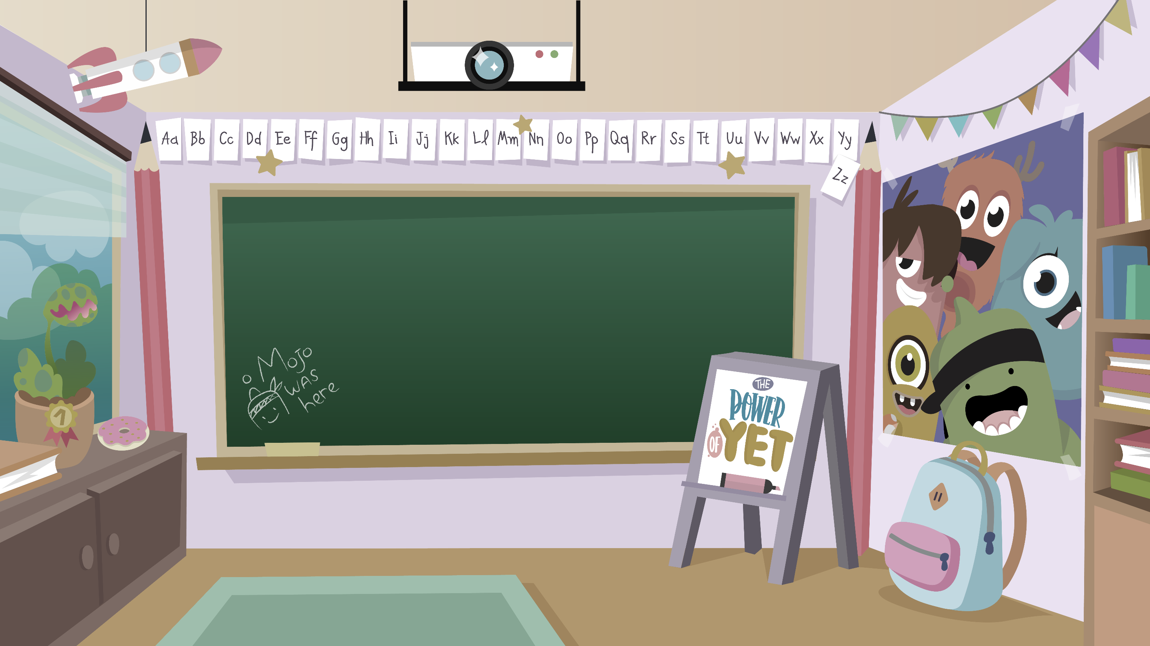
Home Learning activities WC 6.7.20 Year 1 CG Teaching group.
Challenge

Slide 2
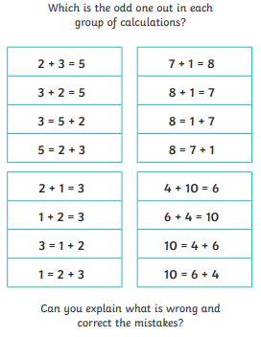
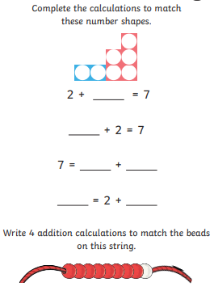
Home Learning Recap - Maths

Slide 3
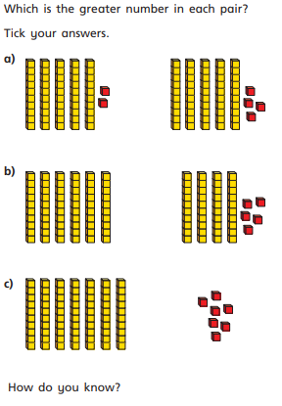
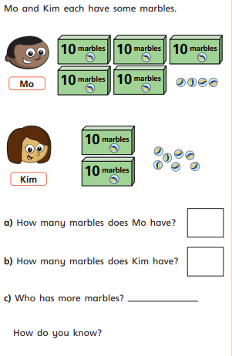
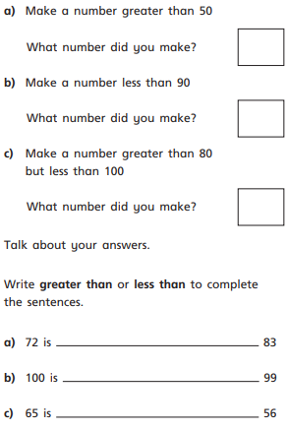
Home Learning Challenges - Maths
This week you will be thinking comparing numbers. – Where it says make a number, draw it instead.

Slide 4
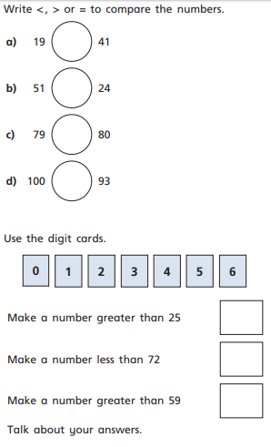
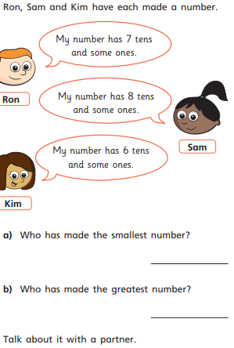
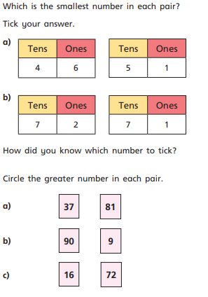
Home Learning Challenges - Maths

Slide 5
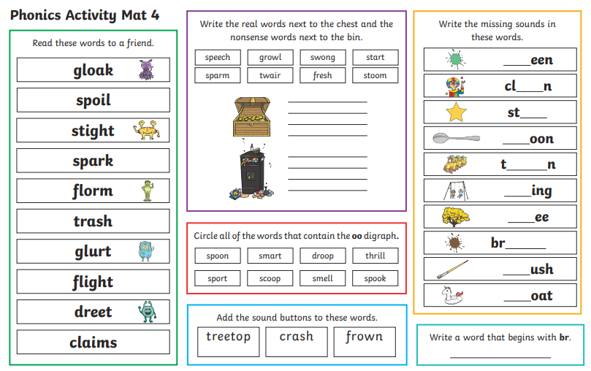
Home Learning Recap - Phonics

Slide 6
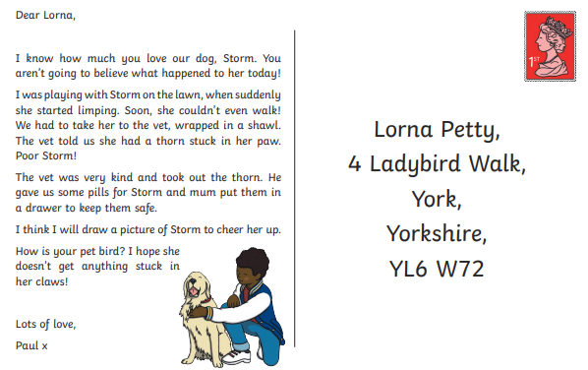
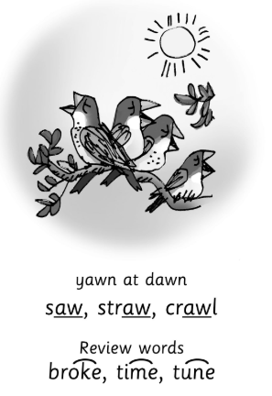
Home Learning Challenges - Phonics
Remember, there are some great videos on Youtube to help. Ruth Miskin Training set 3 speed sounds and spelling lessons are definitely worth while in teaching your child and set 2 are great for recap lessons.
Remember all of the alternative graphemes that we have learnt – or au

Slide 7
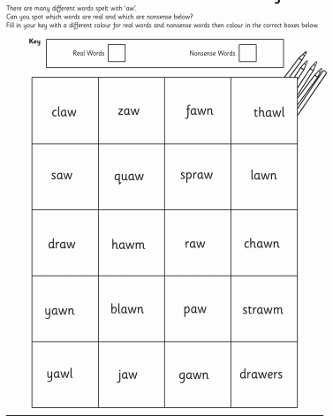
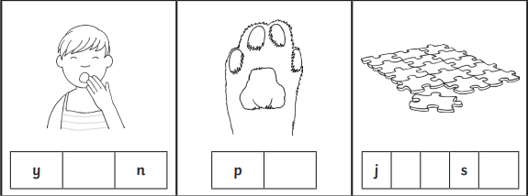
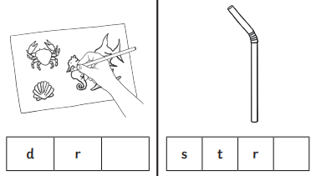
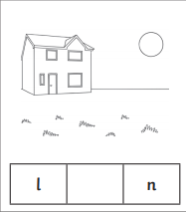
Home Learning Challenges - Phonics

Slide 8
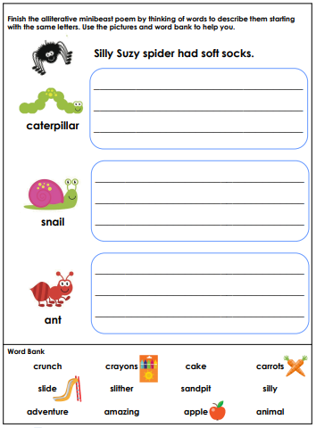
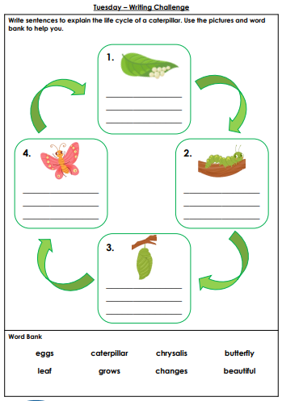
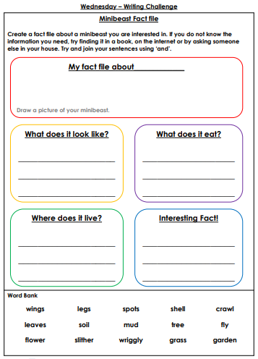
Home Learning Challenges – English

Slide 9
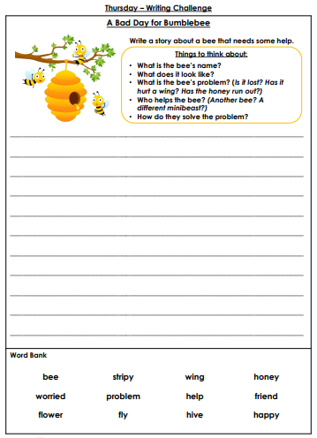
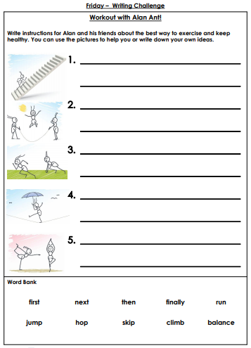
Home Learning Challenges – English

Slide 10
Home Learning Challenge - Spelling
Use look, cover, write, check to learn the prefix words – adding ‘un’ before a word
Look | Cover and say | Write and check | Amend errors | Repeat
unfair
unhappy
unlucky
undo
untie
unloved
unwell
unable
unpick
unseen
unusual
untidy

Slide 11
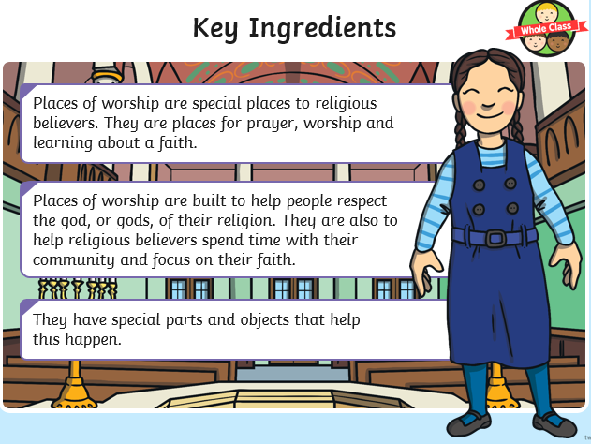
Home Learning Recap - RE
RE – This term we are looking at the Christian Church.

Slide 12
Home Learning Challenge - RE
With your family, design a place of worship that you would like to visit.

Slide 13
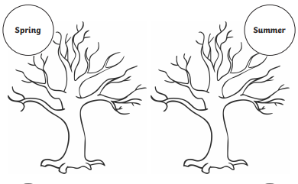
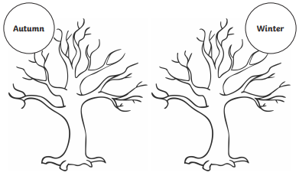
Home Learning Challenge – Science
The Seasons
https://www.youtube.com/watch?v=8ZjpI6fgYSY
Get creative.

Slide 14
Home Learning –
Non-Screen Activities

