Slide 1
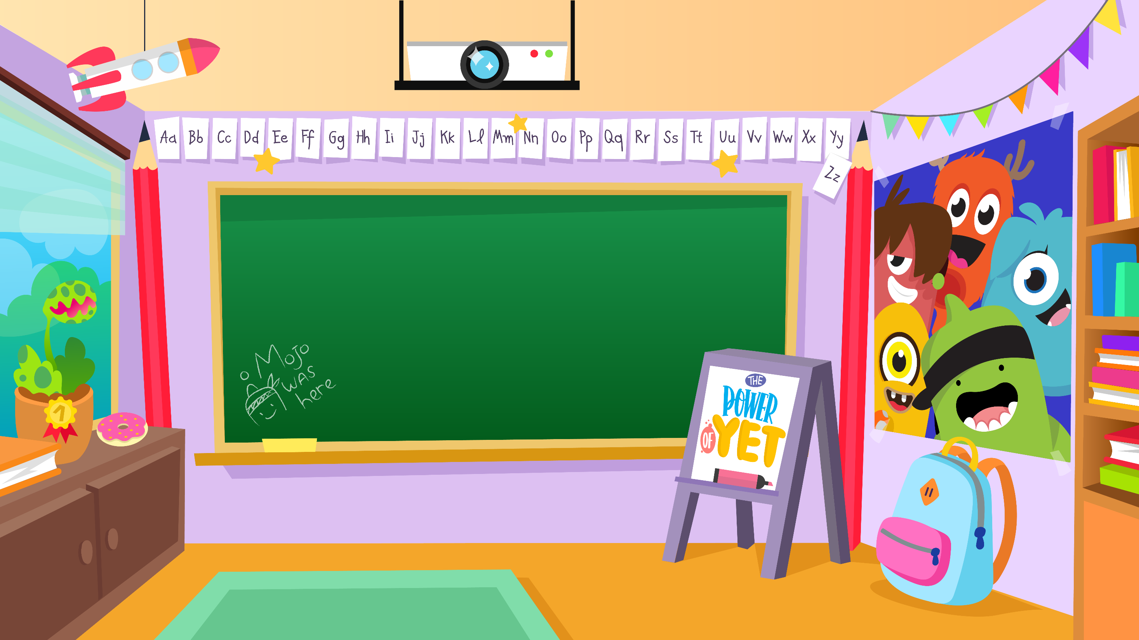
Home Learning activities WC 06.07.20 Year 2 AC Teaching group.
Challenge

Slide 2
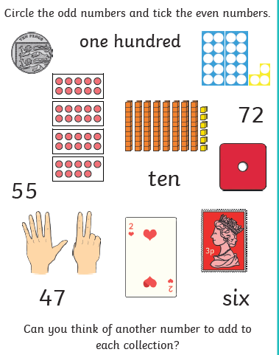
Home Learning Recap - Maths
Odd and even numbers;

Slide 3
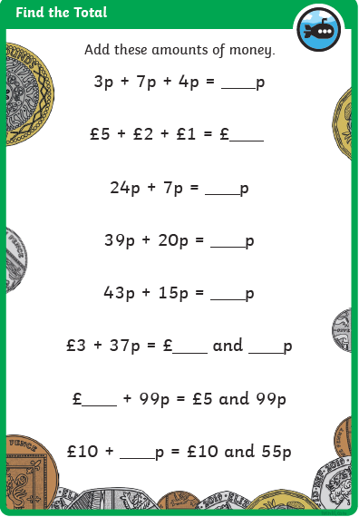
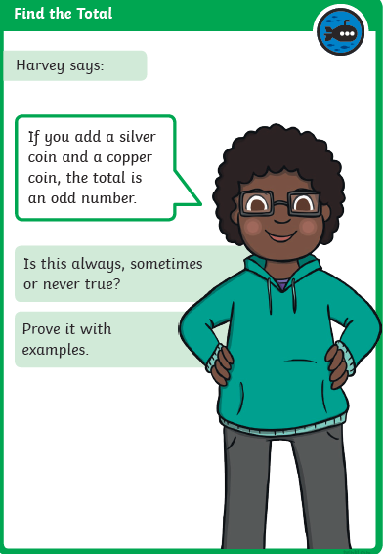
Home Learning Challenges - Maths
Money
Children in Year Two should be able to count an amount, find an amount in different ways, compare money, find the difference and calculate change.
Day 1
Day 2
Challenge

Slide 4
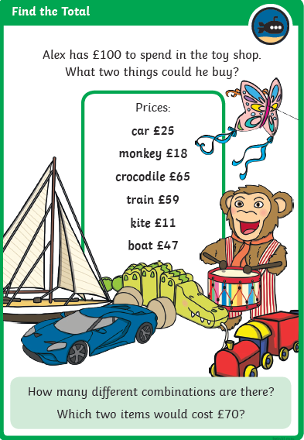
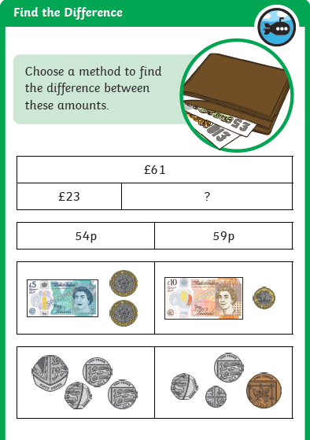
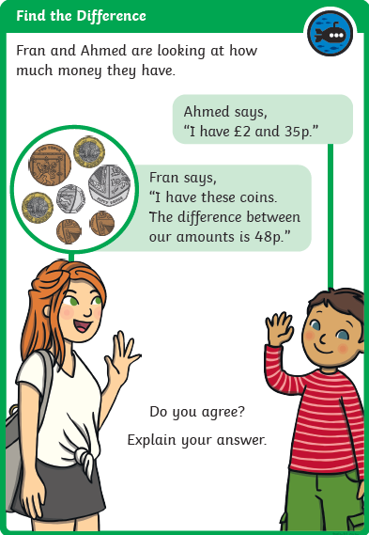
Home Learning Challenges - Maths
Day 3
Day 4
Day 5

Slide 5
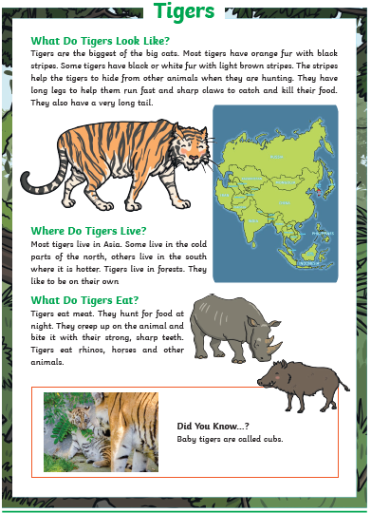
Home Learning Challenges – English
Create a non-chronological report about an animal.
Can you create a report about an animal? It can be an animal of your choice!
Day 1 – Decide on the animal you wish to write about. Research and make notes under subheadings e.g. What do they look like?
Day 2 – Verbally build each of your notes into a sequence of sentences. Include adjectives, verbs adverbs, conjunctions, commas in a list and suffixes (e.g. largest, smallest) Draft the first half of your report. Re-read to check your work makes sense.
Day 3 – The same as Day 2 for the second half of your report.
Day 4 – Edit and improve your sentences, Check your spelling, your sentences make sense, punctuation and conjunctions. Can you add words to improve it?
Day 5 – Publish, write up your report in neat! Copy your edited draft using your best handwriting. Save your work to show me. You can add pictures, fact boxes, borders etc.

Slide 6
Home Learning Challenges – English example
Hedgehogs
What do they look like?
Hedgehogs are small, spiky animals. Adult hedgehogs have long spines around their backs and sides, but not on their faces or legs. Did you know that some hedgehogs can have up to seven thousand spines?
Where do hedgehogs live?
These small creatures can be found almost anywhere in the United Kingdom. They can be found in cities and towns, and can be found on railway land, parks and gardens. Hedgehogs don’t live on mountainsides because there is not enough food for them and there are not many places to nest comfortably.
Here is the start of a report I have created about hedgehogs.

Slide 7
Home Learning Challenge - Spelling
Use look, cover, write, check to learn the spelling rules for the sound ‘or’ in words using ‘al’.
Look | Cover and say | Write and check | Amend errors | Repeat
can’t
didn’t
hasn’t
it’s
couldn’t
wouldn’t
shouldn’t
wasn’t
don’t
won’t

Slide 8
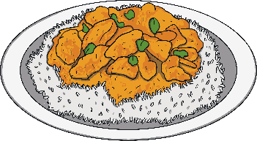
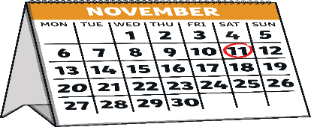
Home Learning Challenge - RE
RE – We are going to be looking at Islam and their traditions.
In the Islamic faith, Muslims welcome babies in a ceremony called the Aqiqah (pronounced Ak-kee-ka).
This is when the baby is introduced to family and friends. They celebrate and share a meal together. They join with loved ones to thank Allah (God) for giving them a child.
The Aqiqah is hosted by the parents of the new baby and may be held in their own home or in a hall or community centre.
Why do you think people celebrate a new baby being born?
The Aqiqah is usually held on the seventh day after the baby is born. If this is not possible, it might be held on the 14th or the 21st day after the baby’s birth.
Guests often bring along cards and gifts for the baby. The hall or home where the Aqiqah is held may be decorated with balloons and other decorations.
What gift would you bring a new baby?

Slide 9
Home Learning Challenge - Science
Think carefully about the materials that you require to make a boat.
What will be suitable/ unsuitable materials?
Can you add a sail or a propeller to your boat to make it move?
How much cargo can your boat hold?
What could you change about your boat to make it hold more cargo?

Slide 10
Home Learning Challenge - RE
RE – We are going to be looking at Islam and their traditions.
Activity:
Have you ever welcomed a new baby into the world? A little brother or sister? A cousin or friend?
How did you welcome them into the world?
Describe what you did or how else the baby was welcomed into the world.

Slide 11
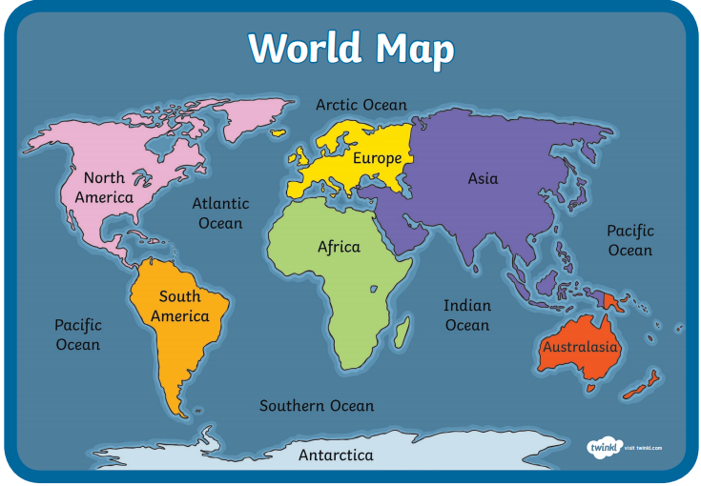
Home Learning Challenge - Georgraphy
Children in Year 2 should be able to name and locate the continents and oceans of the world.
Activity: Can you identify the continents and oceans of the world?
Challenge – can you name any countries in the different continents?

Slide 12
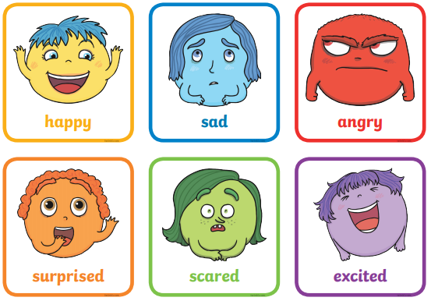
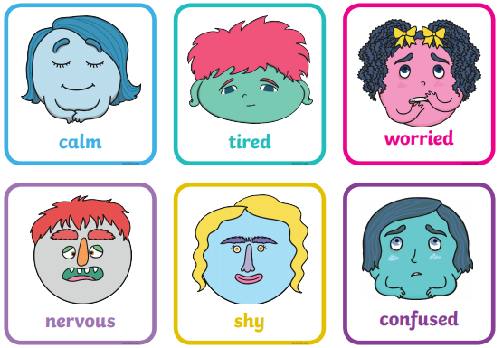
Home Learning Challenge - PSHE
Feelings
Have you ever seen the film ‘Inside Out’? We have lots of different feelings. There are lots of different feelings and emotions – it is okay to feel these at different points in our lives because that’s what makes us, us!
Look at the feelings below. Can you remember a time when you felt like it? Can you talk to an adult about them or draw a picture to describe it?

Slide 13
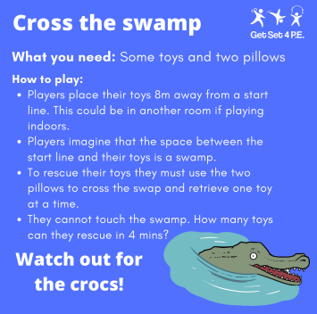
Home Learning- PE

Slide 14
Home Learning
Collective worship from our friend Mr Buckeridge. https://www.youtube.com/watch?v=AdXWAKvzsk4
Picture news- please look on our website weekly for the latest picture news.

Slide 15
Home Learning Non Screen Activities

