Slide 1
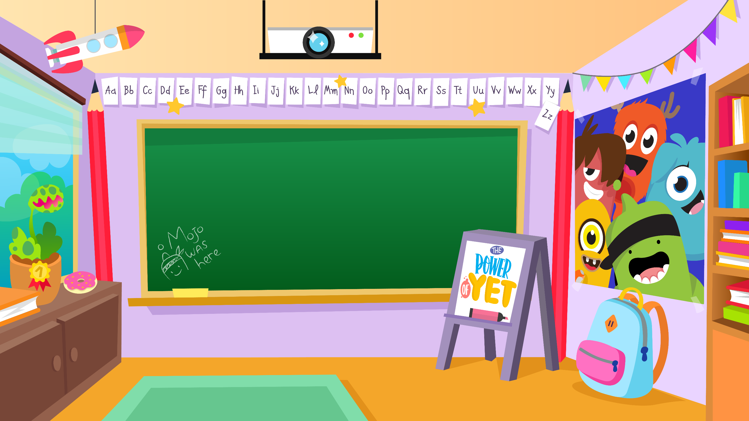
Home Learning activities WC 13.07.20 Year 2 AC Teaching group.
Challenge

Slide 2
Home Learning-Transition
For this week’s home learning, I am going to set some transition type activities for you all to enjoy and complete.

Slide 3
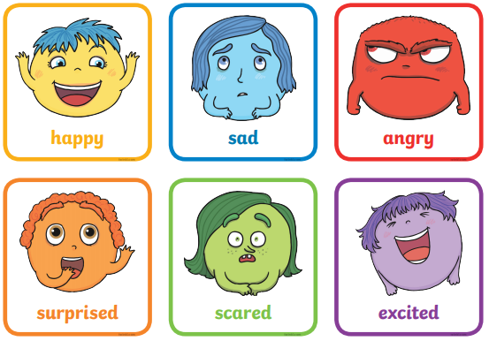
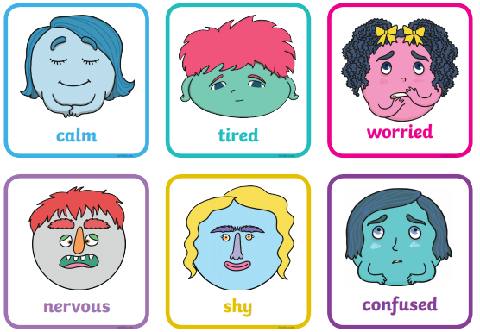
Home Learning PSHE
Feelings
You are going to have lots of mixed feelings about coming back to school which is normal!
Please do not worry about coming back because you are going to be well looked after, trust me!
Activity: Over the summer, remember to talk to someone you trust about your feelings for Year 3 – talking about this will help you cope better.

Slide 4
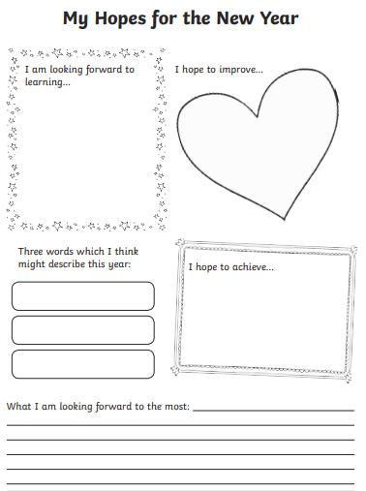
Home Learning
Can you create a ‘Hopes’ sheet for next year?

Slide 5
Discuss or write sentences and draw pictures explaining why you are an amazing person.

Slide 6
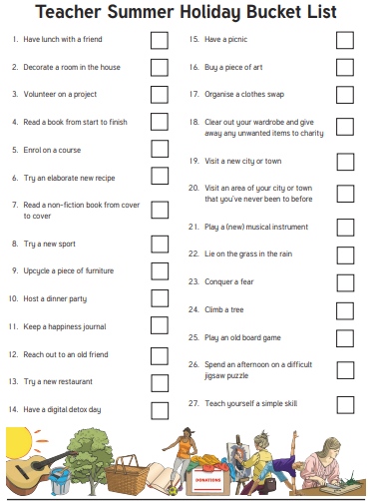
Can you write a Bucket List about what you’d like to do in the summer holidays?

Slide 7
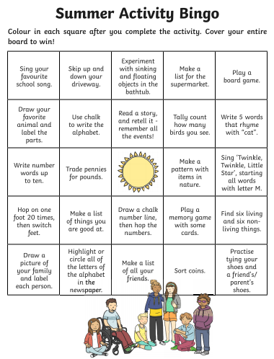
Colour your Bingo board in when you have completed an activity in the summer!

